Slide 1
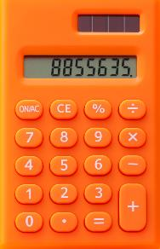
Healthy for Life Cost Calculator
Use this tool to help get an estimate of the costs associated with the different educational experience options.
Start planning your educational experience! Use the Healthy for Life Cost Calculator as a resource to prepare for your educational experience. This document can help you determine the estimated costs of each activity and demonstration.
You can go right to the educational experience you are facilitating for a price breakdown of that experience’s activity and demonstration. Anticipate the cost of the experience by entering the number of participants per experience to determine the costs
for that activity.
See instructions for using the Healthy for Life Cost Calculator on the next page.

Slide 4
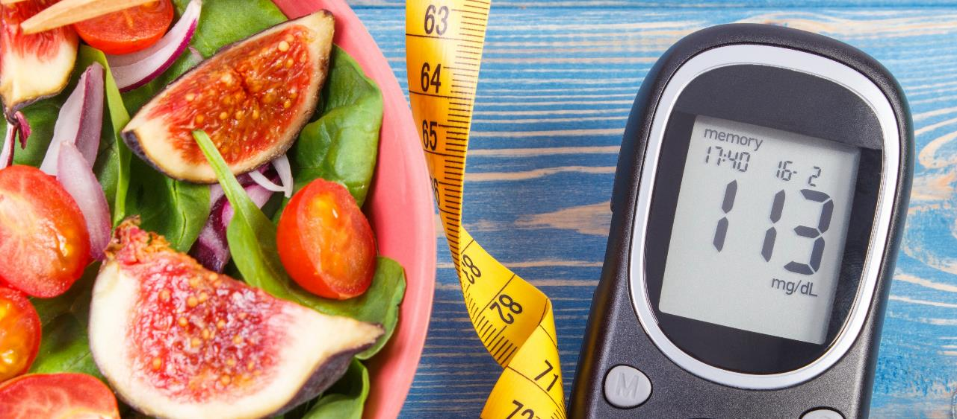
The Role of Food and Your Health: Cholesterol and Blood Sugar
*Product price found on theonlinedrugstore.com
**Price per person
Click here to return.

Slide 5
The Role of Food and Your Health: Blood Pressure
Click here to return.

Slide 6
Exercise Within Reach
Click here to return.

Slide 7
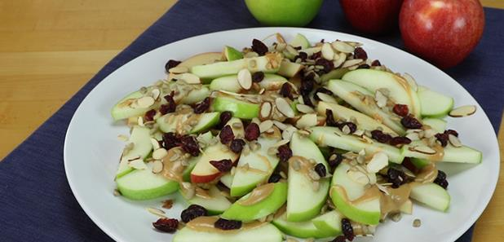
Feed Your Potential
*Choose the microwave, electric kettle or electric burner (with pot and lid) to boil the water. The total price uses the least expensive method, electric kettle.
Click here to return.

Slide 8
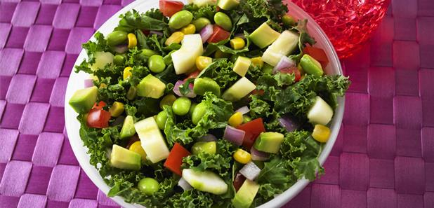
Chopped Salad Competition
Click here to return.

Slide 9
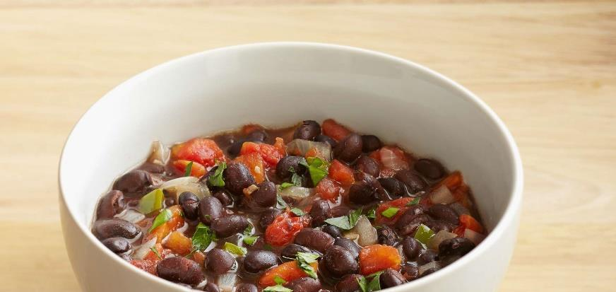
Tasty, Affordable Meals for Busy Families
Click here to return.

Slide 10
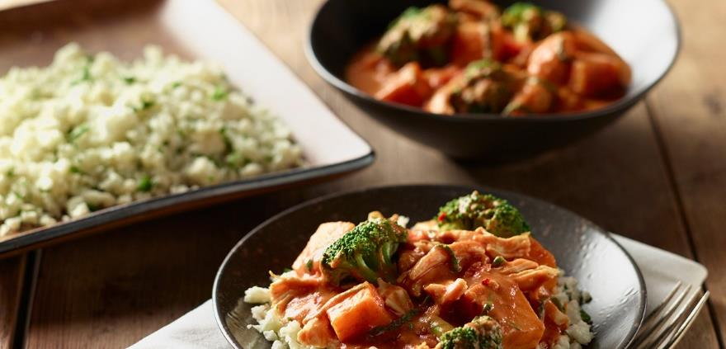
Saute, Simmer & Steam
*There are some overlapping supplies using for both the demo and activity, only purchase them once.
**Choose the blender or food processor. The total price uses the least expensive method, food processor.
Click here to return.

Slide 11
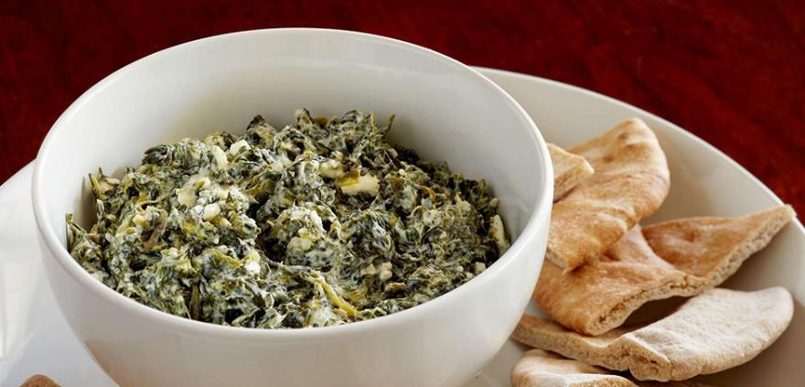
Healthy Ingredient Swap
Click here to return.

Slide 12
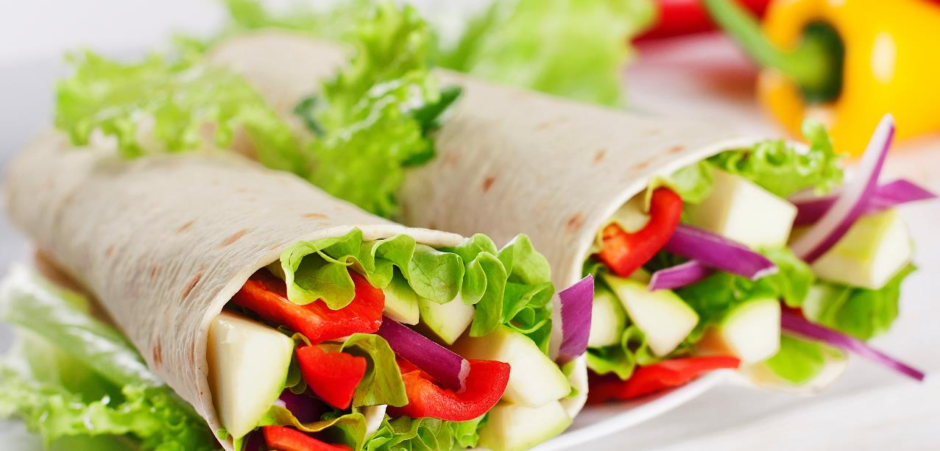
Kitchen Discovery with Kids
Click here to return.

Slide 13
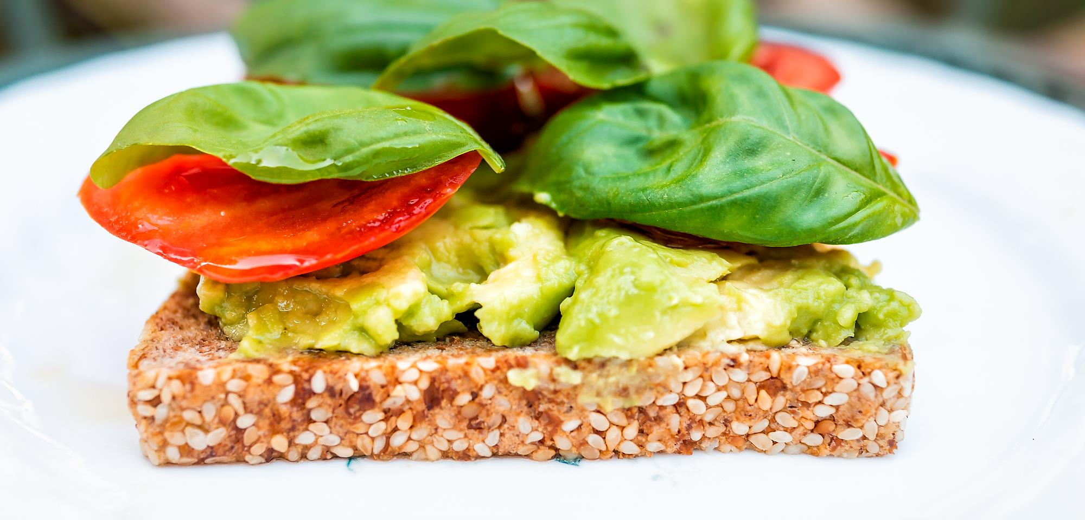
Snack Smarter
Click here to return.

Slide 14
Pick a Protein
Click here to return.

Slide 15
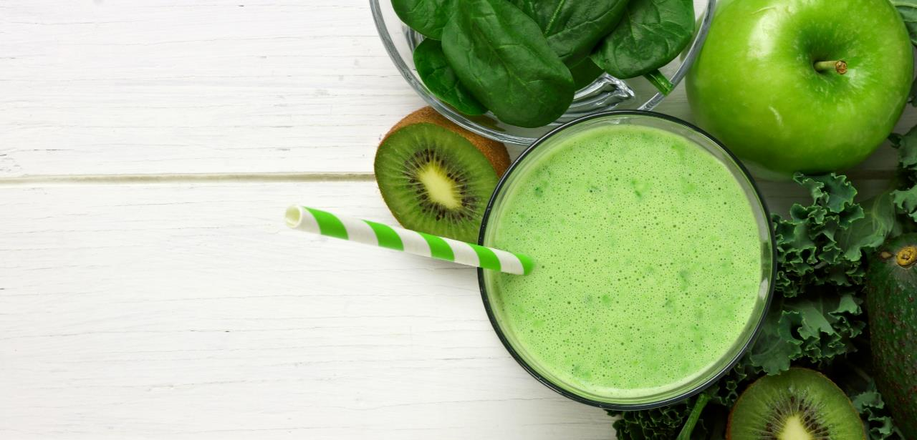
Smart Fearless Shopper
Click here to return.

Slide 16
Pantry Makeover
*Choose the microwave, rice cooker or electric burner (with pot and lid) to cook the rice. The total price uses the least expensive method, rice cooker.
Click here to return.

Slide 17
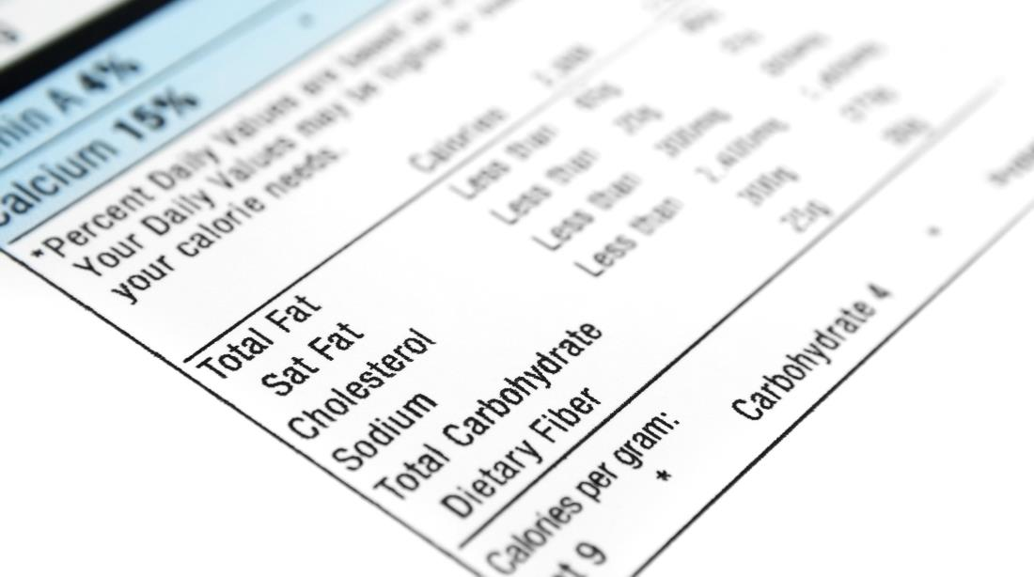
Food Label Smarts
Click here to return.

Slide 18
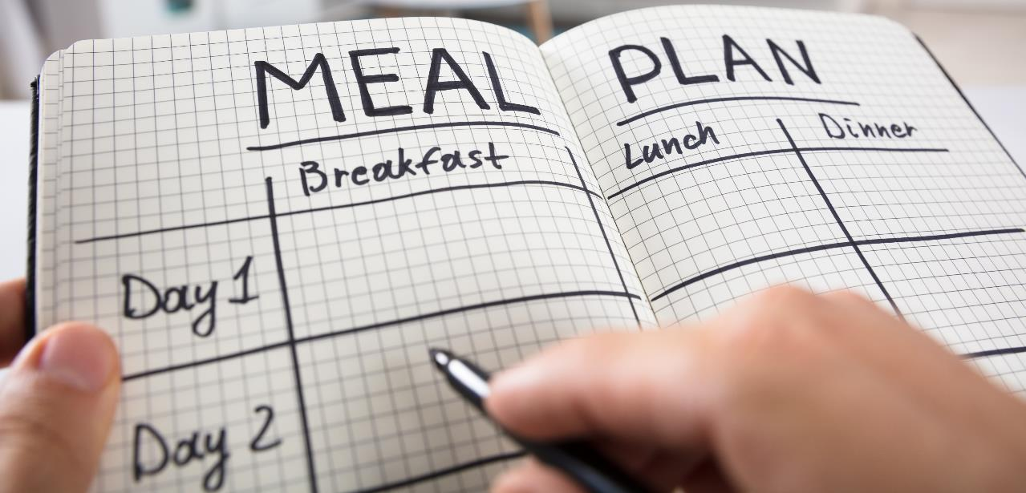
Weekly Meal Plan Made Easy
Click here to return.

Slide 19
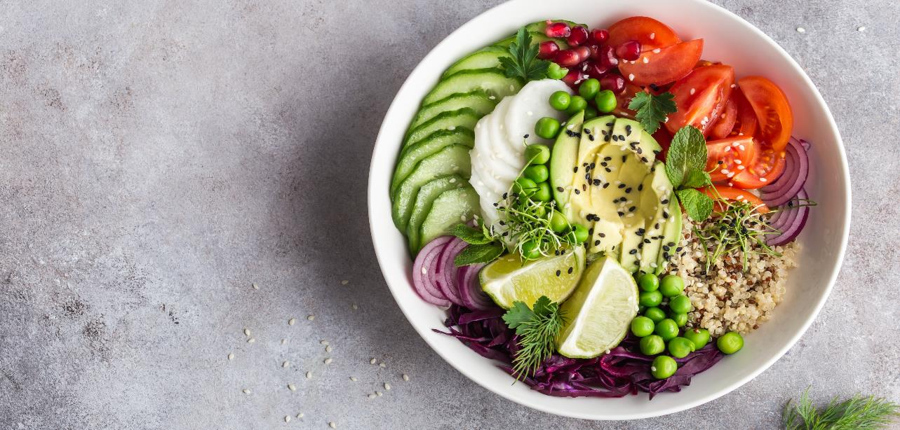
Eat a Rainbow
Click here to return.

Slide 20
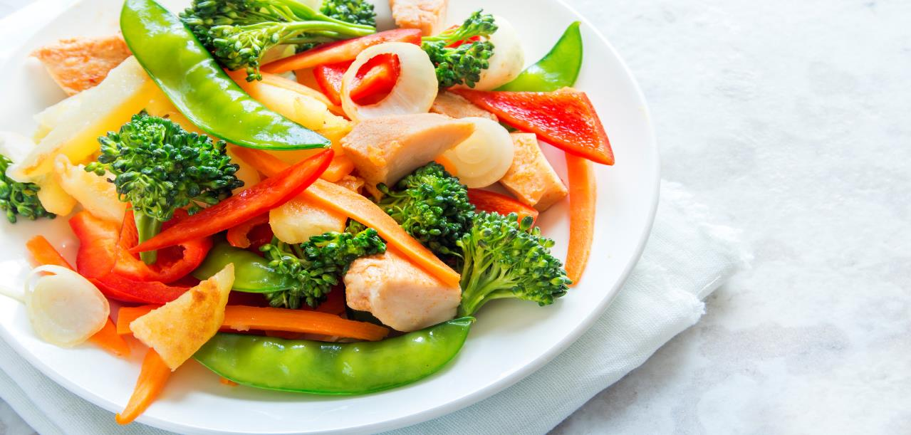
All the Flavors of the Garden
Click here to return.

Slide 21
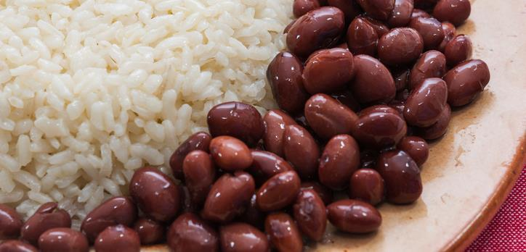
Beans and Rice = A Complete Protein for Global Nutrition
Recipe #1
Rice and Beans with Corn on Cob
Go to recipe #2

Slide 22
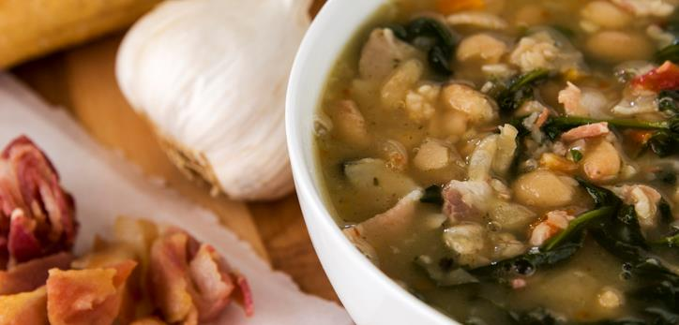
Beans and Rice = A Complete Protein for Global Nutrition
Recipe #2
Tuscan Bean Soup
Go to recipe #1
Click here to return.

Slide 23
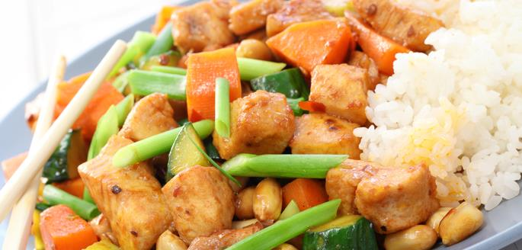
Chicken - A Healthy Protein Choice Across the Globe
Recipe #1
Szechuan Chicken Stir-Fry
Go to recipe #2

Slide 24
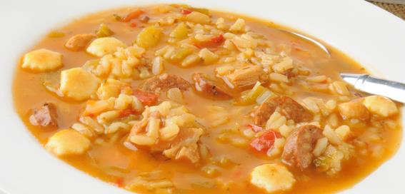
Chicken - A Healthy Protein Choice Across the Globe
Recipe #2
Chicken Gumbo
Go to recipe #1
Click here to return.

Slide 25
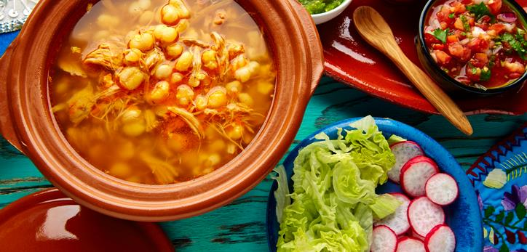
Corn - A Whole Grain for Global Nourishment
Recipe #1
Posole
Go to recipe #2

Slide 26
Corn - A Whole Grain for Global Nourishment
Recipe #2
Creamy Corn Chowder
Go to recipe #1
Click here to return.

Slide 27
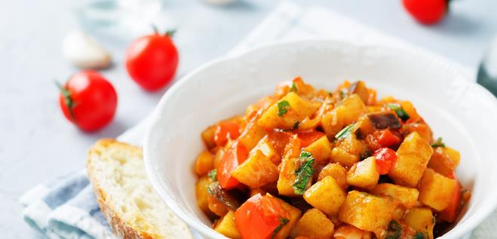
Potatoes - Healthy Carbohydrates for Energy Across the Globe
Recipe #1
Peanut and Green Stew
Go to recipe #2

Slide 28
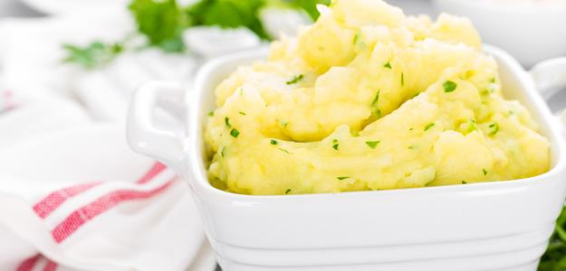
Potatoes - Healthy Carbohydrates for Energy Across the Globe
Recipe #2
Olive Oil Mashed Potatoes
Go to recipe #1
Click here to return.

Slide 29
Become a Sharper Chef
Click here to return.

Slide 30
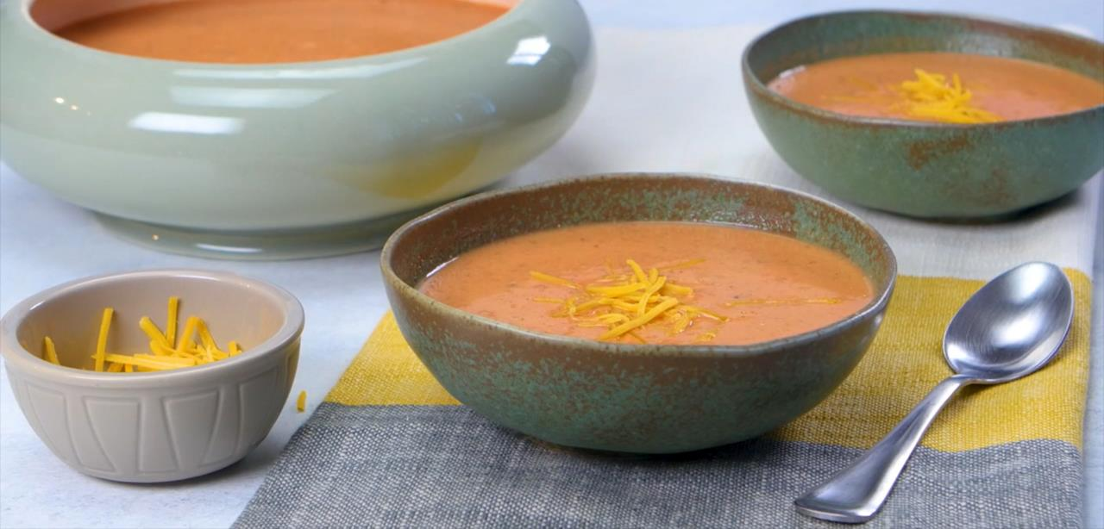
Eating For A Stronger, Healthier You
Click here to return.

Slide 31
Fuel Up to Move More
* Serves 4 (1 pancake per serving)
**Choose the skillet with electric burner or electric skillet. The total price uses the least expensive method, electric skillet.
Click here to return.

Slide 32
Decode Nutrition Facts
Click here to return.

