Slide 1
Clinical Update
ADAPTED FROM:
2021 ACC/AHA/SCAI Guideline of Coronary Artery Revascularization

Slide 2
Table 1.
Applying ACC/AHA Class of Recommendation and Level of Evidence to Clinical Strategies, Interventions, Treatments, or Diagnostic Testing in Patient Care
(Updated May 2019)*
CLASS (STRENGTH) OF RECOMMENDATION
CLASS 1 (STRONG) Benefit >>> Risk
Suggested phrases for writing recommendations: Is recommended Is indicated/useful/effective/beneficial Should be performed/administered/other Comparative-Effectiveness Phrases†: Treatment/strategy A is recommended/indicated in preference to treatment B Treatment A should be chosen over treatment B
CLASS 2a (MODERATE) Benefit >> Risk
Suggested phrases for writing recommendations: Is reasonable Can be useful/effective/beneficial Comparative-Effectiveness Phrases†: Treatment/strategy A is probably recommended/indicated in preference to treatment B It is reasonable to choose treatment A over treatment B
CLASS 2b (Weak) Benefit ≥ Risk
Suggested phrases for writing recommendations: May/might be reasonable May/might be considered Usefulness/effectiveness is unknown/unclear/uncertain or not well-established
CLASS 3: No Benefit (MODERATE) Benefit = Risk
Suggested phrases for writing recommendations: Is not recommended Is not indicated/useful/effective/beneficial Should not be performed/administered/other
CLASS 3: Harm (STRONG) Risk > Benefit
Suggested phrases for writing recommendations: Potentially harmful Causes harm Associated with excess morbidity/mortality Should not be performed/administered/other
LEVEL (QUALITY) OF EVIDENCE‡
LEVEL A
High-quality evidence‡ from more than 1 RCT Meta-analyses of high-quality RCTs One or more RCTs corroborated by high-quality registry studies
LEVEL B-R (Randomized)
Moderate-quality evidence‡ from 1 or more RCTs Meta-analyses of moderate-quality RCTs
LEVEL B-NR (Nonrandomized)
Moderate-quality evidence‡ from 1 or more well-designed, well-executed nonrandomized studies, observational studies, or registry studies Meta-analyses of such studies
LEVEL C-LD (Limited Data)
Randomized or nonrandomized observational or registry studies with limitations of design or execution Meta-analyses of such studies Physiological or mechanistic studies in human subjects
LEVEL C-EO (Expert Opinion)
Consensus of expert opinion based on clinical experience.
COR and LOE are determined independently (any COR may be paired with any LOE).
A recommendation with LOE C does not imply that the recommendation is weak. Many important clinical questions addressed in guidelines do not lend themselves to clinical trials. Although RCTs are unavailable, there may be a very clear clinical consensus that a particular test or therapy is useful or effective.
*The outcome or result of the intervention should be specified (an improved clinical outcome or increased diagnostic accuracy or incremental prognostic information).
†For comparative-effectiveness recommendation (COR 1 and 2a; LOE A and B only), studies that support the use of comparator verbs should involve direct comparisons of the treatments or strategies being evaluated.
‡The method of assessing quality is evolving, including the application of standardized, widely-used, and preferably validated evidence grading tools; and for systematic reviews, the incorporation of an Evidence Review Committee. COR indicates Class of Recommendation; EO, expert opinion; LD, limited data; LOE, Level of Evidence; NR, nonrandomized; R, randomized; and RCT, randomized controlled trial.

Slide 3




Improving Equity of Care in Revascularization
Health disparities by sex and race are evident across the spectrum of CVD in the United States.
Women and non-White patients are less likely to receive guideline-based therapies.
Women and
non-White patients derive comparable benefit from revascularization after controlling for other factors.
In patients who require coronary revascularization, treatment decisions should be based on clinical indication, regardless of sex or race or ethnicity, and efforts to reduce disparities of care are warranted (Class 1).
Abbreviations: CVD indicates cardiovascular disease.

Slide 4



Shared Decision-Making and Informed Consent
Informed Consent
Clinician provides the best available evidence for treatment options, including the risks & benefits of each option
Patient-Centered Care
Treatment & care options take into consideration individual values & preferences
COR | RECOMMENDATIONS
1 | In patients undergoing revascularization, decisions should be patient centered—that is, considerate of the patient’s preferences and goals, cultural beliefs, health literacy, and social determinants of health—and made in collaboration with the patient’s support system.
1 | In patients undergoing coronary angiography or revascularization, adequate information about benefits, risks, therapeutic consequences, and potential alternatives in the performance of percutaneous and surgical myocardial revascularization should be given, when feasible, with sufficient time for informed decision-making to improve clinical outcomes.
Shared Decision-Making
A collaborative decision about treatment or care is documented and shared with relevant stakeholders

Slide 5
Factors for Consideration by the Heart Team
Coronary Anatomy
Procedural Factors
Comorbidities
Patient Factors
Left main disease
Multivessel disease
High anatomic complexity
(i.e., bifurcation disease, high SYNTAX score)
Diabetes
Systolic dysfunction
Coagulopathy
Valvular heart disease
Frailty
Malignancy
ESRD
COPD
Immunosuppression
Debilitating neurological disorders
Liver disease/
cirrhosis
Prior CVA
Calcified aorta
Aortic aneurysm
Local and regional outcomes
Access site for PCI
Surgical risk
PCI risk
Unstable presentation or shock
Patient preferences
Inability or unwillingness to adhere to DAPT
Religious beliefs
Patient education, knowledge, and understanding
Guiding Principle: Ideal situations for Heart Team consideration include patients with complex coronary disease, comorbid conditions that could impact the success of the revascularization strategy, and other clinical or social situations that may impact outcomes.
Abbreviations: COPD indicates chronic obstructive pulmonary disease; CVA, cerebral vascular accident; DAPT, dual antiplatelet therapy; ESRD, end-stage renal disease; PCI, percutaneous coronary intervention; and SYNTAX, Synergy Between PCI With TAXUS and Cardiac Surgery.

Slide 6
Assessing Risk for Patients Undergoing CABG
In patients who are being considered for CABG, calculation of the Society of Thoracic Surgeons (STS) risk score is recommended to help stratify patient risk (Class 1).*
Reoperation
Prolonged Ventilation
Renal Failure
Death
Permanent Stroke
Deep Sternal Wound Infections
Prolonged Length of Stay
Risk Factors Not Quantified in the STS Score | Favors use of stress imaging
Cirrhosis | Meld
Frailty | Gait Speed
Malnutrition | MUST
Guiding Principle: In patients who are being considered for CABG, calculation of the STS risk score is recommended to help stratify patient risk. The MELD score, gait speed, and the MUST score may help in patients with cirrhosis, frailty, and malnutrition respectively.
Abbreviations: CABG indicates coronary artery bypass grafting; MELD, Model for End-Stage Liver Disease; MUST, Malnutrition Universal Screening Tool; and STS, Society of Thoracic Surgeons.
* See: https://www.sts.org/resources/risk-calculator

Slide 7
Defining Lesion Severity
Lesion Severity
Coronary Physiology
(Class 1)
Coronary Physiology
(Class 3:
No Benefit)
IVUS
(Class 2a)
SYNTAX Score
(Class 2b)
Coronary Angiography
In patients with angina or an anginal equivalent, undocumented ischemia, and angiographically intermediate stenoses, the use of FFR or iFR is recommended to guide the decision to proceed with PCI.
In stable patients with angiographically intermediate stenoses and FFR >0.80 or iFR >0.89, PCI should not be performed.
In patients with intermediate stenosis of the left main artery, intravascular ultrasound (IVUS) is reasonable to help define lesion severity.
In patients with multivessel CAD, an assessment of CAD complexity, such as the SYNTAX score, may be useful to guide revascularization.
Significant stenosis is defined as >70% for non-LMT and >50% for LMT.
Intermediate stenoses (40-69%) generally warrant additional investigation.
No standard cutoffs for lesion length used to classify a severe stenosis.
Abbreviations: CAD indicates coronary artery disease; FFR, fractional flow reserve; iFR, instantaneous wave-free ratio; IVUS, intravascular ultrasound; LMT, left main trunk; PCI, percutaneous coronary intervention; and SYNTAX, Synergy Between PCI With TAXUS and Cardiac Surgery.

Slide 8
Table 8. Patient Clinical Status Definitions to Guide Revascularization
Cardiac function has been stable in the days-weeks before intervention. The intervention could be deferred without increased risk of compromise to cardiac outcome.
Elective
Intervention is required during the same hospitalization to minimize chance of further clinical deterioration. Examples include worsening sudden chest pain, heart failure, acute myocardial infarction, anatomy, intra-aortic balloon pump, unstable angina, with intravenous nitroglycerin, or rest angina.
Urgent
Patients requiring emergency intervention will have ongoing, refractory, unrelenting cardiac compromise, with or without hemodynamic instability, and not responsive to any form of therapy except cardiac intervention. There should be no delay in providing operative intervention.
Emergency
Emergency/salvage
Patients requiring emergency/salvage intervention are those who require cardiopulmonary resuscitation in route to intervention, before induction of anesthesia or who require extracorporeal membrane oxygenation to maintain life.

Slide 9
Revascularization of Infarct Artery in STEMI to Improve Survival/Clinical Outcomes
Patient with STEMI
PCI if…
CABG if…
ischemic symptoms for <12 hr (1)
failed reperfusion after fibrinolytic
therapy, then rescue PCI (1)
cardiogenic shock or hemodynamic instability (1)
mechanical complications:
  ventricular septal rupture
  mitral valve insufficiency due to papillary muscle infarction or rupture
  free wall rupture) (1)
cardiogenic shock or hemodynamic instability (1)
Fibrinolytics w/ angiography 3 to 24 hr with PCI intent (2a)
stable &12 to 24 hr after symptom onset (2a)
ongoing ischemia, acute severe HF, or life-threatening arrhythmia (2a)
If PCI is not feasible or successful, with a large area of myocardium at risk (2a)
In STEMI, emergency CABG should NOT be performed after failed primary PCI: In absence of ischemia or large area of myocardium at risk, or If surgical revascularization is not feasible because of a no-reflow state or poor distal targets. (3:Harm)
In asymptomatic stable STEMI w/ total occlusion >24 hr after symptom onset & no severe ischemia, PCI should not be performed. (3:No Benefit)
Abbreviations: CABG indicates coronary artery bypass grafting; HF, heart failure; hr, hour; MI, myocardial infarction; PCI, percutaneous coronary intervention; STEMI, ST-segment–elevation myocardial infarction; and w/, with.

Slide 10
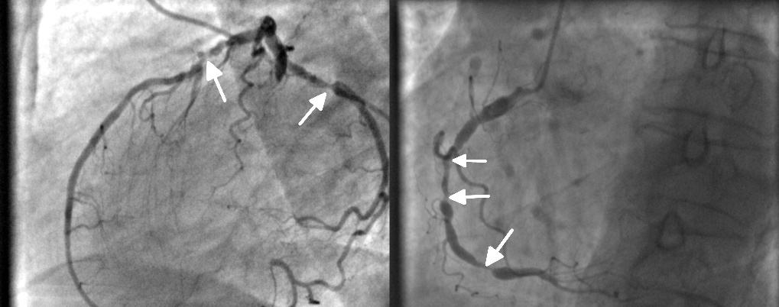
Revascularization of Non–Infarct-Related Coronary Artery Lesions in STEMI
Patients without significant comorbidities with large non-infarct vessels
In selected hemodynamically stable patients with STEMI and …
multivessel disease, after successful primary PCI, staged PCI of a significant non-infarct artery stenosis is recommended. (Class 1)
low-complexity multivessel disease, PCI of a non-infarct artery stenosis may be considered at time of primary PCI to reduce cardiac events. (Class 2b)
in selected patients with complex multivessel non-infarct artery disease, after successful primary PCI, elective CABG is reasonable. (Class 2a)
complicated by cardiogenic shock, routine PCI of a non-infarct artery at time of primary PCI should NOT be performed due to higher risk of death or renal failure. (Class 3:Harm)
In STEMI…
Abbreviations: CABG indicates coronary artery bypass grafting; MI, myocardial infarction;
PCI, percutaneous coronary intervention; and STEMI, ST-segment–elevation myocardial infarction.

Slide 11
Figure 5. Recommendations Timing of Invasive Strategy in NSTE-ACS
NSTE-ACS
Guiding Principle: Revascularization in the context of NSTE-ACS should consider clinical stability, risk of recurrent event(s), coronary anatomy, and degree of myocardium at risk.
Cardiogenic shock
Refractory angina or hemodynamic instability
At high risk
(e.g., GRACE score* >140) for clinical events
In initially stabilized patients who are at intermediate or low risk for clinical events
Immediate invasive strategy (1)
Early invasive strategy within 24 hours (2a)
Invasive strategy with intent to perform revascularization before hospital discharge
(2a)
*https://www.mdcalc.com/grace-acs-risk-mortality-calculator
Abbreviations: GRACE indicates Global Registry of Acute Coronary Events; and NSTE-ACS, non–ST-segment–elevation acute coronary syndrome

Slide 12
Figure 6. Revascularization in Patients With SIHD
Indications to improve symptoms
SIHD
Anatomic indications
to improve survival
YES
Refractory angina
on medical therapy?
NO
Revascularization (1)
YES
Left main disease?
NO
Significant left main stenosis & high anatomic complexity CAD?
Multivessel CAD with anatomy suitable for PCI or CABG?
YES
NO
YES
NO
Suitable candidate for CABG?
GMDT
YES
NO
Ischemic cardiomyopathy EF< 50%?
CABG
(1)
PCI
(2a)
YES
NO
CABG
(1)
Heart Team Discussion (1)
EF>50% and triple-vessel disease
YES
Suitable candidate for CABG?
NO
GMDT with or w/o PCI
Heart Team Discussion (1)
EF<35%
EF 35% to 50%
CABG
(2b)
PCI
(2b)
CABG
(1)
CABG
(2a)
GMDT with or w/o PCI
Abbreviations: CABG indicates coronary artery bypass grafting; CAD, coronary artery disease; EF, ejection fraction; GDMT, guideline-directed medical therapy; PCI, percutaneous coronary intervention; and SIHD, stable ischemic heart disease.

Slide 13
Revascularization Based Approach to Improve Mortality Compared with Medical Therapy in SIHD
Patient Subsets Deriving Class I Benefits of Revascularization
COR | RECOMMENDATIONS
1 | Left ventricular dysfunction and multivessel CAD with severe LVEF<35%, CABG is recommended (Class 1)
1 | Left main CAD with significant left main stenosis, CABG is recommended (Class 1)
Patient Subsets Deriving Class 2a or 2b Recommendations
COR | RECOMMENDATIONS
2a | Left ventricular dysfunction and multivessel CAD with mild-to-moderate LVEF 35%–50%, CABG is recommended (Class 2a)
2a | Left main CAD in selected patients: if PCI can provide equivalent revascularization to that possible with CABG, PCI is reasonable (Class 2a)
2b | Multivessel CAD: normal EF, significant stenosis in 3 major coronary arteries (with or without proximal LAD), and anatomy suitable for CABG, CABG may be reasonable to improve survival (Class 2b)
2b | Multivessel CAD: normal EF, significant stenosis in 3 major coronary arteries (with or without proximal LAD), and anatomy suitable for PCI, the usefulness of PCI to improve survival is uncertain (Class 2b)
2b | Stenosis in the proximal LAD artery: normal LVEF and significant stenosis in the proximal LAD, the usefulness of coronary revascularization to improve survival is uncertain (Class 2b)
Abbreviations: CABG indicates coronary artery bypass grafting; EF, ejection fraction; LAD, left anterior descending artery; LVEF, left ventricle ejection fraction; PCI, percutaneous coronary intervention; and SIHD, stable ischemic heart disease.

Slide 14
Revascularization Based Approach to Improve Mortality Compared with Medical Therapy in SIHD
Patient Subsets Deriving Class 3 Recommendations
COR | RECOMMENDATIONS
3 | Single- or double-vessel disease not involving the proximal LAD: normal LVEF, and 1- or 2-vessel CAD not involving the proximal LAD, coronary revascularization is not recommended to improve survival (Class 3: No Benefit)
3 | Single- or double-vessel disease not involving the proximal LAD: with >1 coronary arteries not anatomically or functionally significant (<70% diameter of non–left main coronary artery stenosis, FFR >0.80), coronary revascularization should NOT be performed with the primary or sole intent to improve survival (Class 3: Harm)
Abbreviations: CABG indicates coronary artery bypass grafting; EF, ejection fraction; LAD, left anterior descending artery; LVEF, left ventricle ejection fraction; PCI, percutaneous coronary intervention; and SIHD, stable ischemic heart disease.

Slide 15
Revascularization Approach to Reduce Cardiovascular Events in SIHD Compared with Medical Therapy
COR | RECOMMENDATIONS
2a | In patients with SIHD and multivessel CAD appropriate for either CABG or PCI, revascularization is reasonable to lower the risk of cardiovascular events such as spontaneous MI, unplanned urgent revascularizations, or cardiac death.
Revascularization Approach to Improve Symptoms
COR | RECOMMENDATIONS
1 | In patients with refractory angina despite medical therapy and with significant coronary artery stenoses amenable to revascularization, revascularization is recommended to improve symptoms.
Abbreviations: CABG indicates coronary artery bypass grafting; EF, ejection fraction; LAD, left anterior descending artery; LVEF, left ventricle ejection fraction; PCI, percutaneous coronary intervention; and SIHD, stable ischemic heart disease.

Slide 16
PCI vs CABG in Patients with COMPLEX DISEASE
Patients with Complex Disease
Complex CAD
Severe tortuosity
Heavy calcification
Complex bifurcation
Trifurcation lesion
Aorto-ostial stenosis
Thrombotic lesion
COR | RECOMMENDATIONS
1 | In patients who require revascularization for significant left main CAD with high-complexity CAD, it is recommended to choose CABG over PCI to improve survival.
2a | In patients who require revascularization for multivessel CAD with complex or diffuse CAD (e.g., SYNTAX score >33), it is reasonable to choose CABG over PCI to confer a survival advantage.
Guiding Principle:
CABG improves survival compared with PCI in patients
with left main and complex CAD.
Abbreviations: CABG indicates coronary artery bypass grafting; CAD, coronary artery disease; PCI , percutaneous coronary intervention; and SYNTAX, synergy between percutaneous coronary intervention with Taxus and cardiac surgery.

Slide 17
PCI vs CABG in Patients with COMPLEX DISEASE
Patients With Diabetes
Diabetes with multivessel CAD
Appropriate candidate for CABG
CABG with LIMA to LAD is recommended (Class 1)
COR | RECOMMENDATIONS
2a | PCI can be useful in diabetics who have multivessel CAD and are poor candidates for surgery.
2b | PCI may be considered to reduce MACO in diabetics with LM stenosis and low/intermediate complexity CAD.
Guiding Principle:
CABG compared to PCI has a benefit in mortality and repeat revascularizations in diabetics.
Abbreviations: CABG indicates coronary artery bypass grafting; CAD, coronary artery disease; LAD, left anterior descending artery; LIMA, left internal mammary artery; LM, left main artery; and MACO, major adverse cardiovascular outcomes.

Slide 18
PCI vs CABG in Patients with COMPLEX DISEASE
Patients with previous CABG
Previous CABG
Patent LIMA to LAD who need repeat revascularization
Refractory angina on GDMT attributable to LAD disease
Complex CAD
Is PCI feasible?
It is reasonable to choose CABG over PCI* (Class 2a)
It may be reasonable to choose CABG over PCI*
(Class 2a)
It is reasonable to choose PCI over CABG (Class 2a)
* When an IMA can be used as a conduit to the LAD.
Guiding Principle:
A Heart Team approach is important for those patients with a prior history of CABG requiring revascularization.
Abbreviations: CABG indicates coronary artery bypass grafting; CAD, coronary artery disease; GDMT, guideline-directed medical therapy; IMA, internal mammary artery; LIMA, left internal mammary artery; and PCI, percutaneous coronary intervention.

Slide 19


Revascularization in Special Populations and Situations
Pregnant Patients
COR | RECOMMENDATIONS
2a | In pregnant patients with STEMI not caused by SCAD, it is reasonable to perform primary PCI as the preferred revascularization strategy.
2a | In pregnant patients with NSTE-ACS, an invasive strategy is reasonable if medical therapy is ineffective for the management of life-threatening complications.
Older Patients
COR | RECOMMENDATIONS
1 | In older adults, as in all patients, the treatment strategy for CAD should be based on an individual patient’s preferences, cognitive function, and life expectancy.
Abbreviations: AKI indicates acute kidney injury; CAD, coronary artery disease; CKD, chronic kidney disease; NSTE-ACS, Non-ST segment elevation acute coronary syndrome; PCI, percutaneous coronary intervention; SCAD; spontaneous coronary artery dissection; and STEMI, ST segment elevation myocardial infarction

Slide 20

Revascularization in Special Populations and Situations
Chronic Kidney Disease
COR | RECOMMENDATIONS
1 | In patients with CKD undergoing contrast media injection for coronary angiography, measures should be taken to minimize the risk of contrast-induced AKI.
1 | In patients with STEMI and CKD, coronary angiography and revascularization are recommended, with adequate measures to reduce the risk of AKI.
2a | In high-risk patients with NSTE-ACS and CKD, it is reasonable to perform coronary angiography and revascularization, with adequate measures to reduce the risk of AKI.
2a | In low-risk patients with NSTE-ACS and CKD, it is reasonable to weigh the risk of coronary angiography and revascularization against the potential benefit.
3: No Benefit | In asymptomatic patients with stable CAD and CKD, routine angiography and revascularization are not recommended if there is no compelling indication .
Abbreviations: AKI indicates acute kidney injury; CAD, coronary artery disease; CKD, chronic kidney disease; NSTE-ACS, Non-ST segment elevation acute coronary syndrome; PCI, percutaneous coronary intervention; SCAD; spontaneous coronary artery dissection; and STEMI, ST segment elevation myocardial infarction

Slide 21








Best Practices in Cath Lab for Patients with CKD Undergoing Angiography
RECOMMENDATIONS
Assess the risk of contrast-induced AKI before the procedure.
Use radial artery if feasible.
Delay CABG in stable patients after angiography beyond 24 hours when clinically feasible.
Administer adequate preprocedural hydration.
Record the volume of contrast media administered, and minimize contrast use.
Do not administer N-acetyl-L-cysteine to prevent contrast-induced AKI.
Pretreat with high-intensity statins.
Do not give prophylactic renal replacement therapy.
Abbreviations: AKI indicates acute kidney injury; CABG, coronary artery bypass grafting; and CKD, chronic kidney disease.

Slide 22




Revascularization in Special Populations and Situations
Reducing Ventricular Arrhythmias
Patients with SCAD
COR | RECOMMENDATIONS
1 | In patients with ventricular fibrillation, polymorphic ventricular tachycardia (VT), or cardiac arrest, revascularization of significant CAD is recommended to improve survival.
3: No Benefit | In patients with CAD and suspected scar-mediated sustained monomorphic VT, revascularization is not recommended for the sole purpose of preventing recurrent VT.
COR | RECOMMENDATIONS
2b | In patients with SCAD who have hemodynamic instability or ongoing ischemia despite conservative therapy, revascularization may be considered if feasible.
3: Harm | Routine revascularization for SCAD should not be performed.
Patients with Cardiac Allografts
Before Noncardiac Surgery
COR | RECOMMENDATIONS
2a | In patients with cardiac allograft vasculopathy and severe, proximal, discrete coronary lesions, revascularization with PCI is reasonable.
COR | RECOMMENDATIONS
3: No Benefit | In patients with non–left main or noncomplex CAD who are undergoing noncardiac surgery, routine coronary revascularization is not recommended solely to reduce perioperative cardiovascular events.
Abbreviations: AKI indicates acute kidney injury; CAD, coronary artery disease; CKD, chronic kidney disease; NSTE-ACS, Non-ST segment elevation acute coronary syndrome; PCI, percutaneous coronary intervention; SCAD; spontaneous coronary artery dissection; and STEMI, ST segment elevation myocardial infarction

Slide 23
General Procedural Issues for PCI:
Procedure Considerations
Vascular Access for PCI
Stent Selection in PCI
Intravascular Imaging in PCI
PCI in ACS
PCI in SIHD
DES should be used in preference to BMS (Class I)
, target vessel revascularization.
IVUS and OCT can be useful for procedural guidance (2a)
Radial Approach (Class I)
Significant reduction in:
MI
Restenosis
Acute stent thrombosis
LM and complex coronary artery stenting
Mechanism of stent failure
Lesion preparation
Stent sizing and expansion
Evaluate complications
30-day rates:
Death
Non-fatal MI and CVA
Non-major bleeding
30-day rates:
Bleeding
Vascular complications
Compared with angiographic-guided PCI at 3 years, decreased MACE, TVR, TLR
Abbreviations: ACS indicates acute coronary syndrome; BMS, bare metal stent; CVA, cerebrovascular accident; DES, drug-eluting stent; IVUS, intravascular ultrasound; LM, left main coronary artery; MACE, major adverse coronary events; MI, myocardial infarction; OCT, optical coherence tomography; PCI, percutaneous coronary intervention; SIHD, stable ischemic heart disease; TLR, target lesion revascularization; and TVR, target vessel revascularization.

Slide 24
General Procedural Issues for PCI:
Clinical Circumstances
Thrombectomy
COR | RECOMMENDATIONS
3: No Benefit | In STEMI, routine aspiration thrombectomy before primary PCI is not useful
No significant reduction in CV death, MI, cardiogenic shock, reinfarction, stent thrombosis or target lesion revascularization
Increased risk of stroke
Selective use in patients with high thrombus burden can be considered
Calcified Lesions
COR | RECOMMENDATIONS
2a | In fibrotic or heavily calcified lesions, plaque modification with rotational atherectomy improves procedural success
2b | Plaque modification with orbital atherectomy, balloon atherotomy, laser angioplasty, or intracoronary lithotripsy can be considered in fibrotic and heavily calcified lesions to improve procedural success
Abbreviations: CV indicates cardiovascular; MI, myocardial infarction; PCI, percutaneous coronary intervention; and STEMI, ST-elevation myocardial infarction.

Slide 25
General Procedural Issues for PCI:
Clinical Circumstances
SVG Disease
COR | RECOMMENDATIONS
2a | In PCI of a SVG, use of an embolic protection device can decrease risk of distal embolization
2a | PCI of the native coronary artery is preferred over SVG PCI if feasible
3: No benefit | PCI of chronically occluded SVG should not be performed
Increased periprocedural MI, no-reflow, stent thrombosis, TVR and death with SVG PCI
Treatment of ISR
COR | RECOMMENDATIONS
1 | For PCI of ISR, a DES should be used to improve outcomes
2a | CABG can be useful over repeat PCI to reduce recurrent events in symptomatic diffuse ISR
2b | Brachytherapy may be considered in recurrent ISR to improve symptoms
Abbreviations: CABG indicates coronary artery bypass grafting; DAPT, dual antiplatelet therapy, DES, drug-eluting stent; ISR, in-stent restenosis; MI, myocardial infarction; PCI, percutaneous coronary intervention; SVG, saphenous vein graft; and TVR, target vessel revascularization.

Slide 26
General Procedural Issues for PCI:
Clinical Circumstances
Hemodynamic Support
COR | RECOMMENDATIONS
2b | Elective placement of a hemodynamic support device, such as Impella or IABP, may be reasonable as an adjunct to PCI in select high-risk patients
RCT showed no benefit in the composite outcome of death, MI, CVA or repeat revascularization
Significant reduction in major procedure complications, largely driven by improvement in hemodynamic support
CTO Treatment
COR | RECOMMENDATIONS
2b | In patients with suitable anatomy and refractory angina despite medical therapy and treatment of non-CTO lesions, the benefit of CTO PCI to improve symptoms is uncertain
80% procedural success
1.3% 30-day mortality
4.8% perforation
Euro CTO: significant reduction in angina frequency and improved QOL
DECISION-CTO: no difference in symptoms or clinical outcomes
Abbreviations: CTO indicates chronic total occlusion; CVA, stroke; IABP, intra-aortic balloon pump; MI, myocardial infarction; PCI, percutaneous coronary intervention; QOL, quality of life; and RCT, randomized controlled trial.

Slide 27
Aspirin and Oral P2Y12 Inhibitors in Patients Undergoing PCI
COR | RECOMMENDATIONS
1 | In patients undergoing PCI, a loading dose of aspirin followed by a daily dosing is recommended.
1 | In patients with ACS undergoing PCI, a loading dose of P2Y12 inhibitor followed by a daily dosing is recommended.
1 | In patients with SIHD undergoing PCI, a loading dose of clopidogrel, followed by daily dosing is recommended.
1 | In patients undergoing PCI within 24 hours after fibrinolytic therapy, a loading dose of 300 mg of clopidogrel, followed by daily dosing, is recommended.
2a | In patients with ACS undergoing PCI, it is reasonable to use ticagrelor or prasugrel in preference to clopidogrel to reduce ischemic events, including ST
2b | In patients undergoing PCI who are P2Y12 inhibitor naïve, intravenous *cangrelor may be reasonable to reduce periprocedural ischemic events *(See section 11.2. Intravenous P2Y12 Inhibitors in Patients Undergoing PCI for synopsis of rationale)
3: Harm | In patients undergoing PCI who have a history of stroke or TIA, prasugrel should not be administered
Abbreviations: ACS indicates acute coronary syndrome; PCI , percutaneous coronary intervention; SIHD, stable ischemic heart disease; ST, stent thrombosis; and TIA, transient ischemic attack.

Slide 28
Aspirin and Oral P2Y12 Inhibitors in Patients Undergoing PCI
COR | RECOMMENDATIONS
2a | In patients with ACS undergoing PCI with large thrombus burden, no reflow or slow flow, intravenous glycoprotein IIb/IIIa inhibitor agents are reasonable to improve procedural success.
3: Harm | In patients with SIHD undergoing PCI, the routine use of an intravenous glycoprotein IIb/IIIa inhibitor is not recommended
Guiding Principle:
The benefit of Gp IIb/IIIa inhibitors has decreased with shorter revascularization times and potent DAPT.
Abbreviations: ACS indicates acute coronary syndrome; PCI , percutaneous coronary intervention; SIHD, stable ischemic heart disease; ST, stent thrombosis; and TIA, transient ischemic attack.

Slide 29
Anticoagulation in Patients Undergoing PCI
COR | RECOMMENDATIONS
1 | In patients undergoing PCI, administration of intravenous unfractionated heparin is useful to reduce ischemic events.
1 | In patients with heparin-induced thrombocytopenia undergoing PCI, bivalirudin or argatroban should be used to replace UFH to avoid thrombotic complications.
2b | In patients undergoing PCI, bivalirudin may be a reasonable alternative to UFH to reduce bleeding.
2b | In patients treated with upstream subcutaneous enoxaparin for unstable angina or NSTE-ACS, intravenous enoxaparin may be considered at the time of PCI to reduce ischemic events.
3: Harm | In patients on therapeutic subcutaneous enoxaparin, in whom the last dose was administered within 12 hours of PCI, UFH should not be used for PCI and may increase bleeding
Guiding Principle:
Antithrombotic therapy is a mainstay of treatment in patients undergoing PCI.
Abbreviations: UFH indicates unfractionated heparin; NSTE-ACS, Non-ST elevation-acute coronary syndrome; and PCI, percutaneous coronary intervention.

Slide 30
Figure 7: Use of DAPT for Patients After PCI
Patients Undergoing PCI
SIHD
ACS
DES
BMS
0 mo
≥6 mo
aspirin plus clopidogrel (Class 1)
≥1 mo
aspirin plus clopidogrel (Class 1)
≥12 mo
aspirin plus clopidogrel,
or prasugrel,
or ticagrelor (Class 1)
1 mo
Discontinue aspirin after
1-3 mo with continued P2Y12 monotherapy (Class 2a)
Discontinue aspirin after 1-3 month with continued P2Y12 monotherapy (Class 2a)
If high risk of bleeding or overt bleeding on DAPT, discontinuing
P2Y12 after 3mo may be reasonable (Class 2b)
3 mo
If high risk of bleeding or overt bleeding on DAPT, discontinuing P2Y12 after 6mo may be reasonable (Class 2b)
6 mo
If no high risk of bleeding or significant overt bleeding on DAPT, >6 mo. DAPT may be reasonable (Class 2b)
If no high risk of bleeding or significant overt bleeding on DAPT, >1 mo DAPT may be reasonable (Class 2b)
12 mo
If no high risk of bleeding or significant overt bleeding on DAPT, >1 y DAPT may be reasonable (Class 2b)
Abbreviations: BMS indicates bare metal stent; DAPT, dual antiplatelet therapy; DES, drug eluting stent; PCI, percutaneous coronary intervention; and SIHD, stable ischemic heart disease.

Slide 31
Antiplatelet Therapy in Patients with Atrial Fibrillation on Anticoagulation After PCI
Patients with atrial fibrillation who are undergoing PCI and are taking oral anticoagulant therapy
Recommend discontinuing aspirin after 1-4 weeks while maintaining P2Y12 inhibitors in addition to a non–vitamin K oral anticoagulant or warfarin (Class 1)
When treated with DAPT or a P2Y12 inhibitor monotherapy, it is reasonable to choose a non–vitamin K oral anticoagulant over warfarin (Class 2a)
Reduce the risk of bleeding
Abbreviations: DAPT indicates dual antiplatelet therapy; and PCI, percutaneous coronary intervention.

Slide 32
Antiplatelet Therapy in Patients After CABG
Patients undergoing CABG
Selected patients undergoing CABG (e.g. off-pump, high SYNTAX score)
Initiate aspirin (100-325 mg daily) within 6 hours postoperatively and
continue indefinitely
(Class 1)
Initiate DAPT with aspirin and
ticagrelor or clopidogrel for 1 year
(Class 2b)
Reduce saphenous vein graft occlusion and adverse cardiovascular events
Improve vein graft patency compared with aspirin alone
Abbreviations: CABG indicates coronary artery bypass grafting; and DAPT, dual antiplatelet therapy.

Slide 33
Beta Blockers in Patients After Revascularization
Patients with SIHD and normal LV function who receive complete revascularization
Patients after
undergoing CABG
The routine use of chronic oral beta blockers is not beneficial to reduce cardiovascular events
(Class 3: No Benefit)
Beta blockers are recommended and should be started as soon as possible (Class 1)
Reduce the incidence or clinical sequelae of postoperative atrial fibrillation
Abbreviations: CABG indicates coronary artery bypass grafting; LV, left ventricle; and SIHD, stable ischemic heart disease.

Slide 34
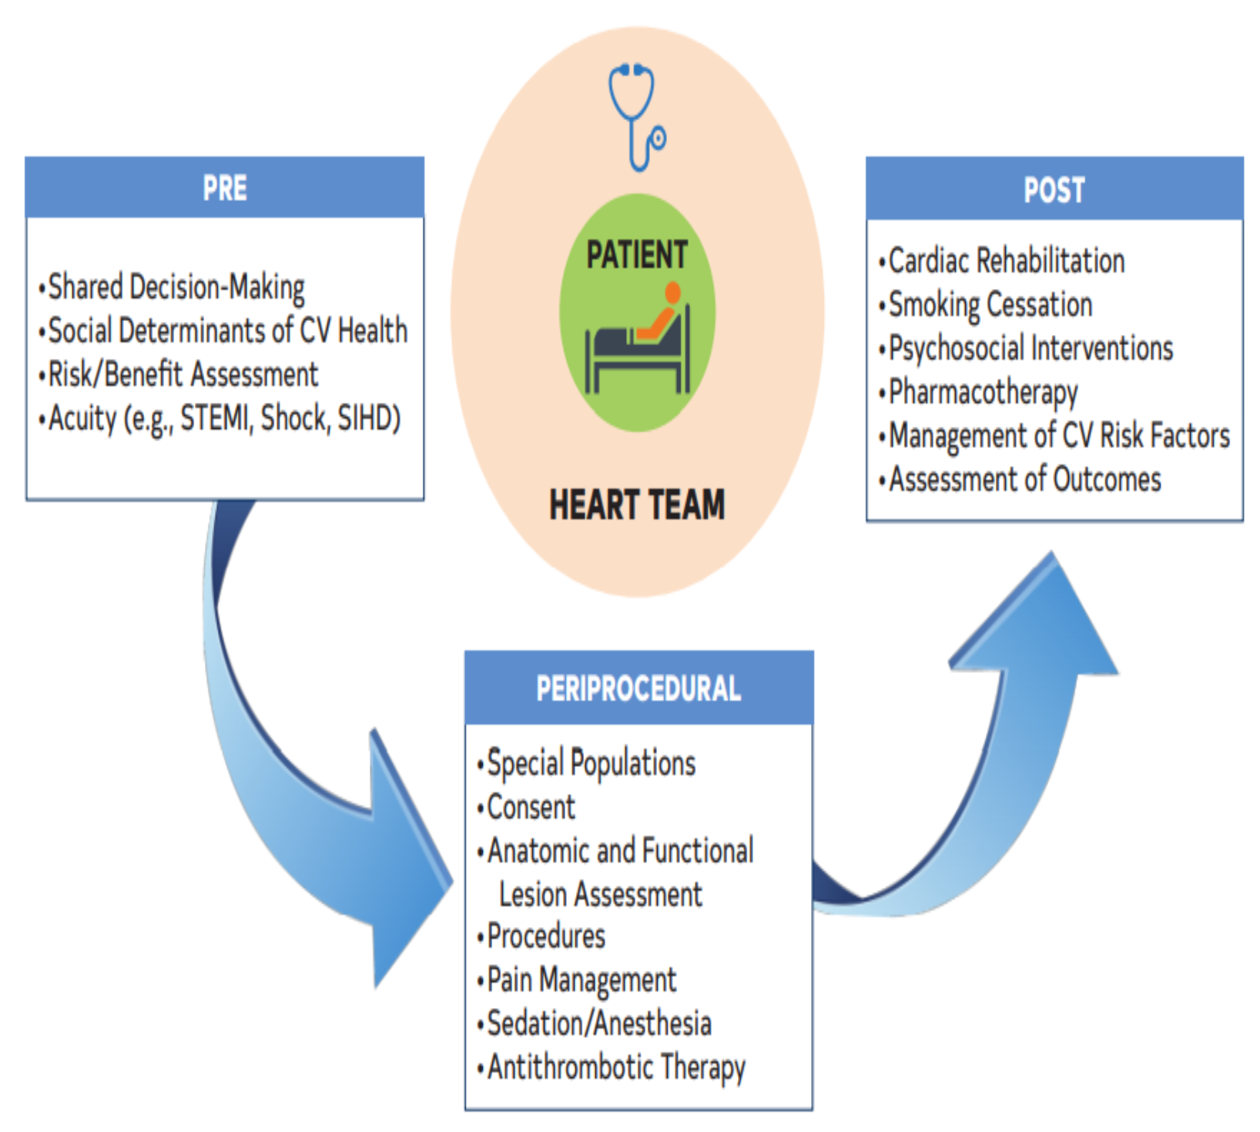

Focus on Perioperative Considerations in Patients Undergoing CABG and Outcomes
For patients undergoing CABG, establishment of multidisciplinary, evidence-based perioperative management programs is recommended to optimize analgesia, minimize opioid exposure, prevent complications and to reduce time to extubation, length of stay, and healthcare costs. (Class 1)
Abbreviations: CABG indicates coronary artery bypass grafting; CNS, central nervous system; CV, cardiovascular disease; LOS, length of stay; SIHD, stable ischemic heart disease; STEMI, ST segment elevation myocardial infarction; and TEE, transesophageal echo.

Slide 35
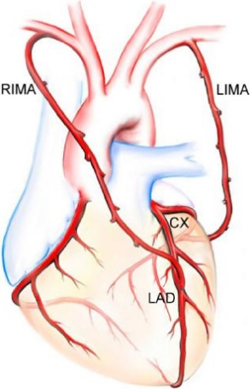
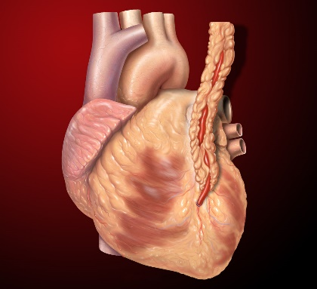
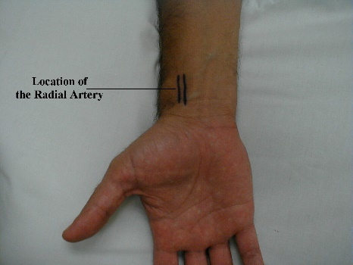
Bypass Conduits in Patients Undergoing CABG
Radial artery
IMA (prefer left)
BIMA
Recommended in preference to a saphenous vein conduit to graft the second most important, significantly stenosed, non–LAD vessel (Class 1)
To LAD (Class 1)
Improves
long-term outcomes when procedure is done by experienced operators
(Class 2a)
Source: This Photo by Unknown Author is licensed under CC BY-SA
Source: This Photo by Unknown Author is licensed under CC BY-SA
Source: https://vpjournal.net/article/view/3141
Click here for more best practices
Abbreviations: BIMA indicates bilateral internal mammary artery; IMA, internal mammary artery; LAD, left anterior descending; and SVG, saphenous vein graft..

Slide 36
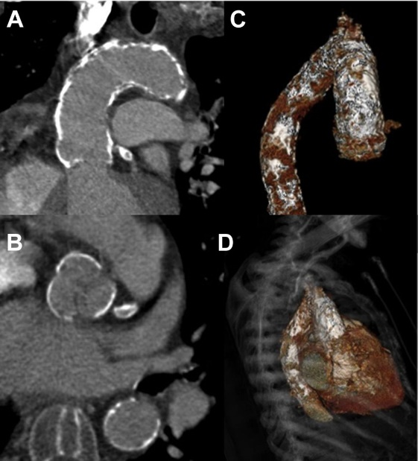
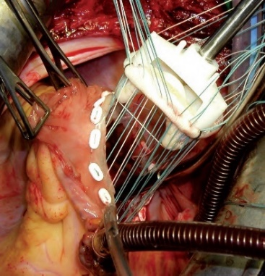
Patients Undergoing Other Cardiac Surgery and Operative Approach
Significant Aortic Calcification OR
Significant Pulmonary disease
Valve, aortic, OR
other cardiac surgery
Significant CAD
Decrease stroke risk
Source: This Photo by Unknown Author is licensed under CC BY-NC
Source: This Photo by Unknown Author is licensed under CC BY-NC
Concomitant CABG
(Class 1)
Off-pump or beating heart approach may be reasonable (Class 2a)
Abbreviations: CABG indicates coronary artery bypass grafting; and CAD, coronary artery disease.

Slide 37

Use of Epiaortic Ultrasound in Patients Undergoing CABG
In patients undergoing CABG, the routine use of epiaortic ultrasound scanning can be useful to evaluate the presence, location, and severity of plaque in the ascending aorta to reduce the incidence of atheroembolic complications
(Class 2a)
  Superior to digital palpation or TEE
  “Gold standard” for detection of presence, location, and severity
Abbreviations: TEE indicates transesophageal echo; and US, ultrasound.

Slide 38



Decrease Post-operative Deep Sternal Wound Infections
Intraop + Postop Target Serum Glucose Level:
<180mg/dL
(Class 1)
Administer IV insulin continuous infusion
AVOID hypoglycemia
Click here for more best practices
Abbreviations: IV indicates intravenous; and SWI, sternal wound infections.

Slide 39

Perioperative Pharmacotherapy
Pre-op
Anti-platelet
PRE-OP ANTI-PLATELET | PLAN TO DECREASE RISK OF BLEEDING
ASA, daily | CONTINUE, if already taking (Class 1)
Clopidogrel & Ticagrelor | STOP At least 24 hrs, if URGENT (Class 1)
 | STOP Ticagrelor at least 3d, if elective (Class 2a) STOP Clopidogrel at least 5d, if elective (Class 2a) STOP Prasugrel at least 7d, if elective (Class 2a)
Eptifibatide & Tirofiban | STOP At least 4 hrs (Class 1)
Abciximab | STOP At least 12 hrs (Class 1)
Anti-Arrhythmics* Preop
BB and Amiodarone can reduce the incidence of post-op afib (Class 2a)
BB may reduce mortality or postop complications (Class 2b)
* In patients with no contraindications to usage
Abbreviations: AFIB indicates atrial fibrillation; ASA, aspirin; BB, beta blockers; D, days; and HRS, hours.

Slide 40



Psychosocial Factors and Lifestyle Changes after Revascularization
COR | RECOMMENDATIONS
1 | Following revascularization, home and center-based cardiac rehabilitation reduced death, hospital readmission and improves quality of life.
1 | After revascularization, patients should be educated about CVD risk factors and their modification to reduce CV events.
Cardiac Rehabilitation and Education
COR | RECOMMENDATIONS
1 | Following revascularization, behavioral interventions and pharmacotherapy are recommended to maximize smoking cessation and reduce CV events.
1 | Smoking cessation interventions should occur during the index hospitalization for revascularization with at least on month supportive follow-up.
Smoking Cessation
COR | RECOMMENDATIONS
1 | Cognitive behavioral therapy, psychological counseling, and/or pharmacological treatment can improve QOL and cardiac outcomes after revascularization in patients with depression, anxiety or stress.
2b | After revascularization, screening for depression and referral/ treatment when indicated improves QOL and recovery.
Psychological Interventions
Abbreviations: CV indicates cardiovascular; CVD, cardiovascular disease; and QOL, quality of life.

Slide 41
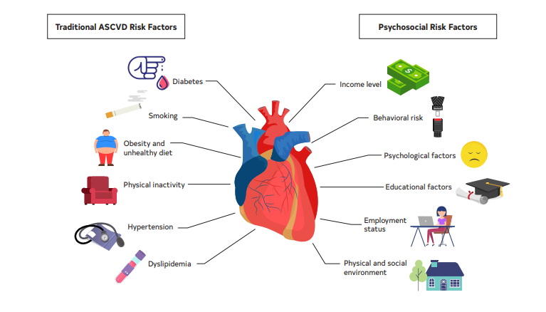
Traditional and Non-Traditional Risk Factors for CVD
After revascularization, patients should be educated about CVD risk factors and their modification to reduce CV events (Class 1).
Behavioral interventions and pharmacotherapy (NRT, varenicline, bupropion) (Class 1)
Cognitive behavioral therapy, psychological counseling, and/or pharmacological treatment (Class 1)
2019 ACC/AHA Guideline on the Primary Prevention of Cardiovascular Disease
AHA’s Life’s Simple 7 program
Abbreviations: ASCVD indicates atherosclerotic cardiovascular disease; CV, cardiovascular; CVD, cardiovascular disease; and NRT, nicotine replacement therapy.

Slide 42
Revascularization Outcomes
Revascularization centers should participate in clinical data registries to review and improve patient outcomes.
With the goal of improving patient outcomes, it is recommended that cardiac surgery and PCI programs participate in state, regional, or national clinical data registries and receive periodic reports of their risk-adjust outcomes as a quality assessment and improvement strategy (Class 1).
With the goal of improving patient outcomes, is reasonable for cardiac surgery and PCI programs to have a QI program that routinely:
reviews institutional quality programs and outcomes,
reviews individual operator outcomes,
provides peer review of difficult or complicated cases,
performs random case reviews. (Class 2a)
In asymptomatic stable STEMI w/ total occlusion >24 hr after symptom onset & no severe ischemia, PCI should not be performed. (3:No Benefit)
Abbreviations: QI indicates quality improvement; and PCI, percutaneous coronary intervention.

Slide 43
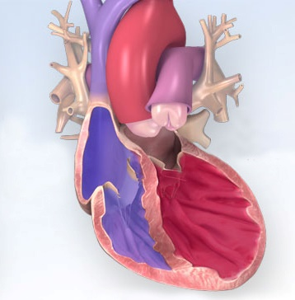
Unanswered Questions and Future Directions
Special Clinical Situations: Left Ventricular Dysfunction
✓
Data from randomized control trials support surgical revascularization in the setting of left ventricular dysfunction to improve survival.
Although commonly used to guide revascularization decisions, the role of myocardial viability imaging (for example, with PET or MRI) in guiding clinical practice is unclear.
Further research is needed into whether PCI can improve survival in patients with systolic heart failure.
?
?
Abbreviations: MRI indicates magnetic resonance imaging; PET, positron emission tomography; and PCI percutaneous coronary intervention.

Slide 44
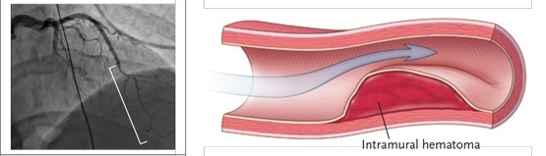
Special Clinical Situations: Nonatherosclerotic Lesions
Spontaneous coronary artery dissection
Coronary artery aneurysms
Myocardial bridging
✓
Expert consensus recommends conservative care for most patients.
Research is needed to understand optimal management in patients with ongoing symptoms, hemodynamic instability, or severely compromised flow to a large myocardial territory.
?
Coronary artery aneurysms can be asymptomatic or lead to ischemia, thrombosis, fistula formation, or rupture. The ideal timing and mode of intervention is unknown.
?
In cases of severe ischemia and significant myocardial bridging, surgical approaches are available, but the long-term risks and benefits are uncertain.
?
Source: https://resident360.nejm.org/clinical-pearls/spontaneous-coronary-artery-dissection

Slide 45
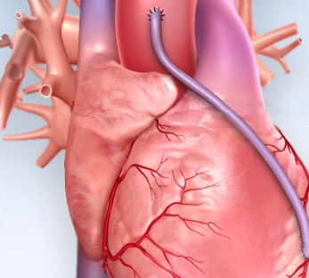
Unanswered Questions and Future Directions Special Clinical Situations: Considerations in Bypass Grafting
✓
Heart Team discussions are appropriate for management of acute graft failure, obstructive graft disease, and PCI of native arteries via bypass grafts.
There are no data to determine the optimal antithrombotic regimen of patients after ACS who undergo CABG and also have an indication for systemic anticoagulation.
The roles of hybrid surgical/ percutaneous revascularization in multivessel disease and the use of non-sternotomy surgical approaches remain unknown.
?
?
Abbreviations: ACS indicates acute coronary syndrome, CABG, coronary artery bypass grafting, and PCI percutaneous coronary intervention.

Slide 46
Unanswered Questions and Future Directions Special Clinical Situations: Completeness of Revascularization
✓
Observational data have shown worse outcomes in patients with multivessel disease if severe stenoses in major epicardial arteries are not revascularized during the index procedure.
However, patients in these studies who underwent incomplete revascularization had more significant comorbidities, and the motivations behind an individual operator's procedural decisions are complex.
It is reasonable to assume that improving perfusion to as large a myocardial territory as possible is likely beneficial, but evidence from RCTs is lacking.
RCTs are needed compare the outcomes of complete versus incomplete revascularization in stable ischemic heart disease.
✓
?
?
Abbreviations: RCT indicates randomized controlled trial.

Slide 47
Special Clinical Situations:
Elective Revascularization prior to other Procedures
COR | RECOMMENDATIONS
2a | In patients undergoing TAVI with significant left main or proximal CAD with or without angina, revascularization by PCI before TAVI is reasonable.
?
Further research is needed to determine whether routine revascularization prior to TAVR improves clinical outcomes.
It is common for a patient to be referred for revascularization in preparation for solid organ transplantation.
Patients awaiting solid organ transplant are complex, and it remains unclear whether revascularization prior to organ transplantation positively impacts survival.
✓
?
Abbreviations: CAD indicates coronary artery disease; PCI, percutaneous coronary intervention; and TAVI, transcatheter aortic valve implantation.

Slide 48
Acknowledgments
Many thanks to our Guideline Ambassadors who were guided by Dr. Elliott Antman in developing this translational learning product in support of the ACC/AHA/SCAI Guideline for Coronary Artery Revascularization
Karen Deffenbacher, MD
Amit Goyal, MD
Madonna Lee, MD
Madeline Mahowald, MD
Manolo Rubio Garcia, MD
Hanjay Wang, MD
The American Heart Association requests this electronic slide deck be cited as follows:
Deffenbacher, K., Goyal, A., Lee, M., Mahowald, M., Garcia, M., Wang, H., Bezanson, J. L., & Antman, E. M. (2021). Clinical Update; Adapted from: ACC/AHA/SCAI Guideline for Coronary Artery Revascularization [PowerPoint slides]. Retrieved from https://professional.heart.org/en/science-news

Slide 49
Appendix

Slide 50
Table 13. Best Practices for the Use of Bypass Conduits in CABG
 Return to previous slide
Objectively assess palmar arch completeness and ulnar compensation before harvesting the radial artery. Use the arm with the best ulnar compensation for radial artery harvesting.
Use radial artery grafts to target vessels with subocclusive stenoses.
Avoid the use of the radial artery after transradial catheterization.
Avoid the use of the radial artery in patients with chronic kidney disease and a high likelihood of rapid progression to hemodialysis.
Use oral calcium channel blockers for the first postoperative year after radial artery grafting.
Avoid bilateral percutaneous or surgical radial artery procedures in patients with coronary artery disease to preserve the artery for future use.
Harvest the internal mammary artery using the skeletonization technique to reduce the risk of sternal wound complications.
Use an endoscopic saphenous vein harvest technique in patients at risk of wound complications.
Use a no-touch saphenous vein harvest technique in patients at low risk of wound complications.
Use the skeletonized right gastroepiploic artery to graft right coronary artery target vessels with subocclusive stenosis if the operator is experienced with the use of the artery.
Abbreviations: CABG indicates coronary artery bypass grafting.

Slide 51
Table 14. Best Practices to Reduce Sternal Wound Infection in Patients Undergoing CABG
 Return to previous slide
Perform nasal swab testing for Staphylococcus aureus (8).
Apply mupirocin 2% ointment to known nasal carriers of S aureus (8).
Apply preoperative intranasal mupirocin 2% ointment to those patients whose nasal culture or PCR result is unknown (8).
Redose prophylactic antimicrobials for long procedures (>2 half-lives of the antibiotic) or in cases of excessive blood loss during CABG (10, 11, 27).
Measure perioperative HbA1c (31).
Treat all distant extrathoracic infections before nonemergency surgical coronary revascularization (19).
Advise smoking cessation before elective CABG surgery (7).
Apply topical antibiotics (vancomycin) to the cut edges of the sternum on opening and before closing in cardiac surgical procedures involving a median sternotomy (4, 32).
Use skeletonized harvest of IMA in BIMA grafting (16).
Do not continue prophylactic antibiotics beyond 48 hours (9, 11)
Abbreviations: CABG indicates coronary artery bypass grafting.

