Slide 1
Clinical Update
ADAPTED FROM:
2021 AHA/ASA Guideline for the Prevention of Stroke in Patients With Stroke and Transient Ischemic Attack

Slide 2
Table 1.
Applying Class of Recommendation and Level of Evidence to Clinical Strategies, Interventions, Treatments, or Diagnostic Testing in Patient Care
CLASS (STRENGTH) OF RECOMMENDATION
CLASS 1 (STRONG) Benefit >>> Risk
Suggested phrases for writing recommendations: Is recommended Is indicated/useful/effective/beneficial Should be performed/administered/other Comparative-Effectiveness Phrases†: Treatment/strategy A is recommended/indicated in preference to treatment B Treatment A should be chosen over treatment B
CLASS 2a (MODERATE) Benefit >> Risk
Suggested phrases for writing recommendations: Is reasonable Can be useful/effective/beneficial Comparative-Effectiveness Phrases†: Treatment/strategy A is probably recommended/indicated in preference to treatment B It is reasonable to choose treatment A over treatment B
CLASS 2b (Weak) Benefit ≥ Risk
Suggested phrases for writing recommendations: May/might be reasonable May/might be considered Usefulness/effectiveness is unknown/unclear/uncertain or not well-established
CLASS 3: No Benefit (MODERATE) Benefit = Risk
Suggested phrases for writing recommendations: Is not recommended Is not indicated/useful/effective/beneficial Should not be performed/administered/other
CLASS 3: Harm (STRONG) Risk > Benefit
Suggested phrases for writing recommendations: Potentially harmful Causes harm Associated with excess morbidity/mortality Should not be performed/administered/other
LEVEL (QUALITY) OF EVIDENCE‡
LEVEL A
High-quality evidence‡ from more than 1 RCT Meta-analyses of high-quality RCTs One or more RCTs corroborated by high-quality registry studies
LEVEL B-R (Randomized)
Moderate-quality evidence‡ from 1 or more RCTs Meta-analyses of moderate-quality RCTs
LEVEL B-NR (Nonrandomized)
Moderate-quality evidence‡ from 1 or more well-designed, well-executed nonrandomized studies, observational studies, or registry studies Meta-analyses of such studies
LEVEL C-LD (Limited Data)
Randomized or nonrandomized observational or registry studies with limitations of design or execution Meta-analyses of such studies Physiological or mechanistic studies in human subjects
LEVEL C-EO (Expert Opinion)
Consensus of expert opinion based on clinical experience.
COR and LOE are determined independently (any COR may be paired with any LOE).
A recommendation with LOE C does not imply that the recommendation is weak. Many important clinical questions addressed in guidelines do not lend themselves to clinical trials. Although RCTs are unavailable, there may be a very clear clinical consensus that a particular test or therapy is useful or effective.
*The outcome or result of the intervention should be specified (an improved clinical outcome or increased diagnostic accuracy or incremental prognostic information).
†For comparative-effectiveness recommendation (COR 1 and 2a; LOE A and B only), studies that support the use of comparator verbs should involve direct comparisons of the treatments or strategies being evaluated.
‡The method of assessing quality is evolving, including the application of standardized, widely-used, and preferably validated evidence grading tools; and for systematic reviews, the incorporation of an Evidence Review Committee.
COR indicates Class of Recommendation; EO, expert opinion; LD, limited data; LOE, Level of Evidence; NR, nonrandomized; R, randomized; and RCT, randomized controlled trial.

Slide 3




Introduction & Scope
Annual Ischemic Stroke and TIA Incidence
Pillars of Prevention
Total Strokes:
~795K
Recurrent Stroke
185K
Blood Pressure Control
Diet
TIA
~240K
Ischemic Strokes
690K
(87%)
Physical Activity
Smoking Cessation
Guiding Principle: Secondary prevention for Stroke and TIA patients is identical!
Abbreviation: TIA indicates transient ischemic attack.

Slide 4
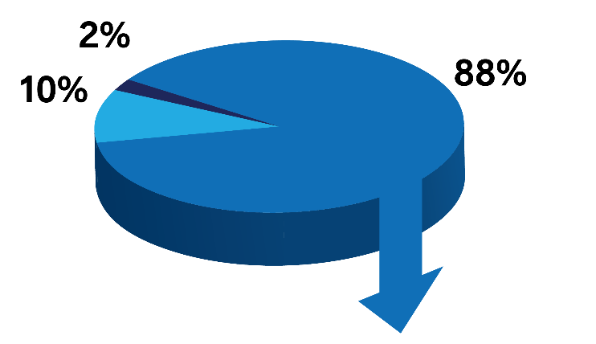
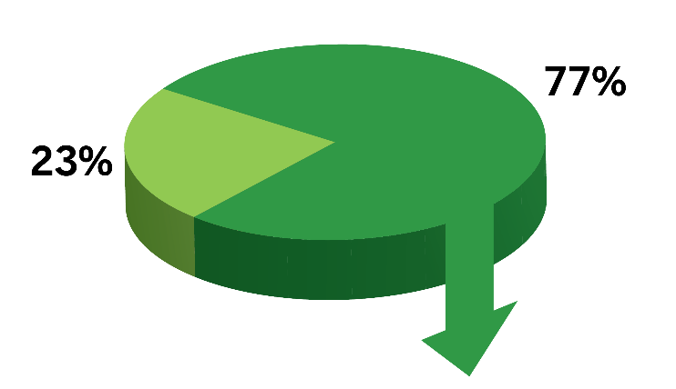
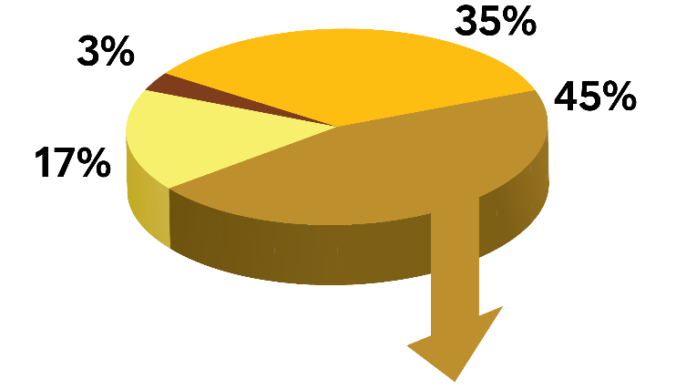
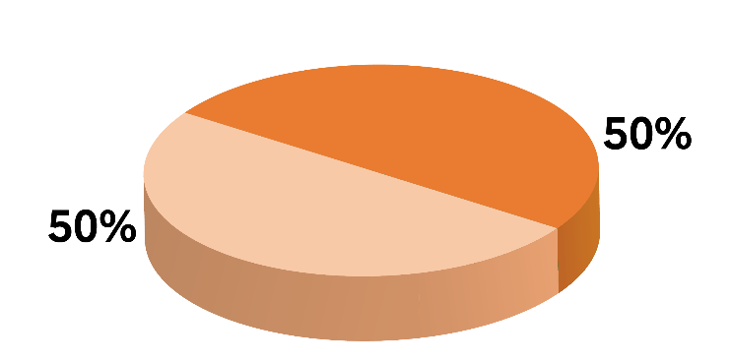
Figure 1. Conceptual Representation of Ischemic Stroke Subtypes
Intracerebral Hemorrhage
Stroke
Subarachnoid Hemorrhage
Ischemic Stroke
Lacunar (Majority due to small vessel disease)
Ischemic Stroke
Non-Lacunar
Cardioembolic
Large Artery
Cryptogenic
Non-Lacunar Stroke
Other
ESUS
Cryptogenic Stroke
NON-ESUS
Abbreviations: ESUS indicates embolic stroke of undetermined source; and non-ESUS, non-embolic stroke of undetermined source.

Slide 5



Shared Decision-Making & Adherence
  Shared Decision Making
  Key component of patient-centered care
  Process in which clinicians describe options, risks, benefits and assists patients in evaluating options
  Collaboratively develop care plans with patients, incorporating patients’ wishes, goals, and concerns
  Assessing Barriers to Adherence
  Assess and address barriers to adherence to medications and lifestyle
  In recurrent stroke, vital to assess whether taking prescribed medications
  Explore and, if possible, address factors that contributed to non-adherence, prior to assuming medications were ineffective

Slide 6

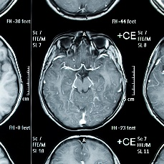
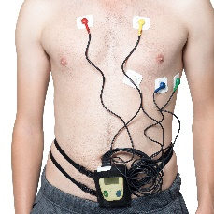

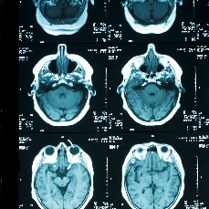
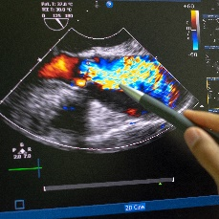
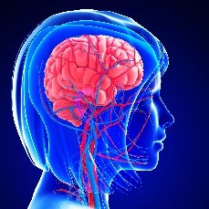
Diagnostics: Test and Implications for Stroke Prevention
ECG
  Screen for atrial fibrillation/flutter
  Detects additional arrhythmias
  Assesses for myocardial infarction
Intracranial Arterial Imaging
  Identifies stenosis, dissection, etc.
Rhythm Monitoring
  Mobile cardiac outpatient telemetry, implantable loop recorder, or other approach, is reasonable to detect intermittent atrial fibrillation
Blood Testing
  Informs therapy and identifies risk factors for modification
  Can include testing for cryptogenic strokes if needed
CT or MRI Brain Imaging
  Confirms ischemic cause of symptoms
  May need repeat imaging after thrombolysis or to confirm diagnosis
Echocardiography
Identifies possible cardioaortic sources of or transcardiac pathways for cerebral embolism
Transthoracic echocardiography is preferred over TEE for the detection of left ventricular (LV) thrombus, but TEE is superior to transthoracic echocardiogram in detecting left atrial thrombus, aortic atheroma, prosthetic valve abnormalities, native valve abnormalities, atrial septal abnormalities, and cardiac tumors
Cervical Carotid Imaging
  Utilized to screen for stenosis, dissection, etc.
  Types of diagnostic testing approaches include carotid ultrasound, CTA, and MRA
  ultrasonography, CTA), or magnetic CT angiography (CTA), or magnetic resonance angiography (MRA) is recommended to screen for stenosis.4arotid ultrasonography, CT angiography (CTA), or magnetic resonance angiography (MRA) is recommended to screen for stenosis.4onst
Abbreviations: CT, indicates computed tomography; ; CTA, computerized tomography angiography; MRA, magnetic resonance angiography; MRI, magnetic resonance imaging; and TEE, transesophageal echocardiography.

Slide 7
Figure 2. Algorithm for Evaluating Patients with Clinical Diagnosis of Stroke for Optimizing Prevention of Recurrent Ischemic Stroke
CT or MRI (Class 1)
NO
Consider delayed reimaging with CT or MRI if not done initially (Class 2a)
Shows
ischemic
stroke†
CT or MRI
shows ischemic
stroke mimic
NO
YES
YES
Manage accordingly
ECG and basic laboratory tests*
(Class 1)
Echocardiography to evaluate for cardiac SOE (Class 2a)
Anterior
circulation
infarct
YES
NO
Non-invasive intracranial and extracranial imaging of
vertebrobasilar arterial system
(Class 2a)
Non-invasive
cervical carotid
imaging
[CTA, MRA, or US]
(Class 1)
Non-invasive intracranial arterial imaging (Class 2a)
Based on age, medical comorbidities and clinical syndrome, consider:
Long-term cardiac rhythm monitoring (Class 2a)
Manage accordingly
Cause
identified
Test for genetic stroke syndrome (Class 2a)
YES
NO
Test for infectious vasculitis (Class 2a)
TEE, Cardiac CT or Cardiac MRI (Class 2b)
Evaluate for other rare causes of stroke
Abbreviations: CT indicates computed tomography; CTA, computed tomography angiogram; ECG, electrocardiogram; MRA, magnetic resonance angiography; MRI, magnetic resonance imaging; SOE, source of embolism; TEE, transesophageal echo; TIA; transient ischemic attack: and US, ultrasound. †When a patient has a transient neurological deficit clinically characteristic of transient ischemic attack, the patient should be evaluated in the same manner as a patient who has an ischemic stroke with a corresponding cerebral infarct on imaging.

Slide 8
Vascular Risk Factor Management: Nutrition
Stroke or transient ischemic attack
+ hypertension
(if not currently restricting dietary sodium)
Mediterranean type diet (in preference to low-fat diet)
(Class 2a)
In patients with stroke or TIA and hypertension who are not currently restricting their dietary
sodium intake, it is reasonable to recommend that individuals reduce their sodium intake by
at least 1g/d sodium (2.5 grams/day salt) to reduce the risk of cardiovascular disease (CVD)
events (including stroke)
(Class 2a)
Mediterranean Diet (Summarized)
High monounsaturated/saturated fat ratio (use of olive oil as main cooking ingredient and/or consumption of other traditional foods high in monounsaturated fats such as tree nuts) High intake of plant‐based foods, including fruits, vegetables and legumes High consumption of whole grains and cereals Increased consumption of fish Low consumption of meat and meat products Discourages red and processed meats Low to moderate red wine consumption Moderate consumption of milk and dairy products Discourages soda drinks, pastries, sweets, commercial bakery products and spread fats
Reduced risk of cardiovascular disease events (including stroke)
Reduced risk of recurrent stroke

Slide 9
Vascular Risk Factor Management: Physical Activity
COR | PATIENT POPULATION | RECOMMENDATIONS | IMPACT
1 | Capable of physical activity | Moderate intensity aerobic activity for a minimum of 10 minutes 4 times a week OR Vigorous intensity aerobic activity for a minimum of 20 minutes 2 times a week | Lower risk of recurrent stroke and composite cardiovascular endpoint of recurrent stroke, myocardial infarction, or vascular death
2a | Able to increase physical activity | Engage in exercise class that includes counseling to change physical activity behavior | Reduces cardiometabolic risk factors and increases leisure time physical activity participation
2a | Impaired ability to exercise | Supervision of exercise program by health care professional (ex. physical therapist, cardiac rehabilitation professional) in addition to routine rehabilitation | Beneficial for secondary stroke prevention
2b | Sit for long periods of uninterrupted time | Break up sedentary time with intervals as short as 3 minutes of standing OR light exercise every 30 minutes | Improves cardiovascular health

Slide 10
Vascular Risk Factor Management:
Smoking Cessation and Substance Use
Tobacco
Alcohol
Current smoker
Environmental (passive) exposure
If consumption:
Men: >2 alcoholic drinks per day
Women: >1 alcoholic drink per day
Counsel eliminate or reduce consumption of alcohol to reduce stroke risk (Class 1)
Counsel stop smoking ± drug therapy*
(or reduce use if unable to)
(Class 1)
Stimulant use
Avoid exposure
(Class 1)
Stimulant use† or
patients with infective endocarditis
(with intravenous drug use)
Counsel behavior is health risk and to stop use (Class 1)
†i.e., amphetamines, amphetamine derivatives, cocaine, or khat
Reduces risk of recurrent stroke
Substance use
*Nicotine replacement, bupropion, varenicline
Substance use disorders
(drugs and/or alcohol)
Specialized services to help manage dependency (Class 1)

Slide 11
Vascular Risk Factor Management: Hypertension
Stroke or transient ischemic attack
History of
hypertension?
YES
NO
In patients with hypertension who experience a stroke or TIA, treatment with a thiazide diuretic, angiotensin-converting enzyme inhibitor, or angiotensin II receptor blockers is useful for lowering BP and reducing recurrent stroke risk
(Class 1)
In patients with hypertension who experience a stroke or TIA, an office BP goal of <130/80 mmHg is recommended for most patients to reduce the risk of recurrent events and vascular stroke
(Class 1)
In patients with no history of hypertension who experience a stroke or TIA and have an average office BP of ≥130/80 mmHg, antihypertensive medication treatment can be beneficial to reduce the risk of recurrent stroke, ICH, and other vascular events
(Class 2a)
In patients with hypertension who experience a stroke or TIA, individualized drug regimens that take into account patient comorbidities, agent pharmacological class, and patient preference are recommended to maximize drug efficacy
(Class 1)
Abbreviations: BP indicates blood pressure; ICH; intracranial hemorrhage; mm/Hg; millimeters of mercury; and TIA, transient ischemic attack.

Slide 12
Vascular Risk Factor Management:
Hyperlipidemia and Hypertriglyceridemia
HYPERLIPIDEMIA
COR | RECOMMENDATIONS
1 | In patients with ischemic stroke with no known coronary heart disease, no major cardiac sources of embolism, and LDL cholesterol (LDL-C) >100 mg/dL, atorvastatin 80 mg daily is indicated to reduce risk of stroke recurrence
1 | In patients with ischemic stroke or TIA and atherosclerotic disease (intracranial, carotid, aortic, or coronary), lipid-lowering therapy with a statin and also ezetimibe, if needed, to a goal LDL-C of <70 mg/dL is recommended to reduce the risk of major cardiovascular events
2a | In patients with ischemic stroke who are very high risk (defined as stroke plus another major ASCVD or stroke plus multiple high-risk conditions), are taking maximally tolerated statin and ezetimibe therapy and still have an LDL-C >70 mg/dL, it is reasonable to treat with PCSK9 inhibitor therapy to prevent ASCVD events
*Stroke plus another major ASCVD or stroke plus multiple high-risk conditions
1 | Monitoring | In patients with stroke or TIA and hyperlipidemia, patients’ adherence to changes in lifestyle and the effects of LDL-C lowering medication should be assessed by measurement of fasting lipids and appropriate safety indicators 4-12 weeks after statin initiation or dose adjustment and every 3-12 months thereafter, based on need to assess adherence of safety
Abbreviations: AF indicates atrial fibrillation; ASCVD, atherosclerotic cardiovascular disease; HbA1c, glycated hemoglobin A1c; LDL-C, low-density lipoprotein cholesterol; PCSK9, proprotein convertase subtilisin/kexin type 9; and TIA, transient ischemic attack.

Slide 13
Vascular Risk Factor Management:
Hyperlipidemia and Hypertriglyceridemia
HYPERTRIGLYCERIDEMIA
COR | RECOMMENDATIONS
2a | In patients with ischemic stroke or TIA, with fasting triglycerides 135 to 499 mg/dL and LDL-C of 41 to 100 mg/dL, on moderate- or high-intensity statin therapy, with HbA1c <10%, and with no history of pancreatitis, AF, or severe heart failure, treatment with icosapent ethyl (IPE) 2 g twice a day is reasonable to reduce risk of recurrent stroke.
2a | In patients with severe hypertriglyceridemia (ie, fasting triglycerides ≥500 mg/dL [≥5.7 mmol/L]), it is reasonable to identify and address causes of hypertriglyceridemia and, if triglycerides are persistently elevated or increasing, to further reduce triglycerides in order to lower the risk of ASCVD events by implementation of a very low-fat diet, avoidance of refined carbohydrates and alcohol, consumption of omega-3 fatty acids, and, if necessary to prevent acute pancreatitis, fibrate therapy.
Abbreviations: AF indicates atrial fibrillation; ASCVD, atherosclerotic cardiovascular disease; HbA1c, glycated hemoglobin A1c; LDL-C, low-density lipoprotein cholesterol; and TIA, transient ischemic attack.

Slide 14
Vascular Risk Factor Management: Glucose
DIABETES & ISCHEMIC STROKE OR TIA
PRE-DIABETES & ISCHEMIC STROKE OR TIA
COR | RECOMMENDATIONS
1 | Goal for glycemic control individualized based on risk for adverse events, patient characteristics, and preferences.
1 | For most patients, especially if <65 years old without life-limiting comorbid illness, achieving a goal of HbA1c ≤ 7% to reduce risk of microvascular complications.
1 | Treatment of diabetes should include glucose-lowering agents with proven cardiovascular benefit to reduce the risk for future major adverse cardiovascular events (i.e., stroke, MI, cardiovascular death).
1 | Multidimensional care is indicated to achieve glycemic goals and improve stroke risk factors: Lifestyle counseling Medical nutritional therapy Diabetes self-management education Support Medication
2b | Usefulness of achieving intense glucose control (i.e., HbA1c ≤ 7%) beyond acute phase of ischemic event for prevention of recurrent stroke is unknown.
COR | RECOMMENDATIONS
2a | Lifestyle optimization (i.e., healthy diet, regular physical activity, and smoking cessation) can be beneficial to prevent progression to diabetes.
2b | If body mass index ≥ 35 kg/m² , aged <60 years old, or women with a history of gestational diabetes, metformin may be beneficial to control blood sugar and prevent progression to diabetes.
Abbreviations: HbA1c indicates glycated hemoglobin A1c; MI, myocardial infarction; and TIA, transient ischemic attack.

Slide 15
Vascular Risk Factor Management: Glucose
ISCHEMIC STROKE OR TIA & UNKNOWN IF DIABETES
COR | RECOMMENDATIONS
2a | Reasonable to screen for prediabetes / diabetes using HbA1c.
≤ 6 MONTHS AFTER ISCHEMIC STROKE OR TIA WITH INSULIN RESISTANCE, HBA1C < 7%, AND WITHOUT HEART FAILURE OR BLADDER CANCER
COR | RECOMMENDATIONS
2b | Pioglitazone may be considered to prevent recurrent stroke.
Abbreviations: HbA1c indicates glycated hemoglobin A1c; and TIA, transient ischemic attack .

Slide 16
Vascular Risk Factor Management:
Obesity and Obstructive Sleep Apnea
OBESITY
OBSTRUCTIVE SLEEP APNEA
COR | PATIENT POPULATION | RECOMMENDATIONS
1 | Ischemic stroke or TIA and overweight or obese | Weight loss to improve ASCVD risk factor profile
1 | Ischemic stroke or TIA and obese | To achieve sustained weight loss, referral to intensive, multicomponent, behavioral lifestyle-modification program
1 | Ischemic stroke or ASCVD | Calculate body mass index at time of the event and annually thereafter to screen for and classify obesity
COR | PATIENT POPULATION | RECOMMENDATIONS
2a | Ischemic stroke or TIA and OSA | Treatment with positive airway pressure (i.e., continuous positive airway pressure) can be beneficial for improved sleep apnea, blood pressure, sleepiness, and other apnea-related outcomes
2b | Ischemic stroke or TIA | Evaluation for OSA may be considered for diagnosing sleep apnea
Abbreviations: ASCVD indicates atherosclerotic cardiovascular disease; OSA, obstructive sleep apnea; and TIA, transient ischemic attack.

Slide 17
Management of Intracranial Large Artery Atherosclerosis
COR | RECOMMENDATIONS
 | Antithrombotic Therapy
1 | 1. In patients with a stroke or TIA caused by 50% to 99% stenosis of a major intracranial artery, aspirin 325 mg/d is recommended in preference to warfarin to reduce the risk of recurrent ischemic stroke and vascular death.
2a | 2. In patients with recent stroke or TIA (within 30 days) attributable to severe stenosis (70%–99%) of a major intracranial artery, the addition of clopidogrel 75 mg/d to aspirin for up to 90 days is reasonable to further reduce recurrent stroke risk.
2b | 3. In patients with recent (within 24 hours) minor stroke or high-risk TIA and concomitant ipsilateral >30% stenosis of a major intracranial artery, the addition of ticagrelor 90 mg twice a day to aspirin for up to 30 days might be considered to further reduce recurrent stroke risk.
2b | 4. In patients with stroke or TIA attributable to 50% to 99% stenosis of a major intracranial artery, the addition of cilostazol 200 mg/day to aspirin or clopidogrel might be considered to reduce recurrent stroke risk.
2b | 5. In patients with stroke or TIA attributable to 50% to 99% stenosis of a major intracranial artery, the usefulness of clopidogrel alone, the combination of aspirin and dipyridamole, ticagrelor alone, or cilostazol alone for secondary stroke prevention is not well established.
Abbreviations: TIA indicates transient ischemic attack.

Slide 18
Management of Extracranial Large Artery Atherosclerosis
COR | RECOMMENDATIONS
1 | 1. In patients with a TIA or nondisabling ischemic stroke within the past 6 months and ipsilateral severe (70%–99%) carotid artery stenosis, carotid endarterectomy (CEA) is recommended to reduce the risk of future stroke, provided that perioperative morbidity and mortality risk is estimated to be <6%.
1 | 2. In patients with ischemic stroke or TIA and symptomatic extracranial carotid stenosis who are scheduled for carotid artery stenting (CAS) or CEA, procedures should be performed by operators with established periprocedural stroke and mortality rates of <6% to reduce the risk of surgical adverse events.
1 | 3. In patients with carotid artery stenosis and a TIA or stroke, intensive medical therapy, with antiplatelet therapy, lipid-lowering therapy, and treatment of hypertension, is recommended to reduce stroke risk.
1 | 4. In patients with recent TIA or ischemic stroke and ipsilateral moderate (50%–69%) carotid stenosis as documented by catheter-based imaging or noninvasive imaging, CEA is recommended to reduce the risk of future stroke, depending on patient-specific factors such as age, sex, and comorbidities, if the perioperative morbidity and mortality risk is estimated to be <6%.
2a | 5. In patients ≥70 years of age with stroke or TIA in whom carotid revascularization is being considered, it is reasonable to select CEA over CAS to reduce the periprocedural stroke rate.
2a | 6. In patients in whom revascularization is planned within 1 week of the index stroke, it is reasonable to choose CEA over CAS to reduce the periprocedural stroke rate.
Abbreviations: CAS indicates carotid artery stenting; CEA, carotid endarterectomy; and TIA, transient ischemic attack.

Slide 19
Continued ….. Management of Extracranial Large Artery Atherosclerosis
COR | RECOMMENDATIONS
2a | 7. In patients with TIA or nondisabling stroke, when revascularization is indicated, it is reasonable to perform the procedure within 2 weeks of the index event rather than delay surgery to increase the likelihood of stroke free outcome.
2a | 8. In patients with symptomatic severe stenosis (≥70%) in whom anatomic or medical conditions are present that increase the risk for surgery (such as radiation-induced stenosis or restenosis after CEA) it is reasonable to choose CAS to reduce the periprocedural complication rate.
2b | 9. In symptomatic patients at average or low risk of complications associated with endovascular intervention, when the internal carotid artery stenosis is ≥70% by noninvasive imaging or >50% by catheter-based imaging and the anticipated rate of periprocedural stroke or death is >6 %, CAS may be considered as an alternative to CEA for stroke prevention, particularly in patients with significant cardiovascular comorbidities predisposing to cardiovascular complications with endarterectomy.
2b | 10. In patients with a recent stroke or TIA (past 6 months), the usefulness of transcarotid artery revascularization (TCAR) for prevention of recurrent stroke and TIA is uncertain.
3: No Benefit | 11. In patients with recent TIA or ischemic stroke and when the degree of stenosis is <50%, revascularization with CEA or CAS to reduce the risk of future stroke is not recommended.
3: No Benefit | 12. In patients with a recent (within 120 days) TIA or ischemic stroke ipsilateral to atherosclerotic stenosis or occlusion of the middle cerebral or carotid artery, extracranial intracranial bypass surgery is not recommended.
Abbreviations: CAS indicates carotid artery stenting; CEA, carotid endarterectomy; and TIA, transient ischemic attack.

Slide 20
Overall Stroke Risk Reduction Strategies
For Symptomatic
Intracranial
Atherosclerosis
Intensive medical therapy
Anti-platelet therapy
High intensity statin
Blood pressure control
Physical activity
(Class 1)
For Symptomatic
Extracranial
Vertebral
Atherosclerosis
For Symptomatic Extracranial Atherosclerosis
For Symptomatic
Aortic Arch
Atherosclerosis

Slide 21
Recommendations
Symptomatic
Moyamoya Disease
Anti-platelet therapy may be reasonable to prevent recurrent ischemic stroke or TIA
(Class 2b)
Surgical revascularization with direct or indirect extracranial to intracranial bypass can be beneficial to prevent recurrent ischemic stroke or TIA
(Class 2a)
Abbreviations: TIA indicates transient ischemic attack.

Slide 22
Ischemic Stroke Due to Cerebral Small Vessel Disease
Small Vessel Stroke
The usefulness of cilostazol for secondary stroke prevention is uncertain
(Class 2b)

Slide 23
Timing of Anticoagulation after Stroke or TIA
DAY 0
Ischemic stroke or TIA
DAY 0-2
DAY 2 – DAY 14
DAY 14 AND ON
TIA and
non-valvular atrial fibrillation
(Class 2a)
Stroke and atrial fibrillation (low risk for hemorrhagic conversion)
(Class 2b)
Stroke and atrial fibrillation (HIGH risk for hemorrhagic conversion*)
(Class 2a)
*Large cerebral infarcts (NIHSS>15, lesions involving complete arterial territory or more than one arterial territory), evidence of hemorrhage on neuroimaging, or other features which place patient at increased risk of hemorrhagic conversion following acute stroke.
Abbreviation: TIA indicates transient ischemic attack.

Slide 24
Figure 3. Antithrombotic Regimen in Ischemic Stroke or TIA and Different Valvular Heart Disease Conditions
Valvular Heart Disease and Ischemic Stroke or TIAs
Atrial Fibrillation
Sinus Rhythm
Infective Endocarditis
Intracranial
Hemorrhage or
Major Ischemic
Stroke
Moderate-Severe MS or Mechanical Valve*
All Other VHD Conditions
Non-Rheumatic MVD†
AVD‡
MV/AV Bioprosthesis
Mechanical MV/AV
YES
NO
Warfarin
(Class 1)
DOAC
(Class 1)
Antiplatelet
(Class 1)
Warfarin
(Class 1)
Delay Surgery
(Class 2b)
Recurrent Stroke/TIA?
Mobile Vegetation >10 mm
Recurrent Embolic Stroke Despite Abx therapy
​*Definition of Valvular AF
†Includes MAC and MVP
‡Rheumatic and Non-Rheumatic AVD
§Increase the target INR by 0.5 depending on bleeding risk.
Abbreviations: Abx indicates antibiotics; AF, atrial fibrillation; AV, aortic valve; AVD, aortic valve disease; DOAC, direct oral anticoagulant; MAC, mitral annular calcification; MS, mitral stenosis; MV, mitral valve; MVD, mitral valve disease; MVP, mitral valve prolapse; TIA, transient ischemic attack; VHD, and valvular heart disease.
Assess Valve Function, Rule Out Non-Valvular Causes, Assess Bleeding Risk
Early Surgery
(Class 2b)
Early Surgery
(Class 2a)
Consider Intensifying Warfarin§
(Class 2b)

Slide 25
Secondary Stroke Prevention with Prosthetic Heart Valves
Prosthetic Heart Valve and Ischemic Stroke or TIA
Bioprosthetic
MV/AV
Treatment with Dabigatran
is harmful
Mechanical MV/AV
Mechanical
MV
Mechanical
AV
Stroke or TIA BEFORE valve placement
(and no other reason for AC beyond 3-6 months of valve placement)
Stroke or TIA
BEFORE valve placement
Stroke or TIA with
aortic valve in place
Long-Term therapy with Aspirin
(Class 1)
Warfarin INR target 3.0
(range 2.5-3.5)
AND
Aspirin (75-100mg/d)
(Class 1)
Higher intensity Warfarin to INR 3.0 (range 2.5-3.5)
OR
Add Aspirin (75-100mg/d)
(Class 2a)
Abbreviations: AC indicates anticoagulation; AV, aortic valve; INR, international normalized ratio; MV, mitral valve; and TIA, transient ischemic attack.

Slide 26
Figure 4. Secondary Stroke Prevention in cardiomyopathy and intra-cardiac thrombus
Cardiomyopathy and history of ischemic stroke/TIA in Sinus Rhythm
Left ventricular or left atrial thrombus
Presence of LVAD
LV Non-Compaction
Other
Warfarin
(Class 1)
Warfarin + Aspirin
(Class 2a)
Warfarin
(Class 2a)
Individualized Choice
(Class 2b)
Abbreviations: LV indicates left ventricle; LVAD, left ventricular assist device; and TIA, transient ischemic attack.
.

Slide 27
Figure 5. Secondary Stroke Prevention with PFO
MRI of brain confirming ischemic stroke
MRI or CT of intracranial and extracranial vessels with contrast
Contrasted echocardiography or other advanced cardiac imaging
Early evaluation for DVT, including lower extremity doppler and consideration of pelvic MRV
Prolonged cardiac monitoring to screen for intermittent atrial fibrillation
Consider toxicology screen,
C-reactive protein, antiphospholipid antibodies, other labs as indicated
Low threshold for blood cultures, hypercoagulable evaluation, vasculitis workup including catheter angiogram and LP, consideration of rare causes of stroke including genetic etiologies
Patients age 18-60 with non-lacunar stroke and PFO
Evaluation for cause by combined neurology/cardiology team
Alternative
etiology
found?
High Risk PFO – PFO closure is reasonable
Factors reducing potential benefit of closure:
  Low RoPE score, including older age and multiple risk factors
  Need for anticoagulation
(Class 2a)
YES
NO
Treat underlying etiology
Potential paradoxical embolism
YES
Atrial
septal aneurysm
or large
right-to-left
shunt
Low Risk PFO – Benefit of PFO closure is not well established
Factors increasing potential benefit of closure:
  High RoPE score, including young age and no risk factors
  History of DVT or prothrombotic condition
  Prior non-lacunar stroke or cortical TIA
  Failure of antiplatelet treatment
  (Class 2b)
Abbreviations: CT indicates computed tomography; DVT, deep vein thrombosis; LP, lumbar puncture; MRI, magnetic resonance imaging; MRV, magnetic resonance venography; PFO, patent foramen ovale; RoPE, Risk of Paradoxical Embolism; and TIA, transient ischemic attack.
NO

Slide 28
Secondary Stroke Prevention in Congenital Heart Disease
Stroke or TIA and Fontan Palliation
Stroke or TIA of presumed cardioembolic origin with cyanotic CHD and other complex lesions
Warfarin
(Class 1)
Warfarin
(Class 2a)
Abbreviations: CHD indicates congenital heart disease; and TIA, transient ischemic attack

Slide 29
Management: Cardiac Tumors, Malignancy, and Stroke
Stroke or Transient Ischemic Attack
AND
AND
Left-sided cardiac tumor
Atrial fibrillation
AND
Cancer
Tumor resection
(Class 2a)
DOAC preferred over warfarin (Class 2a)
Abbreviation: DOAC indicates direct acting oral anticoagulants.

Slide 30
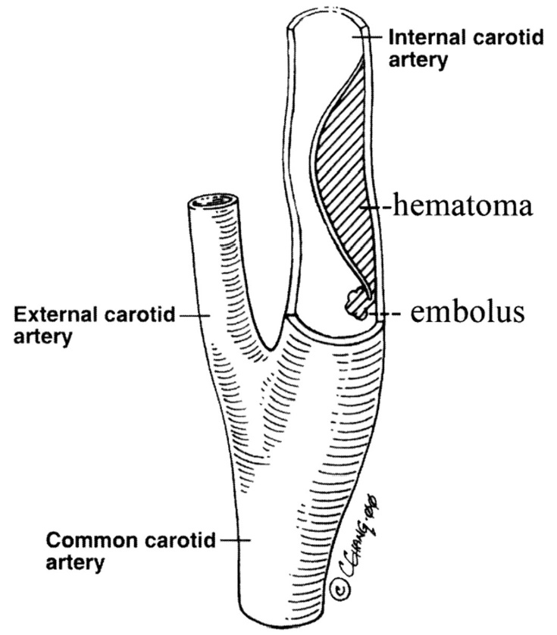
Management: Cervical Artery Dissection
Extracranial carotid OR vertebral arterial dissection
AND
Ischemic stroke or TIA
Antithrombotic therapy for at least three months
(Class 1)
In patients with ischemic stroke or TIA who are <3 months after an extracranial carotid or vertebral arterial dissection, it is reasonable to use either aspirin or warfarin to prevent recurrent stroke or TIA. (Class 2a)
Recurrent events despite antithrombotic therapy
Sudden neck movement and cervical artery dissection
John W. Norris, Vadim Beletsky, Zurab G. Nadareishvili and
on behalf of the Canadian Stroke Consortium
CMAJ July 11, 2000 163 (1) 38-40;
Endovascular therapy
(Class 2b)
Abbreviation: TIA indicates transient ischemic attack.

Slide 31
Hypercoagulable States: Hematologic Traits
COR | RECOMMENDATIONS
2a | In patients with ischemic stroke or TIA of unknown source despite thorough diagnostic evaluation and no other thrombotic history who are found to have prothrombin 20210A mutation, activated protein C resistance, elevated factor VIII levels, or deficiencies of protein C, protein S, or antithrombin III, antiplatelet therapy is reasonable to reduce the risk of recurrent stroke or TIA.
Abbreviations: TIA indicates transient ischemic attack.

Slide 32
Hypercoagulable States: Antiphospholipid Syndrome
COR | LOE | RECOMMENDATIONS
1 | B-NR | In patients with ischemic stroke or transient ischemic attack who have an isolated antiphospholipid antibody but do not fulfill the criteria for antiphospholipid syndrome, antiplatelet therapy alone is recommended to reduce the risk of recurrent stroke.
2a | B-R | In patients with ischemic stroke or transient ischemic attack with confirmed antiphospholipid syndrome, treated with warfarin, it is reasonable to choose a target international normalized ratio between 2-3 over a target international normalized ratio > 3 to effectively balance the risk of excessive bleeding against the risk of thrombosis.
2a | C-LD | In patients with ischemic stroke or transient ischemic attack who meet the criteria for the antiphospholipid syndrome, it is reasonable to anticoagulate with warfarin to reduce the risk of recurrent stroke or transient ischemic attack.
3 HARM | B-R | In patients with ischemic stroke or transient ischemic attack, antiphospholipid syndrome with history of thrombosis and triple positive aPL antibodies (i.e., lupus anticoagulant, anticardiolipin and anti-beta2-glycoprotein I), rivaroxaban is not recommended because it is associated with excess thrombotic events compared to warfarin.
Abbreviations: aPL indicates antiphospholipid.

Slide 33
Clinical Management: Hyperhomocysteinemia
Elevated serum homocysteine levels have been
associated with elevated risk of stroke
however
COR | RECOMMENDATIONS
3 NO BENEFIT | In patients with ischemic stroke or transient ischemic attack with hyperhomocysteinemia, supplementation with folate, vitamin B6, and vitamin B12 is not effective for preventing subsequent stroke.

Slide 34
Clinical Management: Sickle Cell Disease
SCD and Ischemic stroke/TIA
Transfusion therapy available
Transfusion therapy unavailable
Chronic blood transfusion(s)
to reduce hemoglobin S to <30% of total hemoglobin is recommended for the prevention of recurrent ischemic stroke
(Class 1)
Hydroxyurea
(Class 2a)
Abbreviations: Hgb indicates hemoglobin; SCD, sickle cell disease; and TIA, transient ischemic attack.

Slide 35
Recommendations for Autoimmune and Infectious Vasculitis
COR | RECOMMENDATIONS
1 | In patients with ischemic stroke or transient ischemic attack and symptoms attributed to giant cell arteritis, immediate initiation of oral high-dose glucocorticoids is recommended to reduce recurrent stroke risk.
2a | In patients with ischemic stroke or transient ischemic attack and diagnosis of giant cell arteritis, methotrexate or tocilizumab therapy adjunctive to steroids is reasonable to lower the risk of recurrent stroke. In patients with ischemic stroke or transient ischemic attack and diagnosis of primary central nervous system angiitis, induction therapy with glucocorticoids and/or immunosuppressants followed by long-term maintenance therapy with steroid-sparing immunosuppressants is reasonable to lower the risk of stroke recurrence.
3 HARM | In patients with ischemic stroke or transient ischemic attack and confirmed diagnosis of giant cell arteritis, infliximab is associated with recurrent ocular symptoms and markers of disease activity and should not be administered.
COR | RECOMMENDATIONS
1 | In patients with ischemic stroke or transient ischemic attack and infectious vasculitis such as varicella zoster virus cerebral vasculitis, neurosyphilis, bacterial meningitis, treating the underlying infectious etiology is indicated to reduce the risk of stroke.
2a | In patients with ischemic stroke or transient ischemic attack in the context of human immunodeficiency virus vasculopathy, daily aspirin plus human immunodeficiency virus viral control with combined antiretroviral therapy is reasonable to reduce risk of recurrent stroke.

Slide 36
Recommendations for Genetic Disorders
COR | RECOMMENDATIONS
1 | In patients with ischemic stroke or transient ischemic attack and cystathionine beta-synthase deficiency, pyridoxine (in responsive patients) and a low methionine, cysteine-enhanced diet supplemented with pyridoxine, vitamin B12 and folate is recommended to reduce plasma homocysteine to population normal levels and thereby reduce risk of recurrent ischemic stroke.
2b | In patients with ischemic stroke or transient ischemic attack and Anderson-Fabry Disease, agalsidase alfa or agalsidase beta is of uncertain value in preventing recurrent stroke or TIA.
Recommendations for Carotid Webs
COR | RECOMMENDATIONS
1 | In patients with carotid web in the distribution of ischemic stroke and transient ischemic attack, without other attributable cause of stroke, antiplatelet therapy is recommended to prevent recurrent ischemic stroke or transient ischemic attack.
2b | In patients with carotid web in the distribution of ischemic stroke refractory to medical management, with no other attributable cause of stroke despite comprehensive work-up, carotid stenting or carotid endarterectomy may be considered to prevent recurrent ischemic stroke.
Abbreviation: TIA indicates transient ischemic attack.

Slide 37
Recommendations for Fibromuscular Dysplasia
COR | RECOMMENDATIONS
1 | In patients with fibromuscular dysplasia and a history of ischemic stroke or transient ischemic attack without other attributable causes, antiplatelet therapy, blood pressure control and lifestyle modification is recommended for the prevention of future ischemic events.
2a | In patients with a history of ischemic stroke or transient ischemic attack attributable to dissection, fibromuscular dysplasia, and no evidence of intraluminal thrombus, it is reasonable to administer antiplatelet therapy for the prevention of future ischemic events.
2b | In patients with cervical carotid artery fibromuscular dysplasia and recurrent ischemic stroke without other attributable causes despite optimal medical management, carotid angioplasty with or without stenting may be reasonable to prevent ischemic stroke.
Recommendations for Dolichoectasia
COR | RECOMMENDATIONS
2a | In patients with vertebrobasilar dolichoectasia and history of prior ischemic stroke or transient ischemic attack without other attributable causes, the use of antiplatelet or anticoagulant therapy is reasonable for the prevention of recurrent ischemic events.

Slide 38
Recommendations for ESUS
ESUS: non-lacunar cryptogenic ischemic stroke (after imaging of proximal large vessels, echocardiogram, rhythm monitoring with debate in duration of rhythm monitoring required)
COR | RECOMMENDATIONS
3 HARM | In patients with embolic stroke of undetermined source, treatment with direct oral anticoagulants is not recommended to reduce risk of secondary stroke.
3 HARM | In patients with embolic stroke of undetermined source, treatment with ticagrelor is not recommended to reduce risk of secondary stroke.
Abbreviations: ESUS indicates embolic stroke of unknown source.

Slide 39
Recommendations for Antithrombotic Medication
COR | RECOMMENDATIONS
1 | In patients with noncardioembolic ischemic stroke or TIA, antiplatelet therapy is indicated in preference to oral anticoagulation to reduce the risk of recurrent ischemic stroke and other cardiovascular events while minimizing the risk of bleeding
1 | For patients with noncardioembolic ischemic stroke or TIA, aspirin 50 to 325mg daily, clopidogrel 75mg, or the combination of aspirin 25mg and extended release dipyridamole 200mg twice daily is indicated for secondary prevention of ischemic stroke.
1 | For patients with recent minor (NIHSS ≤3) noncardioembolic ischemic stroke or high-risk TIA (ABCD² score ≥4), DAPT (aspirin plus clopidogrel) should be initiated early (ideally within 12-24 hours of symptom onset and at least within 7 days of onset) and continued for 21-90 days, followed by single antiplatelet therapy, to reduce the risk of recurrent ischemic stroke.
2b | For patients with recent (< 24 hours) minor to moderate stroke (NIHSS ≤5), or high-risk TIA (ABCD² score ≥6), or symptomatic intra- or extracranial ≥30% stenosis of an artery that could account for the event, DAPT with ticagrelor plus aspirin for 30 days may be considered to reduce the risk of 30-day recurrent stroke but may also increase the risk of serious bleeding events including ICH .
2b | For patients already taking aspirin at the time of noncardioembolic ischemic stroke or TIA, the effectiveness of increasing the dose of aspirin or changing to another antiplatelet medication is not well established.
3 HARM | For patients with noncardioembolic ischemic stroke or TIA, the continuous use of DAPT (aspirin plus clopidogrel) for >90 days, or the use of triple antiplatelet therapy, are associated with excess risk of hemorrhage.
Abbreviations: DAPT indicates dual antiplatelet therapy; ICH, Intracranial hemorrhage; NIHSS, National Institutes of Health Stroke Scale; and TIA, transient ischemic attack.

Slide 40
Figure 6. Antiplatelet Therapy For Non-Cardioembolic Stroke and Transient Ischemic Attack
Non- cardioembolic Ischemic Stroke or Transient Ischemic Attack
Ischemic Stroke (IS)
Transient Ischemic Attack
Early IS?
YES
NO
NIHSS ≤3?
High Risk?
NO
NO
YES
YES
0-90 days
Dual Antiplatelet
(Class 1)
Single
Antiplatelet
Dual Antiplatelet
(Class 1)
>90 days
Single Antiplatelet
(Class 1)
Single Antiplatelet
(Class 1)
Note: Algorithm does not apply to patients who receive acute thrombolysis.
Note: Please see Section 5.1.1. for recommendations related to severe symptomatic intracranial large vessel stenosis
Abbreviations: IS, ischemic stroke; NIHSS, National Institutes of Health Stroke Scale; and TIA, transient ischemic attack.

Slide 41
Health Systems–Based Interventions for Secondary
Stroke Prevention
RECOMMENDATION SUMMARY
COR | RECOMMENDATIONS
1 | 1. In patients with ischemic stroke or TIA, voluntary hospital-based or outpatient-focused quality monitoring and improvement programs are recommended to improve short-term and long-term adherence to nationally accepted, evidence-based guidelines for secondary stroke prevention.
2a | 2. In patients with ischemic stroke or TIA, a multidisciplinary outpatient team-based approach (ie, care provision with active medication adjustment from advanced practice providers, nurses, or pharmacists) can be effective to control BP, lipids, and other vascular risk factors.
2a | 3. In patients presenting to their primary care provider as the first contact after TIA or minor stroke, it is reasonable to use a decision support tool that improves diagnostic accuracy, stratifies patients in risk categories to support appropriate triage, and prompts the initiation of medications and counseling for lifestyle modification for secondary stroke prevention to reduce the 90-day risk of recurrent stroke or TIA.
Abbreviations: BP indicates blood pressure; TIA; transient ischemic attack.

Slide 42
Health Equity
Recommendations for Health Equity in Patients with Stroke or TIA
COR | RECOMMENDATIONS
1 | Evaluating and addressing social determinants of health (such as literacy level, language proficiency, medication affordability, food insecurity, housing, and transportation barriers) when managing stroke risk factors is recommended to reduce health care disparities. Monitoring the achievement of nationally accepted, evidence-based performance measures is recommended to allow inequities to be identified and addressed. Systematic adoption of the AHRQ Universal Precautions Toolkit for Health Literacy is recommended to integrate health literacy into the secondary prevention of stroke.
Recommendation for patients from urban, minority, and/or low SES groups
COR | RECOMMENDATIONS
2b | The optimal intervention model for improving stroke risk factor control and reducing disparities is unknown.
Knowledge Gaps
Health Equity: Understanding of which populations have inequities in risk factor control after stroke. Drivers of inequities in risk factor control after stroke; such as social determinants of health and structural racism. Strategies for improving risk factor control among groups at risk for inequities. Strategies for addressing social determinants of health among stroke survivors.
Abbreviations: AHRQ indicates Agency for Healthcare Research and Quality; SES, socio-economic status; and TIA, transient ischemic attack .

Slide 43
Acknowledgments
Many thanks to our Guideline Ambassadors who were guided by Dr. Elliott Antman in developing this translational learning product in support of the 2021 AHA/ASA Guideline for the Prevention of Stroke in Patients With Stroke and Transient Ischemic Attack
Joseph Carrera, MD
Charles Kircher, MD
Christina Lineback, MD
Adeolu Morawo, MD
Amita Singh, MD
Lily Wenya Zhou, MD
The American Heart Association requests this electronic slide deck be cited as follows:
Carrera, J., Kircher, C., Lineback, C., Morawo, A., Singh, A., Zhou, l. W., Bezanson, J. L., & Antman, E. A. (2021). Clinical Update; Adapted from: 2021 AHA/ASA Guideline for the Prevention of Stroke in Patients With Stroke and Transient Ischemic Attack [PowerPoint slides]. Retrieved from https://professional.heart.org/en/science-news.

