Slide 1
Clinical Update
ADAPTED FROM:
2023 AHA/ASA Guideline for the Management of Patients with Aneurysmal Subarachnoid Hemorrhage

Slide 2
Table 1.
Applying Class of Recommendation and Level of Evidence to Clinical Strategies, Interventions, Treatments, or Diagnostic Testing in Patient Care
CLASS (STRENGTH) OF RECOMMENDATION
CLASS 1 (STRONG) Benefit >>> Risk
Suggested phrases for writing recommendations: Is recommended Is indicated/useful/effective/beneficial Should be performed/administered/other Comparative-Effectiveness Phrases†: Treatment/strategy A is recommended/indicated in preference to treatment B Treatment A should be chosen over treatment B
CLASS 2a (MODERATE) Benefit >> Risk
Suggested phrases for writing recommendations: Is reasonable Can be useful/effective/beneficial Comparative-Effectiveness Phrases†: Treatment/strategy A is probably recommended/indicated in preference to treatment B It is reasonable to choose treatment A over treatment B
CLASS 2b (Weak) Benefit ≥ Risk
Suggested phrases for writing recommendations: May/might be reasonable May/might be considered Usefulness/effectiveness is unknown/unclear/uncertain or not well-established
CLASS 3: No Benefit (MODERATE) Benefit = Risk
Suggested phrases for writing recommendations: Is not recommended Is not indicated/useful/effective/beneficial Should not be performed/administered/other
CLASS 3: Harm (STRONG) Risk > Benefit
Suggested phrases for writing recommendations: Potentially harmful Causes harm Associated with excess morbidity/mortality Should not be performed/administered/other
LEVEL (QUALITY) OF EVIDENCE‡
LEVEL A
High-quality evidence‡ from more than 1 RCT Meta-analyses of high-quality RCTs One or more RCTs corroborated by high-quality registry studies
LEVEL B-R (Randomized)
Moderate-quality evidence‡ from 1 or more RCTs Meta-analyses of moderate-quality RCTs
LEVEL B-NR (Nonrandomized)
Moderate-quality evidence‡ from 1 or more well-designed, well-executed nonrandomized studies, observational studies, or registry studies Meta-analyses of such studies
LEVEL C-LD (Limited Data)
Randomized or nonrandomized observational or registry studies with limitations of design or execution Meta-analyses of such studies Physiological or mechanistic studies in human subjects
LEVEL C-EO (Expert Opinion)
Consensus of expert opinion based on clinical experience.
COR and LOE are determined independently (any COR may be paired with any LOE).
A recommendation with LOE C does not imply that the recommendation is weak. Many important clinical questions addressed in guidelines do not lend themselves to clinical trials. Although RCTs are unavailable, there may be a very clear clinical consensus that a particular test or therapy is useful or effective.
*The outcome or result of the intervention should be specified (an improved clinical outcome or increased diagnostic accuracy or incremental prognostic information).
†For comparative-effectiveness recommendation (COR 1 and 2a; LOE A and B only), studies that support the use of comparator verbs should involve direct comparisons of the treatments or strategies being evaluated.
‡The method of assessing quality is evolving, including the application of standardized, widely-used, and preferably validated evidence grading tools; and for systematic reviews, the incorporation of an Evidence Review Committee.
COR indicates Class of Recommendation; EO, expert opinion; LD, limited data; LOE, Level of Evidence; NR, nonrandomized; R, randomized; and RCT, randomized controlled trial.

Slide 3
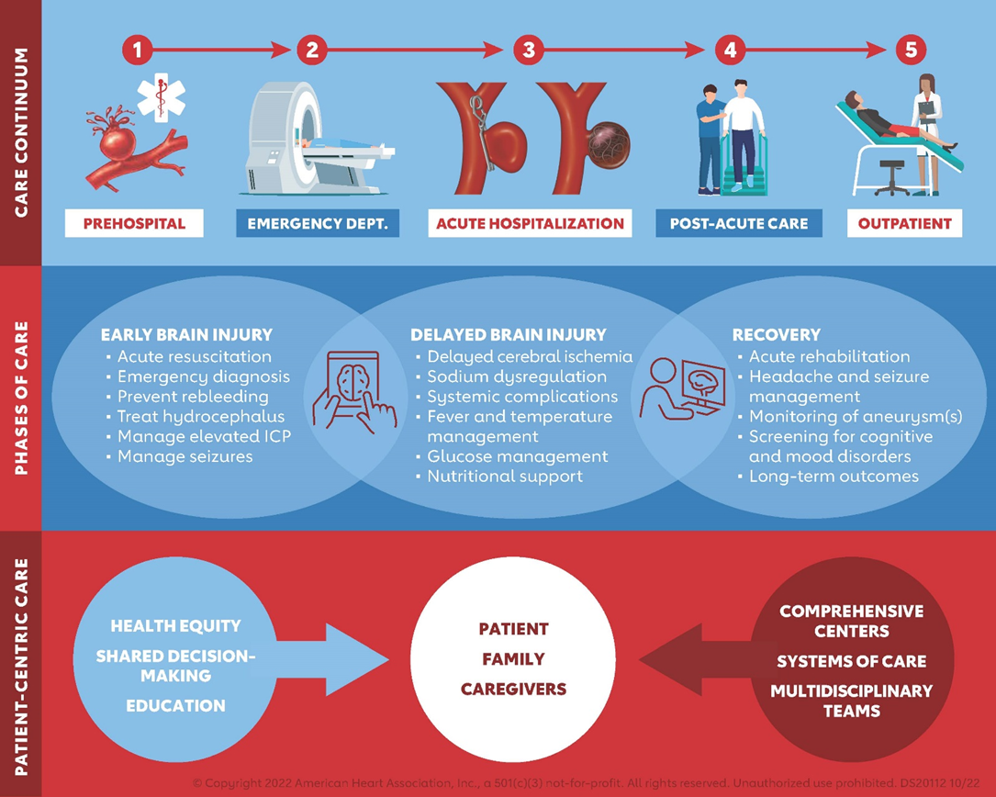
Care Continuum of Aneurysmal Subarachnoid Hemorrhage (aSAH) Patient

Slide 4







Significance of aSAH
MAJOR RISK FACTORS
Usually afflicts individuals in their working years. Average age of 55 yrs
26% of pts will die before arriving to the hospital
13% of pts will die during hospitalization
Family Hx
12% prevalence of harboring a cerebral aneurysm in Individuals with > 2 1st degree relatives w/known cerebral aneurysm
Hypertension
Smoking tobacco
RADIOLOGIC SCREENING
Cost-effective when performed every 5-7 yrs for individuals 20-80 yrs old w/family hx. of > 2 1st degree relatives with known cerebral aneurysms.
Abbreviations: aSAH indicates aneurysmal subarachnoid hemorrhage; DCI, delayed cerebral ischemia; hx, history; pts, patients; w/, with; and yrs years.

Slide 5



Mechanisms of aSAH-Associated Brain Injury
Pathophysiology of delayed cerebral ischemia (DCI):
Arteriolar constriction
Cerebral microembolism
Cortical spreading depolarization
Blood brain barrier breakdown
Cerebral autoregulation impairment
Capillary transit time heterogeneity
Strategies for reduction in case fatality and improved acute outcome
Early repair of the ruptured aneurysm (endovascular coiling or neurosurgical clipping)
Management in specialized neurologic ICUs with multidisciplinary clinical groups
Focused tx of cerebral edema, hydrocephalus and elevated ICP
Tx of DCI
Tx of medical complications
Chronic morbidity in the following:
Cognitive recovery
Mood disorders
QOL
Abbreviations: aSAH indicates aneurysmal subarachnoid hemorrhage; DCI, delayed cerebral ischemia;
ICP, intracranial pressure; ICU, intensive care unit; QOL, quality of life; and tx, treatment.

Slide 6




Recommendations for Natural History and Outcome of aSAH
Utilizing clinical scales (e.g., HH grade or WFNS grade) is recommended to determine initial clinical severity and predict outcome. (Class 1)
In high-grade aSAH, aneurysm tx is reasonable, after careful discussion of likely prognosis with family members, to optimize patient outcome. (Class 2a)
In aSAH and advanced age, aneurysm tx is reasonable, after careful discussion of prognosis with family members, to improve survival and outcome. (Class 2a)
In patients with aSAH who do not improve after correction of modifiable conditions and are deemed unsalvageable due to evidence of irreversible neurological injury, tx of the aneurysm is not beneficial. (Class 3: No Benefit)
Abbreviations: aSAH indicates aneurysmal subarachnoid hemorrhage; BMI, body mass index; CRP, C-reactive protein;
CSF, cerebrospinal fluid; HH: Hunt & Hess grade; tx, treatment; and WFNS: World Federation of Neurosurgical Societies.

Slide 7

Clinical Manifestations and Diagnosis:
Acute Evaluation
Initial Assessment Checklist
Time of symptom onset
Headache characteristics
  “Worst headache of life”
  Sudden onset
  Sentinel (10-43%)
Presence of New Neurological Deficit
Ottawa SAH Rule
(Class 2b recommendation for identifying high-risk patients)
  100% sensitive
For alert patients > 15 years of age with new severe nontraumatic headache reaching maximum intensity within 1 hour. Patients require additional investigation for SAH if they meet any of the following criteria:
Age>= 40 years
Neck pain or stiffness
Witnessed loss of consciousness
Onset during exertion
Thunderclap headache
(instantly peaking pain)
Limited neck flexion on examination
Abbreviation: SAH indicates subarachnoid hemorrhage.

Slide 8
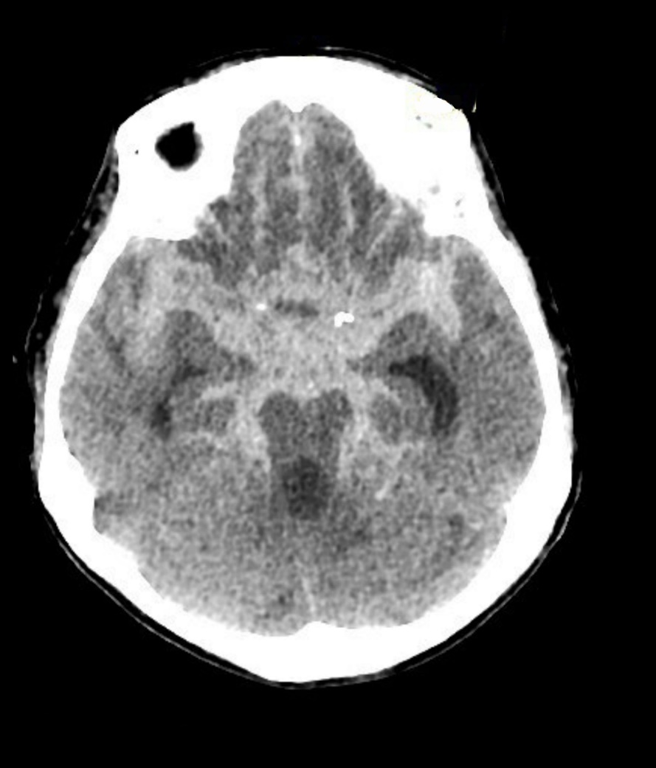
Clinical Manifestations and Diagnosis: Workflow
Patient presents with acute onset severe headache
Appy Ottawa SAH at physician discretion (Class 2b)
< 6 hours and new neuro deficit
≥6 hours or new neuro deficit
Noncontrast head CT (Class 2a)
Noncontrast head CT (Class 1)
NO
SAH Dx?
YES
YES
SAH Dx?
NO
Work-up at physician discretion
Lumbar Puncture (Class 1)
CTA/DSA (Class 1)
YES
Determine optimal tx strategy
Xanthochromia Dx
Work-up at physician discretion
NO
Abbreviations: CT indicates computed tomography; CTA, computed tomography angiography; DSA, digital subtraction angiography; dx, diagnosis; SAH, subarachnoid hemorrhage; and tx, treatment.

Slide 9
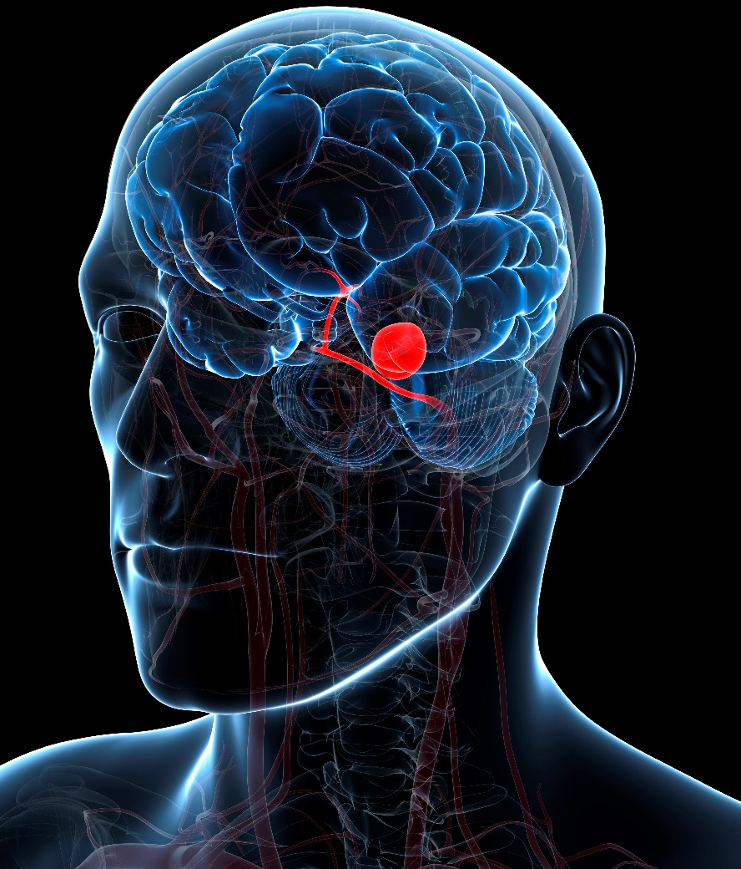
Clinical Manifestations and Diagnosis:
Evaluation for Cause
Findings Favoring Aneurysmal Cause
Location of Subarachnoid Blood
  Diffuse Basal Cistern
  Sylvian Fissure
  Interhemispheric fissure
  Interpeduncular Cisterns
Associated Intraparenchymal Hematoma
Relevant Aneurysm Characteristics
Location of Aneurysm
  Anterior vs. Posterior Circulation
Morphology
Fusiform vs. Blister vs. Saccular
DSA is the gold-standard modality for the evaluation of cerebrovascular anatomy and aneurysm geometry and can aid in the decision-making regarding the choice of optimal treatment modality. (Class 1)
Abbreviation: DSA indicates digital subtraction angiography.

Slide 10






Hospital Characteristics and System of Care
Timely transfer from hospitals with low case volume to higher volume centers with multi-disciplinary neurointensive care services, comprehensive stroke center capabilities, and experienced proceduralists is recommended to improve outcomes. (Class 1)

Slide 11












Hospital Characteristics and System of Care
For patients with aSAH, care should be provided in a dedicated neurocritical care unit by a multidisciplinary team (Class 1)
Abbreviation: aSAH indicates aneurysmal subarachnoid hemorrhage.

Slide 12


Blood Pressure Control with Unsecured Aneurysm
Target BP is individualized according to:
BP at presentation
Brain swelling
Hydrocephalus
History of hypertension or renal impairment
Avoid Hypertension (>180-200 mm Hg)
Minimize BP variability
Avoid Hypotension (MAP < 65 mm Hg)
BP controlled with frequent monitoring and short-acting medications. (Class 1)
Abbreviations: BP indicates blood pressure; MAP, mean arterial pressure and mm hg, millimeters of mercury.

Slide 13

Attaining Hemostasis
DO
DO NOT
Emergent anticoagulation reversal with appropriate reversal agents should be performed to prevent re-bleeding in patients receiving anticoagulants.
(Class 1)
Routine use of antifibrinolytic therapy is not useful to improve functional outcome.
(Class 3: No Benefit)

Slide 14


Treatment of Ruptured Cerebral Aneurysms
Timing
Treatment Goals
Treatment within 24 hrs from onset of aSAH is preferrable
(Class 1)
Complete obliteration is preferred to reduce risk of re-bleeding
(Class 1)
It is reasonable to re-treat partial obliteration aSAH to prevent re-bleeding (Class 2a)
Abbreviations: aSAH indicates aneurysmal subarachnoid hemorrhage; and hrs, hours.

Slide 15
Treatment of Ruptured Cerebral Aneurysms
General Principles for Management of aSAH
Ruptured aSAH should be evaluated by specialists with endovascular and/or neurosurgical expertise.
(Class 1)
Patients deemed salvageable and with depressed level of consciousness due to large IPH should undergo emergent clot evacuation to reduce mortality.
(Class 1)
Abbreviations: aSAH indicates aneurysmal subarachnoid hemorrhage; and IPH, intraparenchymal hemorrhage.

Slide 16

Surgical and Endovascular Treatment of
Ruptured Cerebral Aneurysms
Type of Aneurysm
Aneurysm Clip
Aneurysm Coil
Flow Diverter
Stent Assisted Coiling
Anterior
Circulation
Posterior
Circulation
Wide-neck
Fusiform
Saccular
YES
YES
Coiling preferred to clipping to improve
1-year functional outcome
(Class 1)
Coiling equivalent to clipping in long-term outcome
(Class 2a)
Coiling preferred to clipping to improve outcome
(Class 1)
Flow-diverters can decrease mortality and rebleed risk
(Class 2a)
Flow-diverters can
increase complications
(Class 3: Harm)

Slide 17


Treatment of Ruptured Cerebral Aneurysms
aSAH Surgical and Endovascular Management
Location of Aneurysm
Age of Patient
Type of Aneurysm
Anterior
Posterior
Age > 70
Age < 40
Wide Neck
Fusiform/blister aneurysms
Coiling preferred over to clipping for 1-year outcome
(Class 1)
Coiling equal to clipping in
long term
(Class 2a)
Coiling preferred (Class 1)
Unclear on best treatment (Class 2b)
Clipping preferred (Class 2b)
Stent assisted coiling or flow diverter stent/flow diverter is reasonable ONLY if aneurysm can not be primarily coiled or surgically treated
(Class 2a)
Use of flow diverting stents is reasonable
(Class 2a)
Abbreviations: aSAH indicates aneurysmal subarachnoid hemorrhage.

Slide 18
Surgical and Endovascular Treatment:
Anesthetic Management
COR | RECOMMENDATIONS
2a | Intraoperative use of mannitol and/or hypertonic saline can be effective in reducing ICP and cerebral edema.
2a | Anesthetic goals should include minimizing postprocedural pain, nausea, and vomiting.
2a | Prevention of intraoperative hyper and hypoglycemia during aneurysm surgery is reasonable to improve outcomes.
2a | In aSAH and an unsecured ruptured aneurysm, frequent intraoperative blood pressure monitoring and blood pressure control is reasonable to prevent ischemia and re-rupture.
2b | Intraoperative neuromonitoring may be reasonable to guide anesthetic and operative management. †
2b | In aSAH and an uncontrolled intraoperative aneurysmal rupture, adenosine may be considered to facilitate aneurysm clip placement by inducing cardiac standstill and temporary profound pause. ‡
3: NB | In good grade aSAH, the routine use of induced mild hypothermia during aneurysm surgery is not beneficial.
†Intraoperative neuromonitoring modalities include spontaneous EE, evoked somatosensory, and evoked motor potentials.
‡Adenosine contraindications include sinus node disease, second or third-degree AV block, or BC or BS lung disease.
Note: Recommend cautious use of adenosine in patients with first degree AV block, bundle branch block, or history of heart transplant
Abbreviations: aSAH indicates aneurysmal subarachnoid hemorrhage; BC, bronchoconstrictive; BS, bronchospastic;
COR, Classification of Recommendation; EE, electrical activity; ICP, intracranial pressure monitoring; and NB, no benefit.

Slide 19
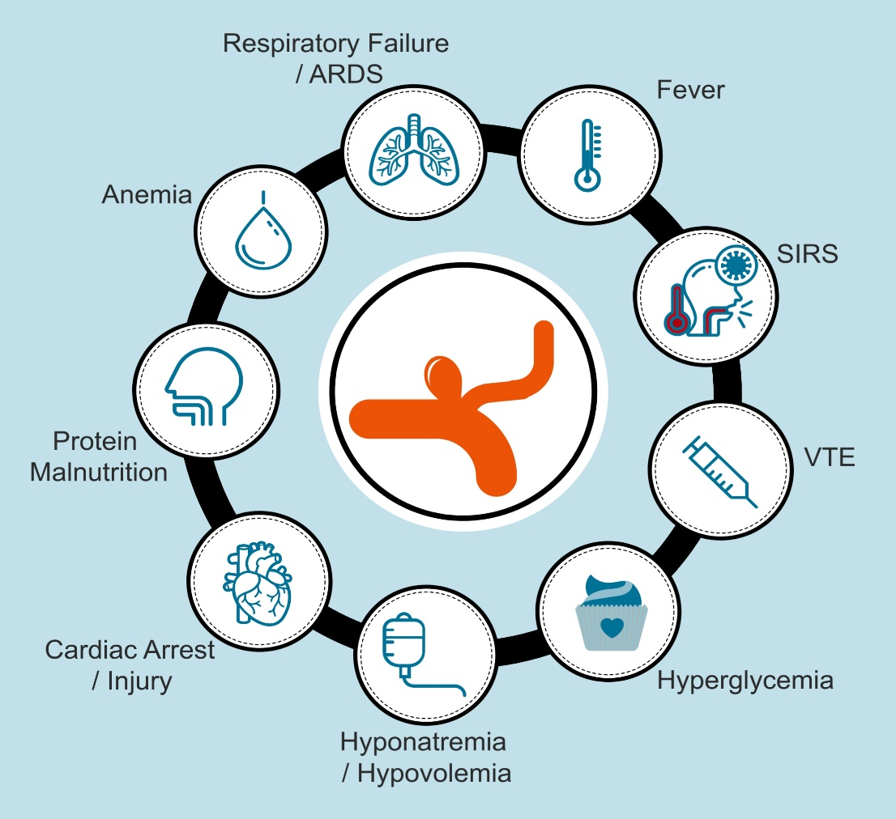
Management of Medical Complications Associated with aSAH
aSAH patients with medical complications have worse outcomes.
Abbreviations: ARDS indicates acute respiratory distress syndrome; aSAH, aneurysmal subarachnoid hemorrhage;
SIRS, systemic inflammatory response syndrome; and VTE, venous thromboembolism.

Slide 20
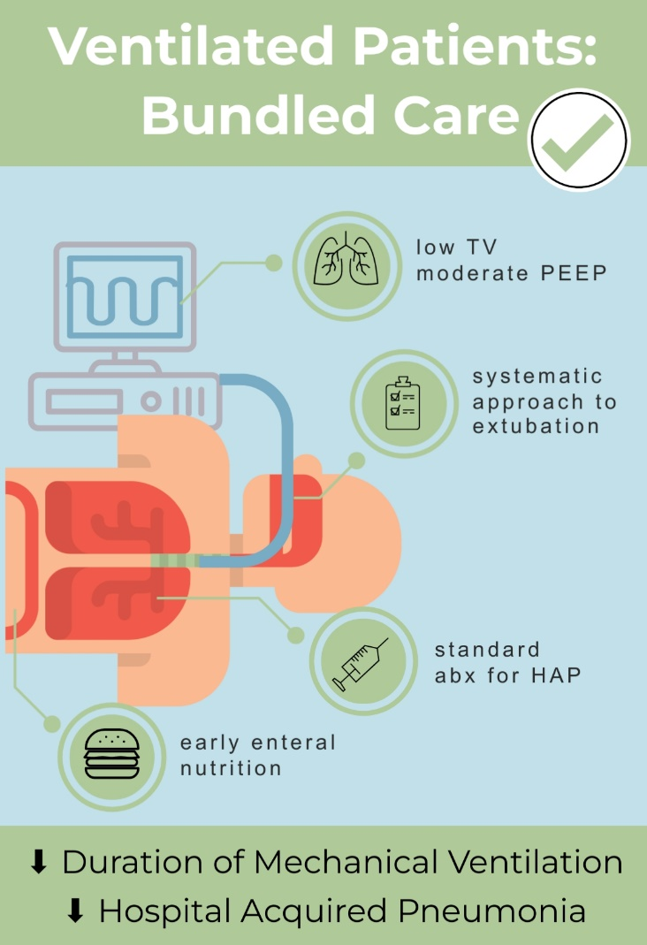
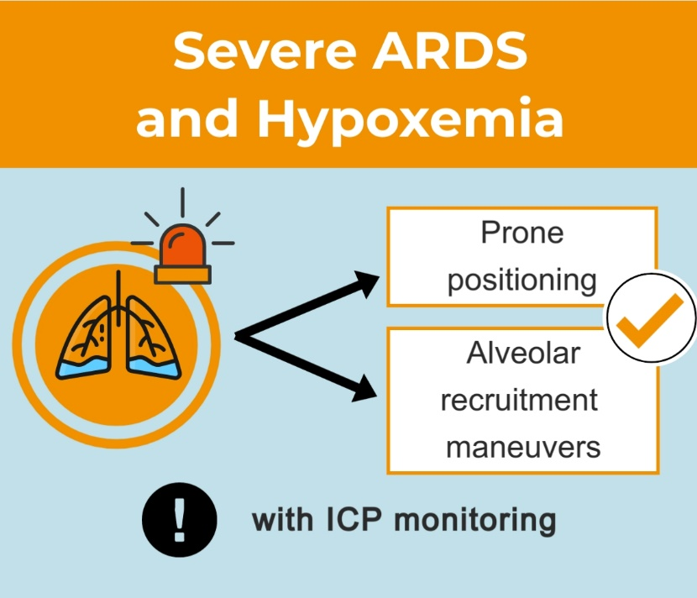
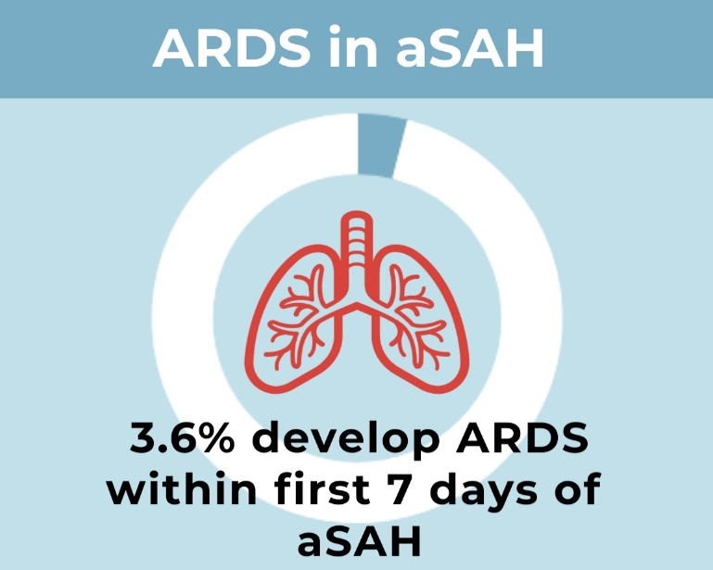
Management of Medical Complications Associated with aSAH
Abbreviations: abx indicates antibiotics; ARDS, acute respiratory distress syndrome; aSAH, aneurysmal subarachnoid hemorrhage; HAP, hospital acquired pneumonia; ICP, intracranial pressure; PEEP, positive end-expiratory pressure; and TV, tidal volume.

Slide 21

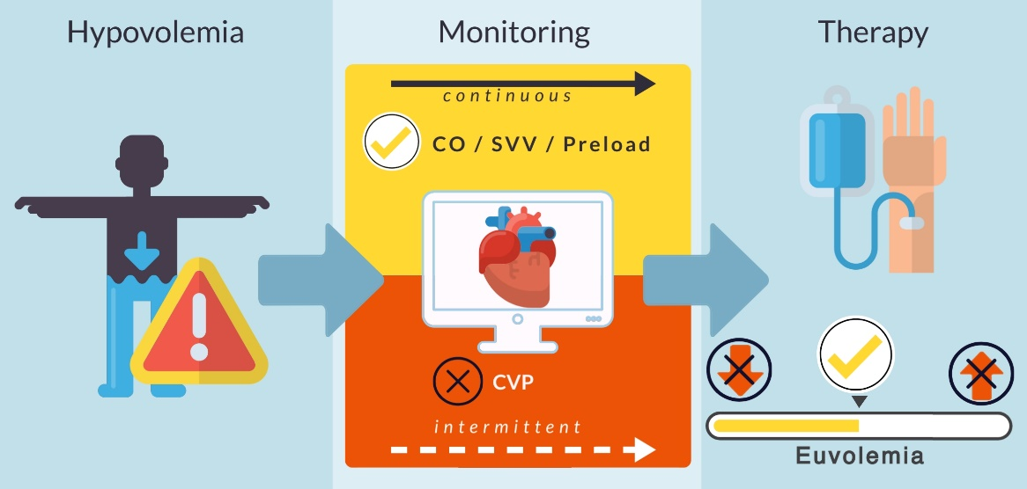
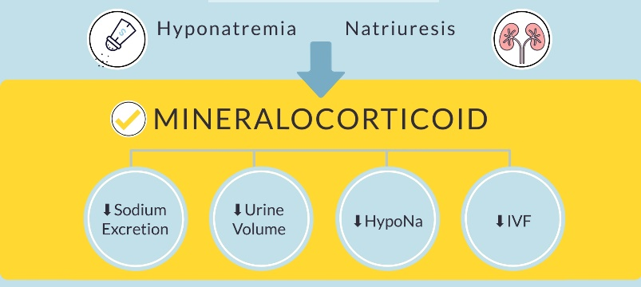
Management of Medical Complications Associated with aSAH
INTRAVASCULAR VOLUME AND ELECTROLYTE MANAGEMENT
Hypovolemia/Hypervolemia
Natriuresis
Hyponatremia
DCI
Poor Outcomes
Abbreviations: CO indicates cardiac output; CVP, central venous pressure; DCI, delayed cerebral ischemia; HypoNa, hyponatremia; IVF, intravenous fluids; and SVV, stroke volume variability.

Slide 22
Management of Medical Complications
Associated with aSAH
Other Considerations
Glycemic Control
VTE
Fever
COR | RECOMMENDATIONS
1 | In patients with aSAH whose ruptured aneurysm has been secured, pharmacologic or mechanical VTE prophylaxis is recommended to reduce the risk for VTE.
2a | In patients with aSAH, effective glycemic control, strict hyperglycemia management and avoidance of hypoglycemia is reasonable to improve outcome.
2b | In patients with aSAH with fever refractory to antipyretic medications, the effectiveness of therapeutic temperature management during the acute phase of aSAH is uncertain.
Abbreviations: aSAH indicates aneurysmal subarachnoid hemorrhage; and VTE, venous thromboembolism.

Slide 23
Nursing Interventions
DCI Detection
Frequent neurological assessment using a neurological assessment tool (GCS, NIHSS, etc)(Class 1)
Neurological
Change Detection
Frequent vital sign and neurological monitoring
(Class 1)
Prevention of
Secondary Problems
Aspiration Prevention
Validated dysphagia screening protocol prior to initiation of oral intake
(Class 1)
Improve
Functional Outcomes
Early, evidence-based mobility algorithm once aneurysm is secured
(Class 2a)
Abbreviations: DCI indicates delayed cerebral ischemia; GCS, Glasgow Coma Scale; and NIHSS, National Institutes of Health Stroke Scale.

Slide 24

Standardized Nursing Care
COR | RECOMMENDATIONS
1 | Use of evidence-based protocols and order sets is recommended to improve standardization of care.
2a | Specialized nursing stroke competencies and certification can positively impact outcomes, timeliness of care, and adherence to stroke protocols.
Notes:
Image: Getty Images, Checking off items in a to do list– stock photo.
https://www.gettyimages.com/detail/photo/checking-off-items-in-a-to-do-list-royalty-free-image/137565172?adppopup=true

Slide 25
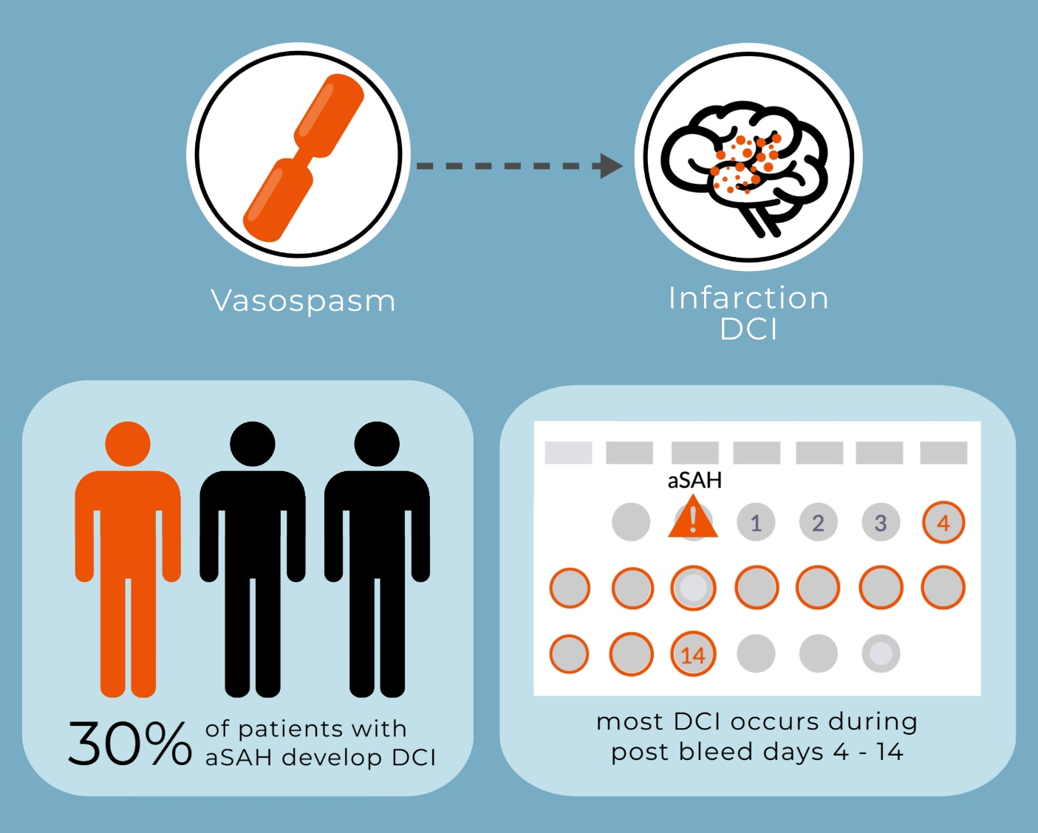
Monitoring and Detection of Cerebral Vasospasm and DCI
Abbreviations: aSAH indicates aneurysmal subarachnoid hemorrhage; and DCI, delayed cerebral ischemia.

Slide 26
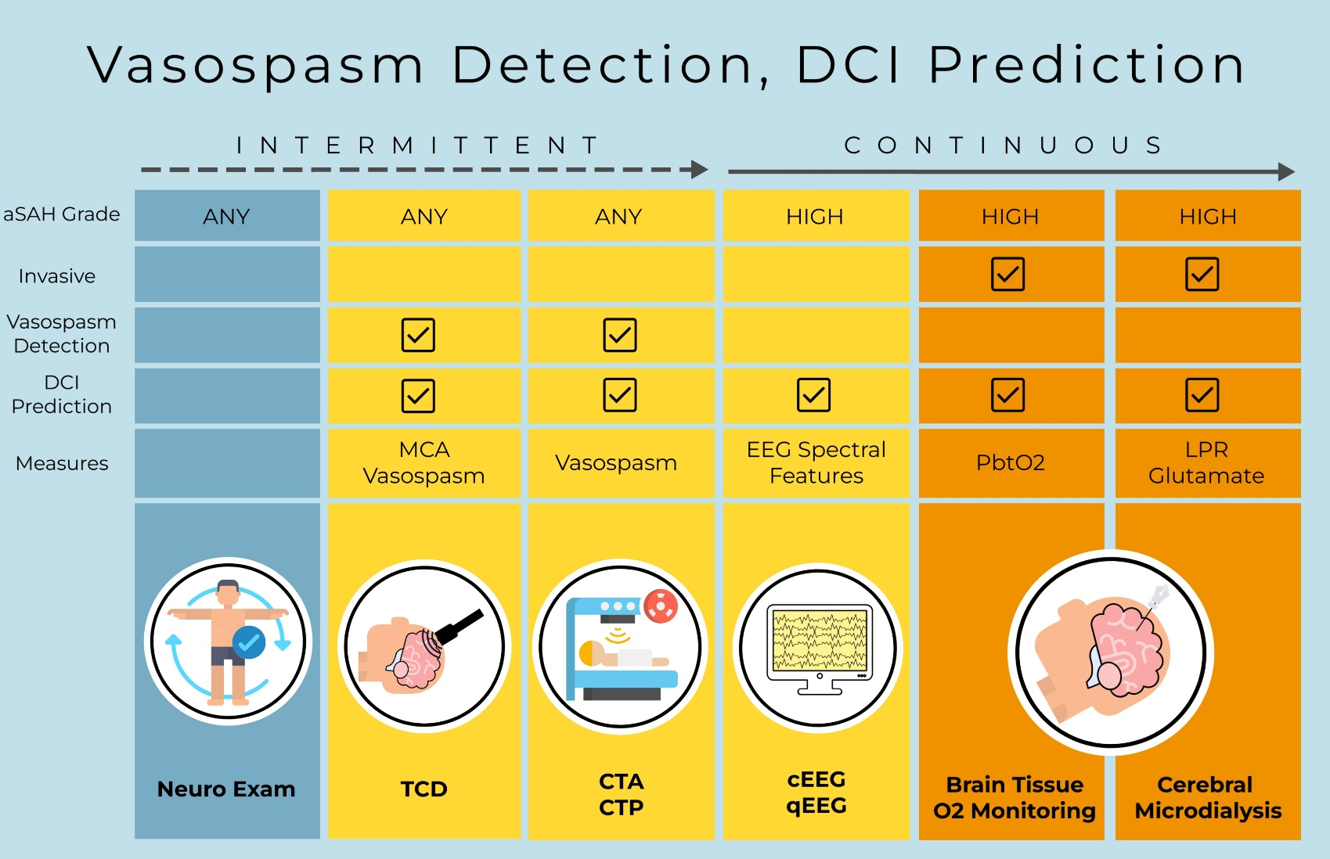
Monitoring and Detection of Cerebral Vasospasm and DCI
Abbreviations: aSAH indicates aneurysmal subarachnoid hemorrhage; cEEG, continuous electroencephalogram; CTA, computed tomography angiography; CTP, computed tomography perfusion; DCI, delayed cerebral ischemia; EEG, electroencephalogram; LPR, lactate pyruvate ratio; O2, oxygen; PbtO2, brain tissue oxygen pressure; qEEG, quantified electroencephalogram; and TCD, transcranial doppler.

Slide 27
Management of Patients with Cerebral Vasospasm and DCI After aSAH
Patients with aSAH
Oral nimpdipine (Class 1)*
Regular neurological exams (Class 1) †
Reliable Neurologic Exam
Unreliable Neurologic Exam
Consider invasive multimodality
neuromonitoring
(Class 2b) ‡
TCD monitoring (Class 2a) ‡
TCD monitoring, cEEG (Class 2a)‡
Avoid prophylactic hemodynamic augmentation (Class 3: Harm)*
Worsening neurologically or on monitoring when neurological exam is unreliable
Address exam confounders; Elevate BP; Ensure euvolemia;
Additional imaging as indicated (e.g. CT/CTA (Class 2a)* ‡
NO
Worsening resolves?
YES
Proceed to endovascular rescue therapy with IA spasmolytic+/- angioplasty (Class 2b)*
Continue monitoring (Class 1) †
* Section 8.3 Management of Cerebral Vasospasm and DCI after aSAH
† Section 8.1 Nursing Interventions and Activities
‡ 8.2 Monitoring and Detection of Cerebral Vasospasm
NO
NO
Worsening resolves?
YES
Imaging for DCI explains deficit or other explanation for exam?
YES
Abbreviations: aSAH indicates aneurysmal subarachnoid hemorrhage; BP, blood pressure; CT, computed tomography; CTA, computed tomography angiography; DCI, delayed cerebral ischemia/injury; cEEG, continuous electroencephalography; IA, intra-arterial; and TCD, transcranial doppler.

Slide 28
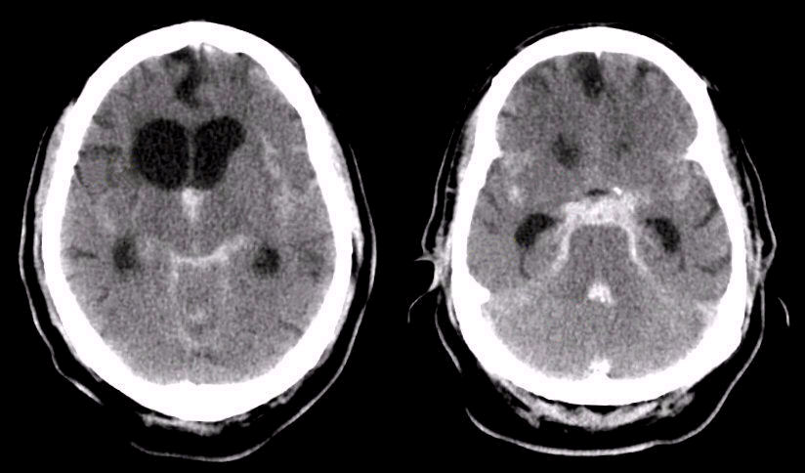
Management of Hydrocephalus
Associated with aSAH
Hydrocephalus in aSAH
Acute hydrocephalus
(Occurs in 15-87% of aSAH pts)
Persistent or chronic hydrocephalus
(Occurs in 8.9-48% of aSAH pts)
Urgent CSF diversion with EVD or lumbar drain (Class 1)
Permanent CSF diversion (Class 1)
Depending on hemorrhage/hydrocephalus pattern
Routine fenestration of the lamina terminalis is not indicated for reducing the rate of shunt-dependency
(Class 3: No Benefit)
Bundled EVD protocol
(Class 1)
OR
Lumbar drain (Class 1)
Abbreviations: aSAH indicates aneurysmal subarachnoid hemorrhage; CSF, cerebrospinal fluid; EVD, external ventricular drain; and pts, patients.

Slide 29

Management of Hydrocephalus Associated with aSAH
Increased age
Poor admission neurological grade
High Fisher grades
Predictors of shunt-dependency
in aSAH
Meningitis Prolonged period of EVD
Presence of IVH Acute hydrocephalus
Persistent or chronic shunt-dependent hydrocephalus
Occurs in 8.9% to 48% of patients with aSAH
Ruptured posterior circulation artery aneurysm or Acom aneurysm
Surgical clipping Endovascular coiling
Rebleeding Cerebral vasospasm
Abbreviations: Acom indicates anterior communicating artery; aSAH, aneurysmal subarachnoid hemorrhage; EVD, external ventricular drain; and IVH, intraventricular hemorrhage.

Slide 30




Management of Hydrocephalus Associated with aSAH
Insertion
Monitoring
EVD set up
Aseptic technique
Skin preparation
EVD insertion location and provider
Catheter selection
Procedure timeout
Number of EVD catheter days
Rates of infection
Utilization of EVD order panel
EVD infection control bundled protocol
(Class 1)
Management
Education
Type of dressing
Frequency of dressing change
Flushing EVD system
CSF sampling frequency and technique
EVD manipulation and mobilization safety
Catheter system exchange
EVD clamping and weaning
Provider training
Staff education and competency
Uniform definition VAI
Knowledge Gap: There are no clear best practice EVD bundles to date identified in current studies.
Abbreviations: aSAH indicates aneurysmal subarachnoid hemorrhage; CSF, cerebrospinal fluid; EVD, external ventricular drain; and VAI, ventriculostomy-associated infection.

Slide 31
Management of Seizures Associated with aSAH
NO seizures at presentation
In patients with fluctuating neurological exam, depressed mental state and High-risk seizure features: ruptured MCA aneurysm, high grade SAH, ICH, hydrocephalus, cortical infarction:
cEEG monitoring is
reasonable to detect seizures (Class 2a)
May be reasonable to consider prophylactic antiseizure medication(s) in patients WITH high- risk seizure features
(Class 2b)
Prophylactic antiseizure medication(s) NOT beneficial in patients WITHOUT high-risk seizure features
(Class 3: No Benefit)
Phenytoin is associated with excess morbidity and mortality
(Class 3:Harm)
Abbreviations: aSAH indicates aneurysmal subarachnoid hemorrhage; cEEG, continuous electroencephalogram; ICH, intracerebral hemorrhage; MCA, middle cerebral artery; and SAH, subarachnoid hemorrhage.

Slide 32
Management of Seizures Associated with aSAH
Onset of Seizures at the time of hemorrhage
Treat with anti-seizure medications for < 7 days (Class 2a)
Treatment with anti-seizure medications beyond 7 days is NOT effective for primary or secondary
prevention of seizures in patients with no prior Epilepsy
(Class 3: No Benefit)
Abbreviations: aSAH indicates aneurysmal subarachnoid hemorrhage; and <, less than or equal to.

Slide 33


Management of Seizures Associated with aSAH
Early Seizures –
within the first 7 days
Distinct from onset seizures as they are not the immediate result of the initial hemorrhage and potentially, are related to the treatment modality or post-hemorrhage infarct
Warrant longer term anti-seizure medication
Late seizures –
after 7 days
Abbreviations: aSAH indicates aneurysmal subarachnoid hemorrhage.

Slide 34




Acute Recovery | Use of Predictive Scores
Patients with aSAH
Use of validated grading scores prior to hospital discharge is recommended to screen for physical, cognitive, behavioral, and QOL deficits (Class 1)
SAHIT and FOUR scores for mortality and 3-month functional outcomes
FRESH score for QOL & MoCA for cognition
HADS and GAD-7
for anxiety
HADS, PHQ-2, PHQ-9 and BDI for depression
Abbreviations: : aSAH indicates aneurysmal subarachnoid hemorrhage; BDI, Beck’s Depression inventory; FOUR, Full Outline of UnResponsiveness score; FRESH, Functional Recovery Expected after Subarachnoid Hemorrhage score; GAD-7, General Anxiety Disorder-7; HADS, Hospital Anxiety Depression Scale; MoCA, Montreal Cognitive Assessment; PHQ-2, Patient Health Questionairre-2; PHQ-9, Patient Health Questionairre-9; QOL, Quality of Life; and SAHIT, Subarachnoid Hemorrhage Interventional Trialists.

Slide 35





Acute Recovery | Pharmacotherapy
In patients with aSAH and Depression
COR | RECOMMENDATIONS
1 | Psychotherapy and pharmacotherapy are recommended to reduce symptoms of depression.
In patients with aSAH and Coma
COR | RECOMMENDATIONS
2b | Early use of neurostimulants may be reasonable to promote consciousness recovery.
In patients with aSAH without Depression
COR | RECOMMENDATIONS
3: No Benefit | Treatment with Fluoxetine is not effective.
Abbreviations: aSAH indicates aneurysmal subarachnoid hemorrhage.

Slide 36


Acute Recovery | Rehabilitation
COR | RECOMMENDATIONS
1 | Early multidisciplinary team-based approach to treatment and rehabilitation is recommended to reduce LOS and identify discharge needs.
COR | RECOMMENDATIONS
2a | Early rehabilitation after the ruptured aneurysm is secured is reasonable to improve functional outcome and reduce LOS.
Abbreviations: COR indicates classification of recommendation; and LOS, length of stay.

Slide 37
Long-Term Recovery | Screening
aSAH Adult Patients
To improve long-term
outcomes screen for:
To identify Cognitive Impairment,
it is reasonable:
To identify long-term needs,
it can be beneficial to counsel
patients and caregivers:
Depression
(Class 1)
Anxiety
(Class 1)
Sexual Dysfunction
(Class 1)
To choose the MoCA over the MMSE
(Class 2a)
Regarding the long-term risk of Cognitive dysfunction
(Class 2b)
Abbreviations: aSAH indicates aneurysmal subarachnoid hemorrhage; MMSE, Mini-Mental Status Examination; and MoCA, Montreal Cognitive Assessment.

Slide 38

Long-Term Recovery | Counseling
COR | RECOMMENDATIONS
2b | Counseling patients and caregivers on the high long-term risk of cognitive dysfunction can be beneficial to identify long-term needs.
Abbreviations: COR indicates classification of recommendation.

Slide 39
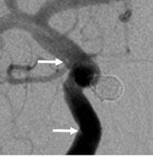
Risk Factors, Prevention, and Subsequent Monitoring for Recurrent aSAH
Monitoring of treated aneurysm
COR | RECOMMENDATIONS | TO IDENTIFY
1 | Perioperative cerebrovascular imaging (Class 1) | Residual aneurysm Recurrent aneurysm
1 | Long term follow-up cerebrovascular imaging (Class 1) | Recurrence or regrowth of the treated aneurysm Changes in another known aneurysm(s) Development of de novo aneurysm(s)
At 1 year, angiography shows a stable and complete aneurysm occlusion and patency of the parent artery. The 2 arrows show the limits of the stent.
Sebastien Soize. Stroke. Imaging Follow-Up of Intracranial Aneurysms Treated by Endovascular Means, Volume: 47, Issue: 5, Pages: 1407-1412,
DOI: (10.1161/STROKEAHA.115.011414)
Abbreviation: aSAH indicates aneurysmal subarachnoid hemorrhage.

Slide 40
Acknowledgments
Many thanks to our Guideline Ambassadors who were guided by Dr. Elliott Antman in developing this translational learning product in support of the 2023 AHA/ASA Guideline for the Management of Patients with Aneurysmal Subarachnoid Hemorrhage.
Hassan Aboul-Nour, MD
Hisham Alhajala, MD
Ritwik Bhatia, MD
Matthew Gusler, DO
Melissa Johnson, MD
Samantha Miller, MD
Veronica Moreno – Gomez, MD
Simona Nedelcu, MD
The American Heart Association requests this electronic slide deck be cited as follows:
Aboul-Nour, H., Alhajal, H., Bhatia, R., Gusler, M., Johnson, M., Miller, S., Moreno-Gomez, V., Nedelcu, S., Nour, H. A., Bezanson, J. L., Reyna, G. & Antman, E. M. (2023). AHA Clinical Update; Adapted from: [PowerPoint slides]. Retrieved from the 2023 AHA/ASA Guideline for the Management of Patients with Aneurysmal Subarachnoid Hemorrhage https://professional.heart.org/en/science-news.

