Slide 1

Guideline Essentials: AHA Clinical Slide Series
ADAPTED FROM: 2023 ACC/AHA/ACCP/HRS Guideline for the Diagnosis and Management of Atrial Fibrillation
AHA Clinical Slides PPTX

Slide 2
Table 1. Applying Class of Recommendation and Level of Evidence to Clinical Strategies, Interventions, Treatments, or Diagnostic Testing in Patient Care
CLASS (STRENGTH) OF RECOMMENDATION
CLASS 1 (STRONG) Benefit >>> Risk
Suggested phrases for writing recommendations: Is recommended Is indicated/useful/effective/beneficial Should be performed/administered/other Comparative-Effectiveness Phrases†: Treatment/strategy A is recommended/indicated in preference to treatment B Treatment A should be chosen over treatment B
CLASS 2a (MODERATE) Benefit >> Risk
Suggested phrases for writing recommendations: Is reasonable Can be useful/effective/beneficial Comparative-Effectiveness Phrases†: Treatment/strategy A is probably recommended/indicated in preference to treatment B It is reasonable to choose treatment A over treatment B
CLASS 2b (Weak) Benefit ≥ Risk
Suggested phrases for writing recommendations: May/might be reasonable May/might be considered Usefulness/effectiveness is unknown/unclear/uncertain or not well-established
CLASS 3: No Benefit (MODERATE) Benefit = Risk
Suggested phrases for writing recommendations: Is not recommended Is not indicated/useful/effective/beneficial Should not be performed/administered/other
CLASS 3: Harm (STRONG) Risk > Benefit
Suggested phrases for writing recommendations: Potentially harmful Causes harm Associated with excess morbidity/mortality Should not be performed/administered/other
LEVEL (QUALITY) OF EVIDENCE‡
LEVEL A
High-quality evidence‡ from more than 1 RCT Meta-analyses of high-quality RCTs One or more RCTs corroborated by high-quality registry studies
LEVEL B-R (Randomized)
Moderate-quality evidence‡ from 1 or more RCTs Meta-analyses of moderate-quality RCTs
LEVEL B-NR (Nonrandomized)
Moderate-quality evidence‡ from 1 or more well-designed, well-executed nonrandomized studies, observational studies, or registry studies Meta-analyses of such studies
LEVEL C-LD (Limited Data)
Randomized or nonrandomized observational or registry studies with limitations of design or execution Meta-analyses of such studies Physiological or mechanistic studies in human subjects
LEVEL C-EO (Expert Opinion)
Consensus of expert opinion based on clinical experience.
COR and LOE are determined independently (any COR may be paired with any LOE).
A recommendation with LOE C does not imply that the recommendation is weak. Many important clinical questions addressed in guidelines do not lend themselves to clinical trials. Although RCTs are unavailable, there may be a very clear clinical consensus that a particular test or therapy is useful or effective.
*The outcome or result of the intervention should be specified (an improved clinical outcome or increased diagnostic accuracy or incremental prognostic information).
†For comparative-effectiveness recommendation (COR 1 and 2a; LOE A and B only), studies that support the use of comparator verbs should involve direct comparisons of the treatments or strategies being evaluated.
‡The method of assessing quality is evolving, including the application of standardized, widely-used, and preferably validated evidence grading tools; and for systematic reviews, the incorporation of an Evidence Review Committee.
COR indicates Class of Recommendation; EO, expert opinion; LD, limited data; LOE, Level of Evidence; NR, nonrandomized; R, randomized; and RCT, randomized controlled trial.
Joglar, J. A. et al., 2023 ACC/AHA/ACCP/HRS Guideline for the Diagnosis and Management of Atrial Fibrillation. Circulation.

Slide 3





Prevalence, Incidence, Morbidity and Mortality of AF
Prevalence and Incidence of AF is increasing and projected to double between 2010 and 2030
50 million
Overall lifetime risk:
30-40% in White individuals
20% in African American individuals
15% in Chinese individuals
AF is associated with increased risks:
1.5-to 2-fold risk of death
2.4-fold risk of stroke
1.5-fold risk of CI/ dementia
1.5-fold risk of MI
2-fold risk of SCD
5-fold risk of HF
1.6-fold risk of CKD
1.3-fold risk of PAD
estimated individuals with AF worldwide in 2020
At least 5.6 million individuals with AF in USA in 2015
In Medicare beneficiaries, the most frequent outcome in 5-yrs after AF diagnosis was death (19.5% at 1-yr; 48.8% at 5-yrs)
- about 11% estimated cases were undiagnosed
AF accounted for $28.4 billion/ year in US healthcare spending in 2016
Abbreviations: AF indicates atrial fibrillation; CI, cognitive impairment; CKD, chronic kidney disease; HF, heart failure; MI, myocardial infarctions; PAD, peripheral arterial disease; SCD, sudden cardiac death; yr, year; and yrs, years.

Slide 4






Risk Factors for Diagnosed Atrial Fibrillation
Demographic, Anthropometric, Cardiovascular Risk Factors
Cardiovascular Disease
Non-Cardiac Conditions
Advancing Age
Smoking
Low Physical Activity
Elevating Resting Heart Rate
Obesity
Increasing Height
Hypertension
Diabetes
HF
CAD
Atrial inflammation from pericarditis or myocarditis
Cardiac Surgery
Valvular Heart Disease
Systemic Arterial Hypertension
Structural Heart Diseases
CKD
OSA
Sepsis
Pulmonary disease (COPD, PE)
Metabolic disturbances from alcohol abuse, hypokalemia, hyperthyroidism
Postoperative state
Biological Markers
Genetic Markers
Socioeconomic Determinants
of Health
ECG markers (prolonged PR, LVH)
Biomarkers (elevated BNP, IL6/TNF-alpha, LP(a))
Imaging markers (increased left atrial size, increased LV wall thickness)
Family history/ heritability
GWAS (presence of associated loci)
Education Level
Income Level
Socioeconomic status
Abbreviations: BNP indicates brain natriuretic peptide; CAD, coronary artery disease; COPD, chronic obstructive pulmonary disease; CKD, chronic kidney disease; GWAS, genome wide association studies; HF, heart failure; IL6, interleukin 6; LP(a), lipoprotein a; LV, left ventricle; LVH, left ventricular hypertrophy; OSA, obstructive sleep apnea; PE, pulmonary embolism; PR, PR interval; and TNF, tumor necrosis factor.

Slide 5
AF Stages: Evolution of Atrial Arrhythmia Progression
At Risk for AF
Pre-AF
AF
Permanent AF
Presence of modifiable and nonmodifiable risk factors associated with AF.
Modifiable risk factors:
Evidence of structural or electrical findings further predisposing a patient to AF:
Atrial enlargement
Frequent atrial ectopy
Short bursts of atrial tachycardia
Atrial Flutter
Other high AF risk scenarios*
Patients may transition among different substages of AF
No further attempts at rhythm control after discussion between patient and clinician
Paroxysmal AF (3A)
AF that is intermittent and terminates within 7 d of onset
Persistent AF (3B)
AF that is continuous and sustains for >7d and requires intervention
Long-standing persistent AF (3C)
AF that is continuous for >12mo in duration
Successful AF ablation (3D)
No AF identified after percutaneous or surgical intervention to eliminate AF
Obesity
Lack of fitness
Hypertension
Sleep apnea
Alcohol
Diabetes
Nonmodifiable risk factors:
Genetics
Male sex
Age
Treat Modifiable Risk Factors
Consider heightened surveillance
Ongoing monitoring as clinically appropriate for AF burden
Is AF associated with pathophysiological changes
Stroke risk assessment and therapy if appropriate
Treat symptoms
Note: *Heart failure, valve disease, coronary artery disease, hypertrophic cardiomyopathy, neuromuscular disorders, thyroid disease.
Abbreviations: AF indicates atrial fibrillation, d, day; and mo, month.

Slide 6
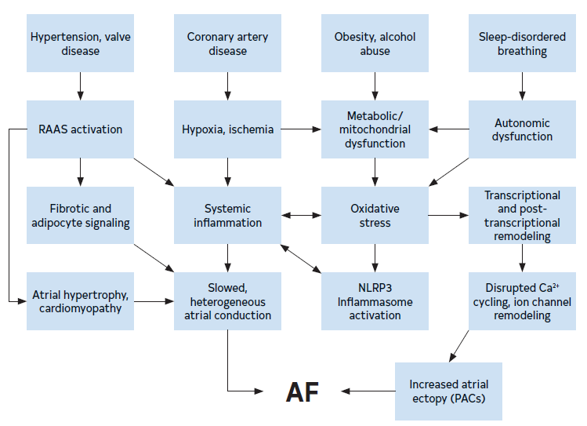
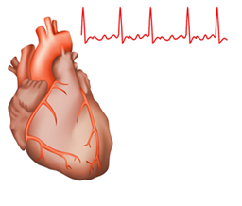
Mechanisms and Pathways Leading to AF
Abbreviations: AF indicates atrial fibrillation; Ca²⁺, calcium cation, PACs, premature atrial contractions; and RAAS, renin-angiotensin-aldosterone system.

Slide 7
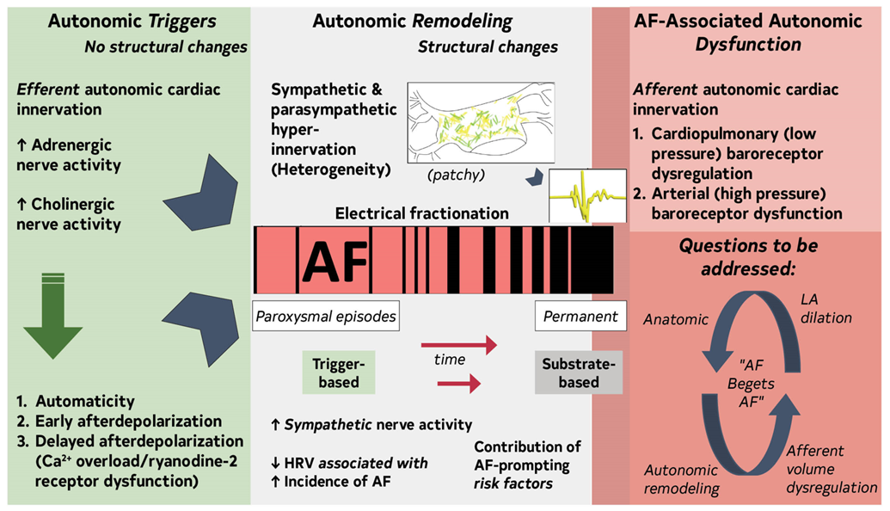
Contemporary Summary of the Role of the Autonomic Nervous System in AF
Abbreviations: AF indicates atrial fibrillation; Ca²⁺ , calcium cation; HRV, heart rate variability; and LA, left atrium.

Slide 8
Genetics of AF
Common and familial AF forms are heritable. Over 100 genetic loci are specific for AF.
Rare pathogenic genetic variants in myocardial structural proteins and ion channels may play a role in AF onset at a younger age.
TTN loss of function variants are associated with AF.
Disease-associated genetic variants in genes with inherited cardiomyopathy or arrhythmias include TTN, MYH7, MYH6, LMNA, and KCNQ1.
Disease-associated genetic variants are more prevalent at younger age of AF onset.
Abbreviation: AF indicates atrial fibrillation.

Slide 9



Health Inequities and Barriers to AF Management
Patients with AF, regardless of sex and gender diversity, race and ethnicity, or adverse SDOH, should be equitably offered guideline-directed stroke risk reduction therapies as well as rate or rhythm control strategies and LRFM as indicated to improve QOL and prevent adverse outcomes. (Class 1)
Barriers include:
Referral for ablation later in disease course
Less likely to be treated with stroke risk reduction therapies
More symptomatic and with worse QOL, yet less likely to be referred to EP specialist
Less likely to receive catheter ablation
Lower oral anticoagulation rates
Lower DOAC adherence rates
Less use of cardioversion
Increased risk of hospitalization, stroke, HF and death
Low income
Less Educated
Inequities in AF care & outcomes
Women
UREG
Abbreviations: AF indicates atrial fibrillation; DOAC, direct oral anticoagulant; EP, electrophysiology; HF, heart failure; LFRM, lifestyle and risk factor modification; QOL, quality of life; SDOH, social determinates of health; and UREG, underrepresented racial and ethnic groups.

Slide 10



Shared Decision Making and Quality of Life in the Management of AF
Shared Decision-Making is essential in AF management
Publicly Available Decision Aids
Agency | Website Link | Focus Area
American College of Cardiology Colorado Program for Patient Centered Decisions | https://patientdecisionaid.org/icd/atrial-fibrillation/ | Stroke risk reduction therapies
Anticoagulation Choice Decision Aid | https://anticoagulationdecisionaid.mayoclinic.org/ | Stroke risk reduction therapies
Ottawa Hospital Research Institute Developer Healthwise | https:// decisionaid.ohri.ca/AZlist.html | AF ablation Stroke Risk Reduction
Stanford | https://afibguide.com/ | Stroke risk reduction therapies
Decision to anticoagulate
Symptom burden and decision to pursue rhythm control
AF ablation
Use of evidence-based decision aids might be useful to guide stroke reduction therapy treatment decisions throughout the disease course to improve engagement, decisional quality and patient satisfaction. (Class 2b)
Abbreviation: AF indicates atrial fibrillation.

Slide 11




Rhythm Monitoring Tools and Methods
Undiagnosed Atrial fibrillation
Known Atrial fibrillation
COR | RECOMMENDATIONS
1 | Diagnosis should be made with visual interpretation of ECG or intracardiac signals by a clinician.
2a | For patients who have had a prior thromboembolic event, implantable cardiac monitors have the highest sensitivity in detecting AF.
COR | RECOMMENDATIONS
2a | AF frequency, duration and burden can be inferred using automated algorithms from ECG monitors, implantable cardiac monitors, and cardiac rhythm devices with an atrial lead.
2a | Consumer-accessible ECG device that provides a high-quality tracing can be used to detect recurrences.
Abbreviations: AF indicates atrial fibrillation; and ECG, electrocardiogram.

Slide 12






Primary Prevention of Atrial Fibrillation
Hypertension
Obesity
Diabetes mellitus
Physical Activity
Lifestyle and Risk Factor Management
Alcohol Consumption
Smoking

Slide 13




Secondary prevention: Lifestyle Factors
COR | RECOMMENDATIONS
1 | In overweight or obese (BMI > 27 kg/m2) patients, 10% weight loss reduces AF symptoms, burden, recurrence, and progression to persistent AF.
1 | Moderate to vigorous exercise training to a target of 210 minutes/week reduces AF symptoms, burden, increases maintenance of SR, increases functional capacity and improves QOL.
1 | Cigarette smokers should be advised to quit smoking . They should receive GDMT for tobacco cessation to mitigate risks of adverse CV outcomes.
2b | It is reasonable to screen for OSA, given its high prevalence in patients with AF, although the role of tx of sleep disordered breathing to maintain SR is uncertain.
Abbreviations: AF indicates atrial fibrillation; BMI, body mass index; CV, cardiovascular; GDMT, guideline-directed medical therapy OSA, obstructive sleep apnea; QOL, quality of life; SR, sinus rhythm; and tx, treatment.

Slide 14


Secondary prevention: Dietary Factors
COR | RECOMMENDATIONS
1 | Patients seeking a rhythm control strategy should minimize or eliminate alcohol consumption to reduce AF recurrence and burden.
3: No Benefit | Caffeine abstention does not prevent AF episodes. It may reduce symptoms in patients who report caffeine triggers.
Abbreviation: AF indicates atrial fibrillation.

Slide 15



Secondary prevention: Medical Conditions
COR | RECOMMENDATIONS
1 | Optimal blood pressure control reduces AF recurrence and AF-related CV events.
1 | Comprehensive care addressing LRFM, AF symptoms, risk of stroke, and associated medical conditions reduces AF burden, progression, and consequences.
2a | Use of clinical care pathways to promote comprehensive, team-based care enhances adherence to evidence based therapies.
Abbreviations: AF indicates atrial fibrillation; CV, cardiovascular; and LRFM, lifestyle and risk factor management.

Slide 16
Risk Stratiﬁcation Schemes to Prevent Thromboembolic Events in AF
COR | RECOMMENDATIONS
1 | Evaluate for annual risk of thromboembolic events using a validated clinical risk score, such as CHA₂DS₂-VASc.
1 | Evaluate for factors that indicate a higher risk of bleeding* to identify interventions to prevent bleeding on anticoagulation.
2a | Those at intermediate annual risk of thromboembolic events (eg, equivalent to CHA₂DS₂-VASc score of 1 in men or 2 in women), who remain uncertain about the benefit of anticoagulation, can benefit from consideration of factors that might modify their risk of stroke to help inform the decision.**
3: No Benefit | Those deemed at high risk for stroke, bleeding risk scores should not be used in isolation to determine eligibility for oral anticoagulation but instead to identify and modify bleeding risk factors and to inform medical decision-making.
Key Considerations:
The CHA₂DS₂-VASc score, is considered the most validated score and most therapies have used that score to prove efficacy, thus is generally the preferred score.
Newer risk scores, such as the ATRIA and GARFIELD-AF scores may be the better option in selected populations (e.g., renal disease).
Note: *Prior bleeding, use of medication that increase bleeding risk
**Higher AF burden/Long duration, persistent/permanent AF vs paroxysmal, obesity (BMI, ≥30 kg/m2), HCM, poorly controlled HTN, eGFR (<45 mL/h), proteinuria (>150 mg/24 h or equivalent), enlarged LA volume (≥73 mL) or diameter (≥4.7 cm)
Abbreviations: AF indicates atrial fibrillation; ATRIA, Anticoagulation and Risk Factors in Atrial Fibrillation; BMI, body mass index; CHA2DS2-VASc, congestive heart failure, hypertension, age ≥75 years (doubled), diabetes mellitus, prior stroke or transient ischemic attack or thromboembolism (doubled), vascular disease, age 65 to 74 years, sex category; cm, centimeter; eGFR, estimated glomerular filtration rate; GARFIELD-AF, Global Anticoagulant Registry in the Field-Atrial Fibrillation; h, hour; HCM, hypertrophic cardiomyopathy; HTN, hypertension; kg, kilogram; LA, left atrium; m2, meters squared; mg, milligram; mL, millimeter; and vs, versus.

Slide 17

Recommendations for Antithrombotic Therapy in AF
Annual Risk stratification using CHA₂DS₂-VASc (Class 1)
High* (≥ 2% per yr)
Intermediate** (~1-2% per yr)
Low (< 1% per yr)
Anticoagulation recommended to prevent stroke and systemic thromboembolism (Class 1)
Anticoagulation reasonable to prevent stroke and systemic thromboembolism (Class 2a)
Those without risk factors for stroke, aspirin monotherapy for prevention of thromboembolic events is of no benefit (Class 3: No Benefit)
If no hx of moderate to severe rheumatic MS or mechanical heart valve and candidate for anticoagulation, DOACs are recommended over warfarin to reduce the risk of mortality, stroke, systemic embolism, and ICH (Class 1)
Decisions based on annual stroke risk rather than specific score
Candidates for anticoagulation and without an indication for antiplatelet therapy, aspirin either alone or in combination with clopidogrel as an alternative to anticoagulation is not recommended to reduce stroke risk (Class 3: Harm)
Note: * CHA₂DS₂-VASc score of ≥2 in men and ≥3 in women
** Equivalent to CHA₂DS₂-VASc score of 1 in men and 2 in women
Reassess risk annually
Abbreviations: AF indicates atrial fibrillation; CHA2DS2-VASc, congestive heart failure, hypertension, age ≥75 years (doubled), diabetes mellitus, prior stroke or transient ischemic attack or thromboembolism (doubled), vascular disease, age 65 to 74 years, sex category; DOACs, direct-acting oral anticoagulants; hx, history; ICH, intracerebral hemorrhage; MS, mitral stenosis; and yr, year.

Slide 18
Oral Anticoagulation for Device-Detected Atrial High-Rate Episodes Among Patients Without a Previous Diagnosis of AF
For patients with a device-detected AHRE lasting:
COR | RECOMMENDATIONS
2a | ≥24 hrs and CHA₂DS₂-VASc score ≥2 or equivalent stroke risk, it is reasonable to initiate oral anticoagulation within a SDM framework that considers episode duration and individual patient risk. (2a)
2b | Between 5 minutes and 24 hrs and CHA₂DS₂-VASc score ≥3 or equivalent stroke risk, it may be reasonable to initiate anticoagulation within a SDM framework that considers episode duration and individual patient risk. (2b)
3: No Benefit | <5 minutes and without another indication for oral anticoagulation should not receive oral anticoagulation. (3: No Benefit)
Reasonable (2a)
24 hr
AHRE Burden
Reasonable (2b)
5 min
3:No Benefit
1
2
3
4
5
6
CHA₂DS₂-VASc Score
Abbreviations: AF indicates atrial fibrillation; AHRE, atrial high-rate episode; CHA2DS2-VASc, congestive heart failure, hypertension, age ≥75 years (doubled), diabetes mellitus, prior stroke or transient ischemic attack or thromboembolism (doubled), vascular disease, age 65 to 74 years, sex category; hr, hour; hrs, hours; and SDM, shared decision-making.

Slide 19
Percutaneous Approaches to Occlude the LAA in AF
Patients with Moderate to High Stroke Risk
(CHA₂DS₂-VASc score > 2)
In those who have a contraindication to long-term OAC due to a nonreversible cause, pLAAO is reasonable. (Class 2a)
In those who have a high risk of major bleeding on oral anticoagulation, pLAAO may be a reasonable alternative to oral anticoagulation based on patient preference, with careful consideration of procedural risk and with the understanding that the evidence for OAC is more extensive. (Class 2b)
Long-Term Anticoagulation Contraindicated
Severe bleeding due to a nonreversible cause involving the gastrointestinal, pulmonary, or genitourinary systems
Spontaneous intracranial/intraspinal bleeding due to a nonreversible cause
Serious bleeding related to recurrent falls when cause of falls is not felt to be treatable
Long-Term Anticoagulation Is Still Reasonable
Bleeding involving the gastrointestinal, pulmonary, or genitourinary systems that is treatable
Bleeding related to isolated trauma
Bleeding related to procedural complications
Abbreviations: AF indicates atrial fibrillation; CHA2DS2-VASc, congestive heart failure, hypertension, age ≥75 years (doubled), diabetes mellitus, prior stroke or transient ischemic attack or thromboembolism (doubled), vascular disease, age 65 to 74 years, sex category; LAA, left atrial appendage; OAC, oral anticoagulation; and pLAAO, percutaneous left atrial appendage occlusion.

Slide 20
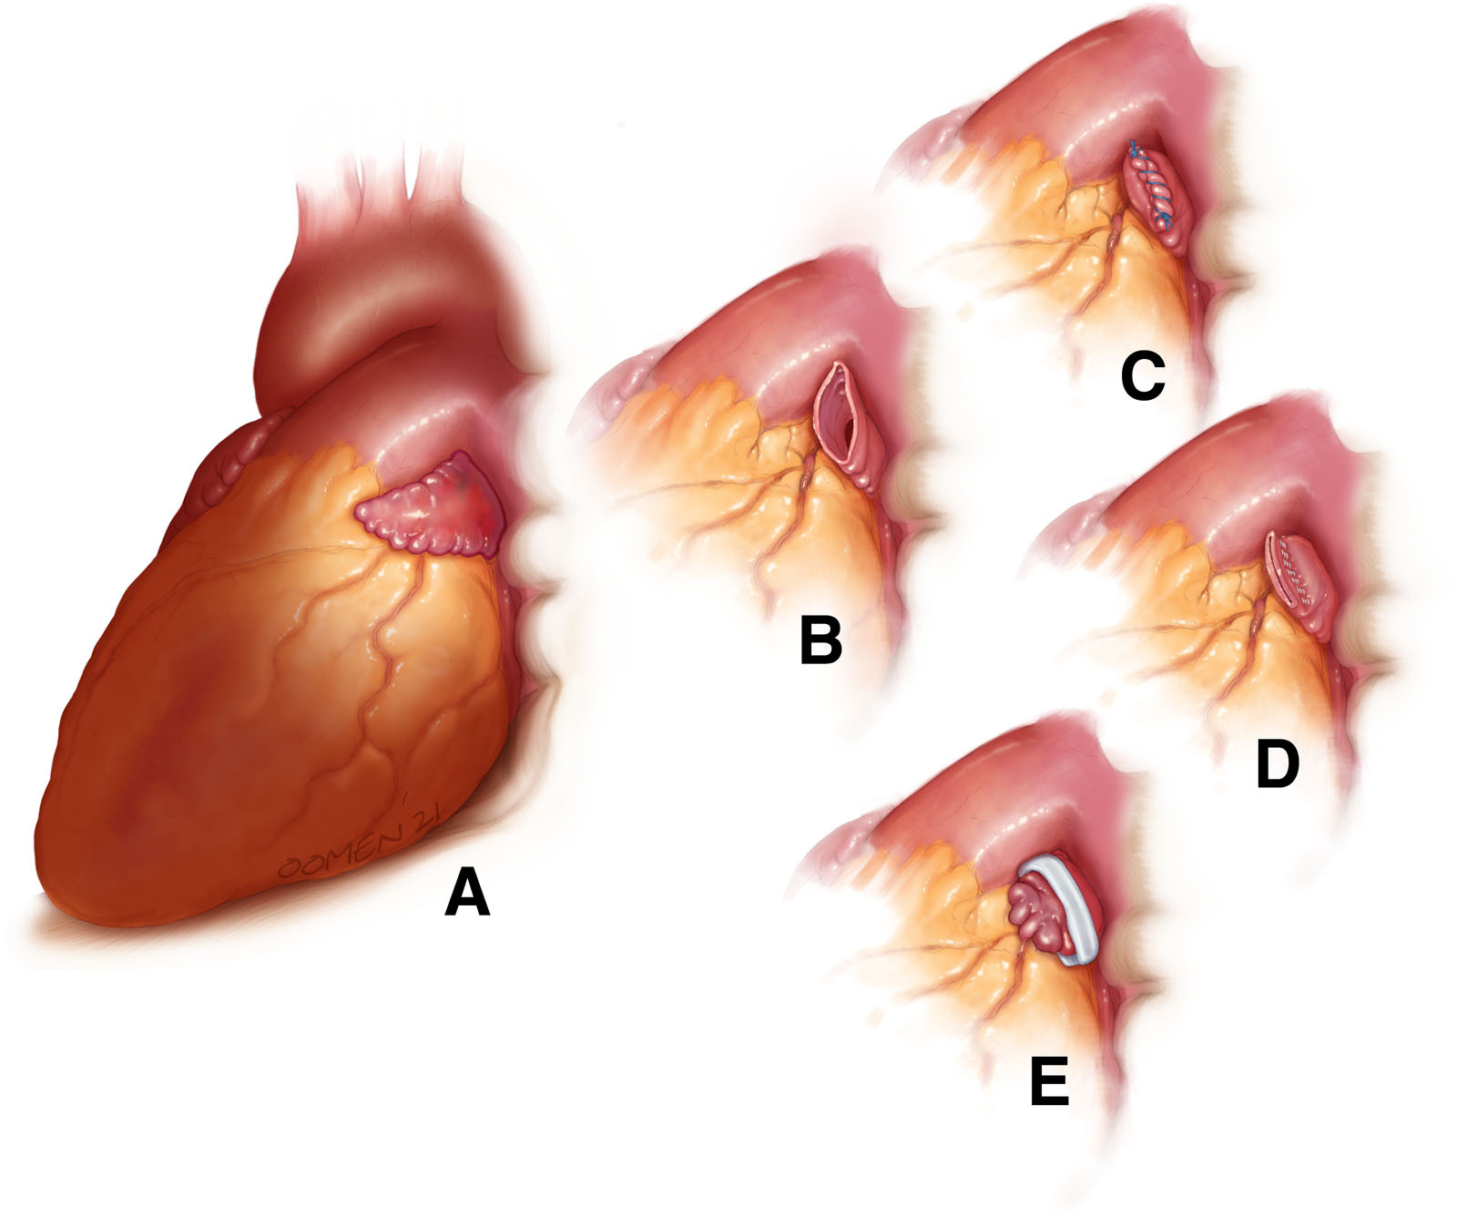
Cardiac Surgery | LAA Exclusion/Excision in AF Patients
Evidence supports a benefit of surgical removal of the LAA occlusion in patients with AF who undergo or valve surgeries.
In patients with AF undergoing cardiac surgery with a CHA₂DS₂-VASc score ≥2 or equivalent stroke risk:
In patients with AF undergoing cardiac surgery:
COR | RECOMMENDATIONS
1 | Surgical LAA exclusion, in addition to continued anticoagulation, is indicated to reduce the risk of stroke and systemic embolism.
2b | The benefit of surgical LAA exclusion in the absence of continued anticoagulation to reduce the risk of stroke and systemic embolism is uncertain.
COR | RECOMMENDATIONS
1 | And LAA exclusion, a surgical technique resulting in absence of flow across the suture line and a stump of <1 cm as determined by intraoperative transesophageal echocardiography should be used.
Views of the left atrial appendage before and after surgical exclusion. A, Intact left atrial appendage. B, Resected left atrial appendage before closure. C, Left atrial appendage after sutured amputation. D, Left atrial appendage after stapled excision. E, Left atrial appendage after clip application.
Abbreviations: AF indicates atrial fibrillation; CABG, coronary artery bypass graft surgery; CHA2DS2-VASc, congestive heart failure, hypertension, age ≥75 years (doubled), diabetes mellitus, prior stroke or transient ischemic attack or thromboembolism (doubled), vascular disease, age 65 to 74 years, sex category; cm, centimeter; LAA, left atrial appendage; and TEE, transesophageal echocardiography.

Slide 21



Active Bleeding on Anticoagulant Therapy and Reversal Drugs
AGENT | REVERSAL | RESUMPTION
Apixaban Edoxaban*
Rivaroxaban
Dabigatran
Warfarin
 | Acute phase | Subacute/ Chronic phase
Life-threatening bleed
CLASS 1
Andexanet alfa
OR
4F-PCC
Idarucizumab
4F-PCC + IV Vitamin K recommended to rapidly achieve INR correction over FFP and IV vitamin K treatment
CLASS 2a
PCC
If idarucizumab unavailable
ICH
Non-ICH
Reasonable to resume once underlying etiology treated
Recurrence risk
Consider LAAO (2b)
Low
High (e.g. CAA)
Thromboembolism risk
Very high (≥ 5%)
(e.g. mechanical valve, rheumatic MS)
Intermediate/high (< 5%)
Early
Within 1-2 weeks (2a)
Delayed
Within 4-8 weeks (2b)
*C-LD LOE applies to data on edoxaban
Abbreviations: 4F-PCC indicates 4-factor prothrombin complex concentrate; CAA; cerebral amyloid angiopathy; LAAO, left atrial appendage occlusion; ICH, Intracerebral hemorrhage; IV, intravenous; C-LD LOE, Level of evidence C and limited data; MS, mitral stenosis; and PCC, prothrombin complex concentrate.

Slide 22
Timing of Discontinuation of OACs in AF Pts Scheduled to Undergo an Invasive Procedure or Surgery in Whom Anticoagulation is to be Interrupted
Anticoagulant | Low Bleeding Risk Procedure | High Bleeding Risk Procedure
Apixaban (CrCl >25 mL/min)* | 1 d† | 2 d
Dabigatran (CrCl >50 mL/min) | 1 d | 2 d
Dabigatran (CrCl 30-50 mL/min) | 2 d | 4 d
Edoxaban (CrCl >15 mL/min) | 1 d | 2 d
Rivaroxaban (CrCl >30 mL/min) | 1 d | 2 d
Warfarin | 5 d for a target INR <1.5 2-3 d for a target INR <2 | 5 d
Note: *For patients on DOAC with creatinine clearance lower than the values in the table, few clinical data exist. Consider holding for an additional 1 to 3 days, especially for high bleeding risk procedures.
†The number of days is the number of full days before the day of surgery in which the patient does not take any dose of anticoagulant. The drug is also not taken the day of surgery. For example, in the case of holding a twice daily drug for 1 day, if the drug is taken at 8 pm, and surgery is at 8 am, at the time of surgery, it will be 36 hours since the last dose was taken.
Abbreviations: AF indicates atrial fibrillation; CrCl, creatinine clearance; d, day; DOAC, direct oral anticoagulation; INR, international normalized ratio; and OAC, oral anticoagulant.

Slide 23
Management of Periprocedural Anticoagulation in Patients with AF
Patients with AF undergoing
invasive procedure or surgery
Procedure is a pacemaker or ICD implant
Procedure cannot be performed safely on uninterrupted anticoagulation
Bridging with LMWH should not be administered (except in patients with mechanical valve or recent stroke or TIA) (3: Harm)
Temporary cessation or oral anticoagulation without bridging is recommended excluding those with recent stroke or TIA, or a mechanical valve. (1)
On warfarin, risk of TEs ≥ 5%
CHA₂DS₂-VASc score
≥2 or equivalent risk
of stroke, on DOAC
Holding
Warfarin
No
Resumption of anticoagulation the day after low bleeding risk surgery and between the evening of the second day and the evening of the third day after high bleeding risk surgery. (2a)
Yes
Timing of interruption of DOAC should be guided by the specific agent, renal function, and the bleeding risk. (1)
Continued anticoagulation in preference to interruption of warfarin and bridging (1)
Either uninterrupted or interrupted DOAC (2a)
Abbreviations: AF indicates atrial fibrillation; CHA2DS2-VASc, congestive heart failure, hypertension, age ≥75 y (doubled), diabetes mellitus, prior stroke or transient ischemic attack or thromboembolism (doubled), vascular disease, age 65 to 74 y, sex category; DOAC, direct oral anticoagulant; ICD, implantable cardioverter-defibrillator; LMWH, low-molecular-weight heparin; TE, thromboembolism; and TIA, transient ischemic attack.

Slide 24
Anticoagulation in AF Specific Populations
ACS or PCI
CCD
PAD
COR | RECOMMENDATIONS
1 | For increased stroke risk in PCI, DOACs preferred over VKAs in combination with APT to reduce risk of clinically relevant bleeding.
1 | In those on OAC undergoing PCI, early discontinuation of ASA (1-4 wk) and continuation of dual antithrombotic therapy with OAC and a P2Y12 inhibitor is preferred over triple therapy (OAC, P2Y12 inhibitor, and ASA) to reduce risk of clinically relevant bleeding.
COR | RECOMMENDATIONS
1 | If beyond 1-y after revascularization or CAD not requiring coronary revascularization, w/o hx of stent thrombosis, OAC monotherapy is recommended over combination therapy of OAC and single APT (aspirin or P2Y12 inhibitor) to decrease risk of major bleeding.
COR | RECOMMENDATIONS
2a | With concomitant stable PAD, monotherapy oral anticoagulation is reasonable over dual therapy (anticoagulation plus aspirin or P2Y12 inhibitors) to reduce the risk of bleeding.
Abbreviations: ACS indicates acute coronary syndrome; AF, atrial fibrillation; APT, antiplatelet therapy; ASA, aspirin; CAD, coronary artery disease; CCD, chronic coronary disease; DOACs, direct-acting oral anticoagulant; hx, history; OAC, oral anticoagulant; PAD, peripheral artery disease; PCI, percutaneous coronary intervention; VHD, valvular heart disease; VKAs, vitamin K antagonist; and wk, week.

Slide 25
Anticoagulation in AF Specific Populations
CKD/Kidney Failure
VHD
COR | RECOMMENDATIONS
1 | If at elevated risk for stroke and CKD stage 3, tx with warfarin or, preferably, evidence-based doses of direct thrombin or factor Xa inhibitors is recommended to reduce stroke risk.
2a | If at elevated risk for stroke and CKD stage 4, tx with warfarin or labeled doses of DOACs is reasonable to reduce stroke risk.
2b | If at elevated risk for stroke & end-stage CKD (CrCl <15 mL/min) or on dialysis, it might be reasonable to prescribe warfarin (INR 2.0-3.0) or an evidence-based dose apixaban for oral anticoagulation to reduce stroke risk.
COR | RECOMMENDATIONS
1 | In rheumatic mitral stenosis or MS of moderate or greater severity and hx of AF, long-term anticoagulation with warfarin is recommended over DOACs, independent of the CHA₂DS₂-VASc score to prevent CV events, including stroke or death.
1 | In valve disease other than moderate or greater mitral stenosis or a mechanical heart valve, DOACs are recommended over VKAs.
Abbreviations: AF indicates atrial fibrillation; CHA2DS2-VASc, congestive heart failure, hypertension, age ≥75 years (doubled), diabetes mellitus, prior stroke or transient ischemic attack or thromboembolism (doubled), vascular disease, age 65 to 74 years, sex category; CKD, chronic kidney disease; CrCl, creatinine clearance; CV, cardiovascular; DOACs, direct-acting oral anticoagulant; hx, history; INR, international normalized ratio; min, minute; ml, milliliter; MS, mitral stenosis; tx, treatment; VHD, valvular heart disease; and VKAs, vitamin K antagonists.

Slide 26





Treatment: Rate Control in AF
Objectives of Rate Control:
Resting heart rate < 100-110 bpm
Reduce symptoms
Reduce risk of tachycardia-induced cardiomyopathy or improve heart function of patients with tachycardia-induced cardiomyopathy
Reduce inappropriate shock in patients with implantable defibrillators
Enhance biventricular pacing in patients with cardiac resynchronization therapy use
Reduce risk of hospitalization
Comorbidities
Shared decision making & patient preference
Clinical presentation
Different factors that guide decision of Rate vs Rhythm therapy
Medication Profile
Presence of Heart Failure
Abbreviations: AF indicates atrial fibrillation; bpm, beats per minute; and vs, versus.

Slide 27
Pharmacological Agents for Rate Control in AF
Non-DHP CCB | IV | Oral Maintenance dose
Diltiazem | 0.25 mg/kg IV over 2 mins. May repeat 0.35 mg/kg over 2 mins; then 5-15 mg/hr continuous infusion | 120 – 360 mg daily (ER)
Verapamil | 5 to 10 mg over ≥2 minutes (may repeat twice); then 5 mg/hr continuous infusion (max 20 mg/hr) | 180 – 480 mg daily (ER)
Rate Control Agents
Beta-Blocker | IV | Oral Maintenance dose
Metoprolol tartrate | 2.5-5 mg bolus over 2 mins; up to 3 doses | 25 – 200 mg twice daily
Metoprolol succinate | N/A | 50 - 400 mg daily
Atenolol | N/A | 25 – 100 mg daily
Bisoprolol | N/A | 2.5 – 10 mg daily
Carvedilol | N/A | 3.125- 25 mg twice daily
Esmolol | 500 mcg/kg bolus over 1 min; then 50 – 300 mcg/kg/min | N/A
Nadolol | N/A | 10-240 mg daily
Propranolol | 1 mg over 1 min; repeat PRN every 2 mins; up to 3 doses | 10-40 mg three to four times daily
Beta-Blockers
Slows AV nodal conduction
Block B-1 receptors
Digoxin
Positive inotropic and vagotonic effects
Could be useful in HFrEF pts
IV Magnesium
Blocks slow inward calcium channels of SA and AV node
Agent | IV | Oral Maintenance dose
Amiodarone | 150-300 mg IV over 1 hr, then 10-50 mg/h over 24 hrs | 100 – 200 mg daily
Digoxin* *Increased mortality at plasma concentrations exceeding 1.2 ng/mL | 0.25 – 0.5 mg over mins; repeat doses of 0.25 mg every 6 hrs (max 1.5 mg/24 hrs) | 0.0625 – 0.25 mg daily
Amiodarone
Useful in critical ill pts who cannot tolerate AV nodal slowing agents
Can result in pharmacologic cardioversion
NDCC
Slow AV nodal conduction
Negative inotropic and chronotropic effect
Abbreviations: AF indicates atrial fibrillation; AV, atrioventricular; ER, extended release; HFrEF, heart failure with reduced ejection fraction; hr, hour; hrs, hours; IV, intravenous; kg, kilogram; min; minute; mins, minutes; mg, milligram; mcg, microgram; ng, nanogram; NDCC, nondihydropyridine calcium channel blocker; PRN, as needed; pts, patients; and SA, sinoatrial.

Slide 28

Approach to Acute Rate Control in AF with Rapid Ventricular Response
Hemodynamically Stable?
No
Yes
Direct-Current Cardioversion (1)
No
Decompensated HF?
Yes
Addition of Magnesium to AV nodal blockage (2a)
BB, verapamil, or diltiazem (1)
IV Amiodarone* (2b)
Digoxin (2a)
Verapamil, diltiazem
(3: Harm)
Amiodarone (2b)
*Contraindicated in patients with moderate-severe LV dysfunction regardless of decompensated HF.
Abbreviations: AF indicates atrial fibrillation; AV, atrioventricular; BB, beta-blocker; HF, heart failure; IV, intravenous; and LV, left ventricular.

Slide 29

Approach to Long Term Rate Control of AF
Long-term rate control
Permanent AF
Dronedarone
(3: Harm)
LVEF $≤$40%
LVEF >40%
NDCC
(Diltiazem, Verapamil)
(3: Harm)
BB (1)
BB or NDCC (1)
Digoxin (2a)
Digoxin (2a)
Abbreviations: AF indicates atrial fibrillation; BB, beta-blocker; LVEF, left ventricular ejection fraction; and NDCC, nondihydropyridine calcium channel blocker.

Slide 30





Recommendations for Atrioventricular Nodal Ablation
COR | RECOMMENDATIONS
1 | In patients with AF and a persistently rapid ventricular repose who undergo AVNA, initial pacemaker lower rate programming should be 80 to 90 bpm to reduce the risk of sudden death.
2b | In patients with AF and uncontrolled rapid ventricular response refractory to rate-control medications, AVNA can be useful to improve symptoms and QOL.
1 | In patients with AF scheduled to have an AVNA, implantation of a pacemaker prior to procedure is recommended to ensure adequacy of the pacing leads before performing the ablation.
2b | In patients with AF and normal EF undergoing AVNA, conduction system pacing of the His bundle or left bundle area may be reasonable.
Abbreviations: AF indicates atrial fibrillation; AVNA, atrioventricular nodal ablation; bpm, beats per minute; EF, ejection fraction; and QOL, quality of life.

Slide 31
Goals of Rhythm Control Therapy in AF
Rhythm control in patients with
Recent AF Diagnosis (< 1 year)
Reduced LV function & Persistent AF
AF and HF
Symptomatic AF
Rhythm control can be useful to reduce hospitalizations, stroke, and mortality (2a)
A trial of rhythm control recommended to evaluate if AF is contributing to reduced LV function (1)
Rhythm control can be useful for improving symptoms and outcomes such as mortality and hospitalizations for HF and ischemia (2a)
Rhythm control can be useful to improve symptoms (2a)
In patients with AF, rhythm-control strategies can be useful to reduce the likelihood of AF progression.(2a)
In patients with AF where symptoms associated with AF are uncertain, a trial of rhythm control (eg, cardioversion or pharmacological therapy) may be useful to determine what if any symptoms are attributable to AF (2b)
In patients with AF, rhythm-control strategies may be useful to reduce the likelihood of development of dementia or worsening cardiac structural abnormalities.(2b)
Abbreviations: AF indicates atrial fibrillation; HF, heart failure; and LV, left ventricular.

Slide 32
Electrical and Pharmacological Cardioversion of AF
Hemodynamically Stable?
Yes
No
Electrical cardioversion can be performed as initial rhythm-control strategy or after unsuccessful pharmacological cardioversion. (1)
Immediate electrical cardioversion should be performed (1)
Or in situations when electrical cardioversion is preferred but cannot be performed. (2a)
Recommendations for pharmacologic cardioversion
Recommendations for electrical cardioversion
COR | RECOMMENDATIONS
2a | Ibutilide is reasonable for pharmacological cardioversion for pts w/o depressed LV function (LVEF <40%). (1)
2a | IV amiodarone is reasonable for pharmacological cardioversion, although time to conversion is generally longer than other agents (8-12 hours). (2a)
2a | Recurrent AF occurring outside the hospital, the PITP approach with a single oral dose of flecainide or propafenone, with concomitant AV nodal blocking agent,¹⁵ is reasonable for pharmacological cardioversion if previously tested in a monitored setting. (2a)
2b | Use of IV procainamide may be considered for pharmacological cardioversion when other intravenous agents are contraindicated or not preferred. (2b)
COR | RECOMMENDATIONS
1 | Electrical cardioversion, energy delivery should be confirmed to be synchronized to the QRS to reduce the risk of inducing VF. (1)
2a | In elective electrical cardioversion, the use of biphasic energy of at least 200 J as initial energy can be beneficial to improve success of initial electrical shock. (2a)
2a | In pts undergoing elective cardioversion, with longer duration of AF or unsuccessful initial shock, optimization of electrode vector, use of higher energy, and pretreatment with antiarrhythmic drugs can facilitate success of electrical cardioversion. (2a)
2b | In pts with obesity and AF, use of manual pressure augmentation and/or further escalation of electrical energy may be beneficial to improve success of electrical cardioversion. (2b)
Abbreviations: AF indicates atrial fibrillation; AV, atrioventricular; IV, intravenous; LV, left ventricular; LVEF, left ventricular ejection fraction; pts, patients; PTTP, pill-in-the-pocket; QRS, QRS interval; and VF, ventricular fibrillation.

Slide 33
Antiarrhythmic Drugs for Maintenance of Sinus Rhythm
Atrial fibrillation
Normal LV function, no prior MI or significant structural heart disease
Prior MI or significant structural heart disease, including HFrEF (LVEF ≤40%)
Considerations:
Risk of development of MI and structural heart disease
The need for in-hospital initiation of antiarrhythmic drugs
Baseline and follow-up tests
Dofetilide
Dronedarone
Flecainide
Propafenone
(2a)
Amiodarone
Dofetilide
(2a)
NYHA FC III or IV or recent decompensated Hf
No
Yes
Sotalol (2b)
Dronedarone
(2a)
Dronedarone
(3: Harm)
Amiodarone (2a)
Flecainide
Propafenone
(3: Harm)
Sotalol (2b)
Abbreviations: HF indicates heart failure; HFrEF, heart failure reduced ejection fraction; LV, left ventricle; LVEF, left ventricular ejection fraction; MI, myocardial infarction; and NYHA FC, New York Heart Association Functional Class.

Slide 34
Antiarrhythmic Drug Initiation in Facility
COR | MEDICATION | DURATION OF IN-FACILITY OBSERVATION | FACILITY SHOULD BE CAPABLE OF:
1 | Dofetilide (1) | Admission for ≥3 days | Continuous ECG monitoring Periodic CrCl Cardiac resuscitation
2a | Sotalol (2a) | 3 days | Continuous ECG monitoring Periodic creatinine clearance calculations Cardiac resuscitation
2a | Flecainide and Propafenone as PTTP (2a) | First dose in a facility | Continuous EG monitoring
Abbreviations: CrCl indicates creatinine clearance; ECG, electrocardiogram; and PTTP, pill-in-the-pocket.

Slide 35




Antiarrhythmic Drug Follow-up
 | BASELINE | WITHIN 6 MONTHS | EVERY 3-6 MONTHS AFTER
Dofetilide | ECG K and Mg CrCl | ECG K and Mg CrCl | ECG K and Mg CrCl
Dronedarone | ECG AST and ALT | AST and ALT | --
Ibutilide | ECG K and Mg | Continuous ECG at least 4 hours following infusion | --
Procainamide | ECG BP | ECG BP during infusion | --
Sotalol | ECG K and Mg CrCl | ECG K and Mg CrCl | ECG K and Mg CrCl
Amiodarone | TSH AST, ALT CXR ECG | TSH AST, ALT | TSH AST, ALT If symptoms -> Assess for ILD, epithelial keratopathy Annual dermatologic and neurologic exam
Abbreviations: ALT indicates alanine transaminase; AST, aspartate aminotransferase; BP, blood pressure; CrCl, creatinine clearance; CXR, chest x-ray; ECG, electrocardiogram; ILD, interstitial lung disease; K, potassium; Mg, magnesium; and TSH, thyroid stimulating hormone.

Slide 36
Anticoagulation Management Strategy Before & After AF Ablation
Prior to ablation
After ablation
COR | RECOMMENDATIONS
1 | Catheter ablation should be performed on uninterrupted therapeutic anticoagulation with a goal INR of 2.0 to 3.0.
1 | If patient on a DOAC, catheter ablation should be performed with either continuous or minimally interrupted oral anticoagulation.
COR | RECOMMENDATIONS
1 | OAC should be continued for at least 2 to 3 months after the procedure with a longer duration determined by underlying risk.
1 | Continuation of longer-term OAC should be dictated according to the patients’ stroke risk (eg, CHA₂DS₂-VASc score ≥2).
Abbreviations: AF indicates atrial fibrillation; CHA2DS2-VASc, congestive heart failure, hypertension, age ≥75 years (doubled), diabetes mellitus, prior stroke or transient ischemic attack or thromboembolism (doubled), vascular disease, age 65 to 74 years, sex category; DOAC, direct oral anticoagulant; INR, international normalized ratio; and OAC, oral anticoagulant.

Slide 37
AF Management in Patients with HF
GDMT, Thromboembolism prophylaxis, Risk factor modification
Cardioversion if indicated
Rate Control
Electrical Cardioversion (1)
LVEF< 40%
LVEF> 40%
Pharmacological Cardioversion (2a)
NDCC (Diltiazem, Verapamil)
(3:Harm)
Beta-Blockers (1)
Beta-Blockers or NDCC (1)
Digoxin (2a)
Digoxin (2a)
IV Amiodarone
Acute rate control (2a)
IV Amiodarone
Acute rate control (2a)
Evaluate if appropriate for rhythm control with catheter ablation – see next slide
Abbreviations: AF indicates atrial fibrillation; HF, heart failure; IV, intravenous; and NDCC, non-dihydropyridine calcium channel blockers.

Slide 38
AF Management in Patients with HF
Evaluate if appropriate for rhythm control with catheter ablation – see previous slide
Likely to benefit from catheter ablation
AF-mediated CMP suspected
Early stage of HF
No significant ventricular scar on CMR
No or mild atrial fibrosis
Paroxysmal and early persistent AF
Younger pts w/o significant other comorbidities
Less Likely to benefit from catheter ablation
Advanced HF
Significant ventricular scar on CMR
Severe atrial myopathy (dilation/fibrosis)
Long-standing persistent AF
Prior failed ablations
Advanced age or multiple comorbidities
HFrEF (LVEF<50%)
Uncontrolled rate + rhythm control failed or not appropriate: AV nodal ablation + pacing (2a)
HFrEF
HFpEF
Decision for pharmacological rhythm vs rate-control strategy
Left bundle of His bundle pacing as alternative to biventricular pacing (2b)
AF catheter ablation (1)
AF catheter ablation (2a)
Uncontrolled rate with biventricular pacemaker in place without effective pacing %: AV Nodal ablation (2a)
Pharmacological cardioversion and maintenance of SR after cardioversion
No clinical AF
Recurrent AF
Repeat ablation
Dronedarone NYHA Class III/IV HF or decompensated HF in past 4 wk (3:Harm)
Long-term surveillance for recurrent AF (in AF-induced CMP and recovered LVEF (2a)
Abbreviations: AF indicates atrial fibrillation; AV, atrioventricular; CMP, cardiomyopathy; CMR, cardiac magnetic resonance; GDMT, guideline-directed medical therapy; HF, heart failure; HFpEF, heart failure with preserved ejection fraction; HFrEF, heart failure with reduced ejection fraction; IV, intravenous; LVEF, left ventricular ejection fraction; NYHA, New York Heart Association; and wk, week.

Slide 39
Management of Early Onset AF, Athletes, Obesity, Hyperthyroidism, Pulmonary disease
Age
Athletes
Obesity (Class III)
Hyperthyroidism
Pulmonary Disease
<30 yr
<45 yr
BMI ≥40 kg/m2
Bariatric surgery
COPD
PH with Pulmonary Vascular Disease
Rhythm control- catheter ablation with PV isolation is reasonable (2a)
Anticoagulation until euthyroid and SR maintained (1)
EP study to evaluate and treat reentrant SVT (2b)
The following may be reasonable:
Referral for genetic counseling
Genetic testing for rare pathogenic variants
Surveillance for cardiomyopathy or arrhythmia syndromes (2b)
DOACs reasonable over warfarin
(2a)
Warfarin may be reasonable over DOACs due to DOAC drug absorption concerns
(Class 2b)
Rate control-
Cardio-selective beta-blockers especially in MI and HF (2a)
Rhythm control- strategy is reasonable (2a)
Targeted ablation may be reasonable (2b)
Abbreviations: AF indicates atrial fibrillation; COPD, chronic obstructive pulmonary disease; DOACs, direct-acting oral anticoagulants; EP, electrophysiologic; HF, heart failure; HTN, hypertension; kg/m2, kilogram per meters squared; MI, myocardial ischemia; PH, pulmonary hypertension; PV, pulmonary vein; SR, sinus rhythm; and SVT, supraventricular tachyarrhythmias.

Slide 40

Management of AF in Cardio-Oncology, Liver disease, and CKD
Cardio-Oncology
Mild or Moderate Liver Disease
(Child-Pugh Class A or B)
CKD/Kidney Failure at Elevate Stroke Risk
Cancer and AF
Cancer with risk for AF
OACs in the absence of clinically significant liver disease-induced coagulopathy or thrombocytopenia (2a)
CKD Stage 3
CKD Stage 4
ESRD/ Dialysis
Multidisciplinary communication & SDM (Reduce drug interactions; QTc prolongation; proarrhythmia; bleeding; and thromboembolism)
(1)
Increased vigilance for incident AF and treatment of contributing factors (2a)
Evidence based doses of direct thrombin or factor Xa inhibitors OR
Warfarin (1)
Warfarin
OR
labelled doses of DOACs (2a)
It might be reasonable to prescribe warfarin (INR 2-3)
OR
Apixaban evidence-based dose (2b)
Class A: Any DOAC (2a)
Class B: Apixaban, Dabigatran, or Edoxaban preferred over warfarin (2a)
DOACs preferred over VKAs for stroke risk reduction (2a)
Patients with AF and moderate liver disease (Class B): Rivaroxaban is contraindicated due to increased risk of bleeding (3:Harm)
Abbreviations: AF indicates atrial fibrillation; CKD, chronic kidney disease; DOACs, direct-acting oral anticoagulants; ESRD, end stage renal disease; INR, international normalised ratio OACs, oral anticoagulants; QTc, QT interval corrected for heart rate; SDM, shared decision-making; and VKAs, vitamin K antagonists.

Slide 41
Pregnancy and the AF Patient
Pregnancy with AF
Direct-current cardioversion (1)
No Structural heart disease
Persistent AF
Elevated stroke risk
Stable AF
SDM regarding anticoagulation with the recognition that no anticoagulation strategy is completely safe for both the mother and fetus (2b)
Rate control:
Beta blocker (propranolol/metoprolol) & digoxin either alone or in combination with beta blocker are reasonable as first-line agents (2a)
Rhythm control: Flecainide, Sotalol are reasonable (2a)
Pharmacologic cardioversion: IV Procainamide may be considered (2b)
Abbreviations: AF indicates atrial fibrillation; IV, intravenous; and SDM, shared decision-making.

Slide 42
Prevention and Treatment of AF After Cardiac Surgery
Treatment of AF After Cardiac Surgery
Rate control:
Beta-blocker OR CCB (1)
Prevention of AF After Cardiac Surgery
Consider anticoagulation when deemed safe from surgical bleeding (2a)
Patients at high risk for postop AF: Short-term prophylactic beta-blockers or amiodarone (2a)
CABG, aortic valve, ascending aortic aneurysm operations: posterior left pericardiotomy (2a)
Hemodynamically stable
Hemodynamically unstable or poorly tolerated AF
Rate control (target HR <100 bpm) with beta-blocker or CCB (1)
Rhythm control
(1)
Direct current cardioversion with antiarrhythmic drug therapy (1)
30 to 60-day postop rhythm assessment ± cardioversion if AF does not revert to SR (2a)
Abbreviations: AF indicates atrial fibrillation; bpm, beats per minute; CABG, coronary artery bypass graft surgery; CCB, calcium channel blocker; HR, heart rate; pts, patients; and SR, sinus rhythm.

Slide 43
Wolff-Parkinson-White and Pre-Excitation syndromes, ACHD, and HCM
AF with rapid anterograde conduction (pre-excited AF)
ACHD and AF
HCM and AF
DOACs are first line in pts with clinical or subclinical AF (duration > 24 hours) (1)
VKAs are second line independent of CHA2DS2-VASc score (1)
Rate control: beta blocker/ verapamil/ diltiazem (1)
If hemodynamically unstable, should be treated with electrical cardioversion
(1)
Evaluate and treat precipitating/reversible causes (1)
Rhythm control: If symptomatic/ paroxysmal/ persistent AF (1)
Catheter ablation of accessory pathways is recommended
(1)
If undergoing PVI, may be reasonable to include ablative strategy in the right atrium (2b)
If hemodynamically stable, pharmacological cardioversion with intravenous ibutilide or IV procainamide is recommended as an alternative to elective cardioversion (1)
If AF is poorly tolerated, rhythm control strategy with cardioversion or anti-arrhythmic drugs can be beneficial (2a)
Catheter ablation can be effective if drug therapy is ineffective, contraindicated or not patient preference (2a)
In pts undergoing surgical myectomy, surgical AF ablation can be beneficial (2a)
Simple CHD
Moderate or Complex/Severe ACHD
Ablation: If symptomatic and antiarrhythmic drug refractory (2a)
EP procedures in collaboration with ACHD cardiologist at specialized centers (1)
Do not use AV Nodal blocking agents: Verapamil, Diltiazem, Amiodarone, Digoxin, Adenosine, or Beta-blockers (3:Harm)
Anticoagulation in pts with low-flow states: Fontan circulation, blind-ending cardiac chambers & cyanosis (2b)
Abbreviations: ACHD indicates adult congenital heart disease; AF, atrial fibrillation; AV, atrioventricular; CHA2DS2-VASc, congestive heart failure, hypertension, age ≥75 years (doubled), diabetes mellitus, prior stroke or transient ischemic attack or thromboembolism (doubled), vascular disease, age 65 to 74 years, sex category; CHD, congenital heart disease; DOACs, direct-acting oral anticoagulants; EP, electrophysiologic; HCM, hypertrophic cardiomyopathy; IV, intravenous; pts, patients; PVI, pulmonary vein isolation; VKA, vitamin K antagonists; and WPW, Wolff-Parkinson-White.

Slide 44
AF in the setting of Acute Medical Illness or Surgery
AF in acute medical illness or surgery
Counseling regarding risk of recurrent AF (Class 1)
Outpatient follow-up:
Thromboembolic risk stratification and decision making on OAC initiation/ continuation AF surveillance (Class 2a)
Anticoagulation in the setting of sepsis: uncertain benefits (Class 2b)
Abbreviations: AF indicates atrial fibrillation and OAC, oral anticoagulation.

Slide 45


Future Research Needs
Evaluation of the AF Patient:
AF as a disease continuum
Individualization of AF and stroke risk
Race, gender and sex differences
Incorporating other stroke risk scores
Standardized measures
Social determinants of health
Genetic testing
Subclinical AF
Sleep
Management of the AF Patient:
Wearable heart monitoring devices
Strategies for anticoagulation
Downstream consequences of AF
Standardization of ablation procedures
Surgical exclusion and occlusion of LAA
Candidates for ablation
Role of risk modifiers in AF stroke prevention
Shared decision making
AI for AF management
Better goal and outcome definition
Abbreviations: AF indicates atrial fibrillation; AI, artificial intelligence; and LAA, left atrial appendage.

Slide 46
Acknowledgments
Many thanks to our Guideline Ambassadors who were guided by Dr. Elliott Antman in developing this translational learning product in support of the 2023 ACC/AHA/ACCP/HRS Guideline for the Diagnosis and Management of Atrial Fibrillation.
Henrietta Afari, MD
Pradnya Brijmohan Bhattad, MD
Balaram Krishna Hanumanthu, MD
Evan Harmon, MD
Mary-Jo Obeid, MD MPH
Justice Oranefo, MD
Iqra Qamar, MD
Ozan Unlu, MD MBI
The American Heart Association requests this electronic slide deck be cited as follows:
Afari, H., Bhattad, P.B., Hanumanthu, B.K., Harmon, E., Obeid, M., Onanefo, J., Qamar, I., Unlu, O., Reyna, G.G., Bezanson, J. L., & Antman, E. M. (2023). AHA Clinical Update [PowerPoint slides]; Adapted from the 2023 ACC/AHA/ACCP/HRS Guideline for the Diagnosis and Management of Atrial Fibrillation. Circulation. Retrieved from:
Guideline Essentials: AHA Clinical Slide Series - Professional Heart Daily | American Heart Association.

Slide 47
Copyright and Permissions Notice
© Copyright 2025. American Heart Association. All rights reserved.
This material is the copyrighted property of the American Heart Association and is provided for reference purposes only. It may not be copied, reproduced, stored in a retrieval system, transmitted, altered in any way or used as a derivative work, or distributed in any form or by any means—electronic, mechanical, photocopying, recording, or otherwise—without prior written permission from the publisher.
This content may be used for limited educational and personal use. Further distribution or dissemination requires a licensing agreement. Unauthorized use or distribution in any media is strictly prohibited.
For permissions inquiries and licensing fee information, please see the information/Request Form at this link:
https://www.heart.org/en/about-us/statements-and-policies/copyright-request-form

